Slide 1
RECORDS MANAGEMENT TRAINING

Slide 2
WHAT HAS RECORDS MANAGEMENT GOT TO DO WITH ME?
Records management is everyone’s responsibility.
The three examples which follow are based on real life stories and highlight the importance of records management in the Higher Education sector.

Slide 3
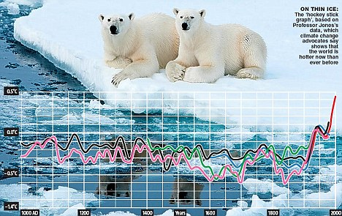
“CLIMATEGATE” SCANDAL
Climatic Research Unit at University of East Anglia, 2010
Thousands of emails and data files were leaked.
Allegations that scientists investigating global warming had distorted data.
The Deputy Information Commissioner stated that Freedom of Information requests for climate data were “not dealt with as they should have been under the legislation”.
Notes:
The “climategate” scandal arose when emails allegedly written by some of the world’s leading climate scientists were stolen by hackers and published on websites run by climate change sceptics. The story broke just before the Copenhagen conference on climate change and appeared to call into question the validity of some of the leading scientists’ claims.
Graham Smith, deputy information commissioner, said the emails between scientists at the UEA’s Climatic Research Unit (CRU) revealed that freedom of information (FOI) requests were “not dealt with as they should have been under the legislation”.

Slide 4
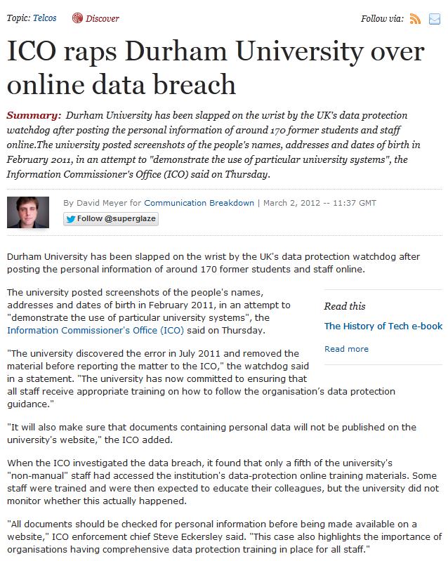
DATA PROTECTION BREACH
Durham University, 2011
Personal information was disclosed in training materials on the University website.
Screenshots of University systems included names, addresses and dates of birth of up to 177 former students and staff.
Durham University discovered the breach in July 2011, and removed the material before reporting itself to the Information Commissioner’s Office (ICO).
An investigation found that only around 20% of the University’s non-manual staff had accessed online data protection training materials.
Notes:
Durham University "discovered the error in July 2011 and removed the material before reporting the matter to the ICO"
The ICO stated "The university has now committed to ensuring that all staff receive appropriate training on how to follow the organisation’s data protection guidance."
When the ICO investigated the data breach, it found that only a fifth of the university's "non-manual" staff had accessed the institution's data-protection online training materials.

Slide 5
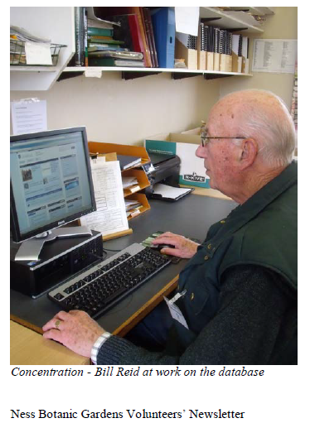
PLANT RECORDS DATABASE
Ness Gardens at University of Liverpool, 2013
By the end of 1999 Bill Reid had entered around 13500 records.
The computer crashed. The records had not been backed up and could not be recovered by the IT team.
During 2000-2013 Bill re-entered all of the data.

Slide 6
OBJECTIVES
By the end of this session participants will be able to
Understand why Records Management is important
Be aware of key concepts of records management, including the records lifecycle
Follow key University policies on records management
Know what University records management services are available and how to access them

Slide 7
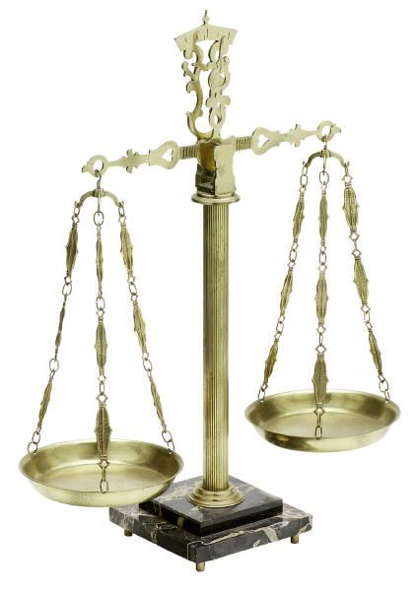
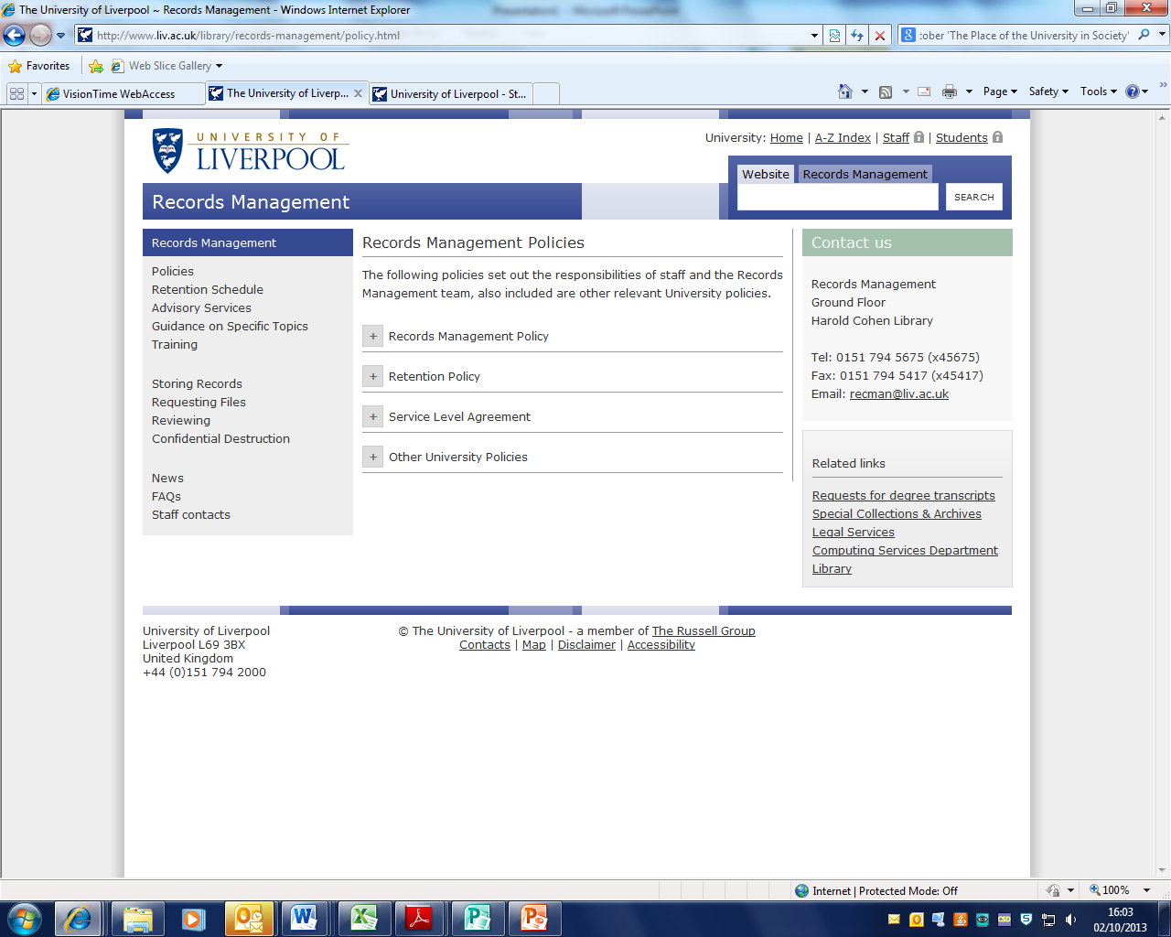
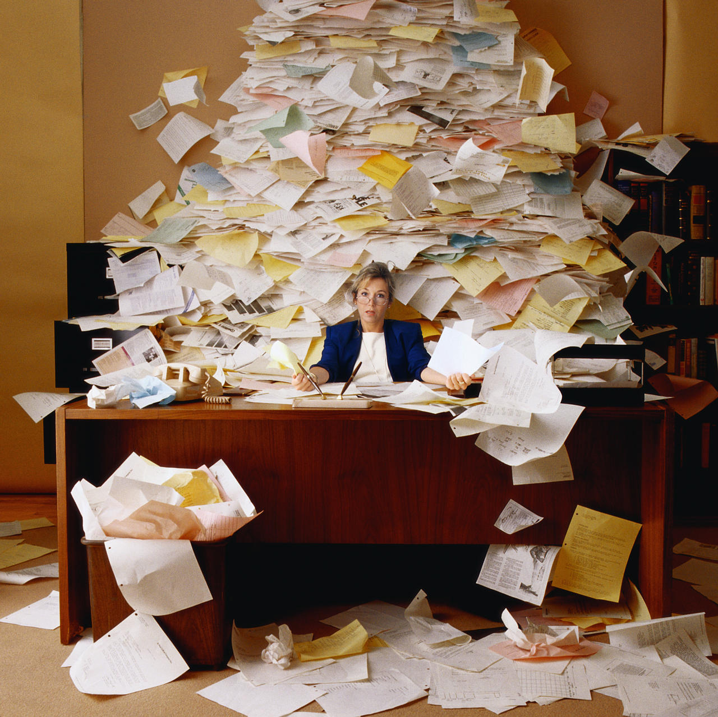
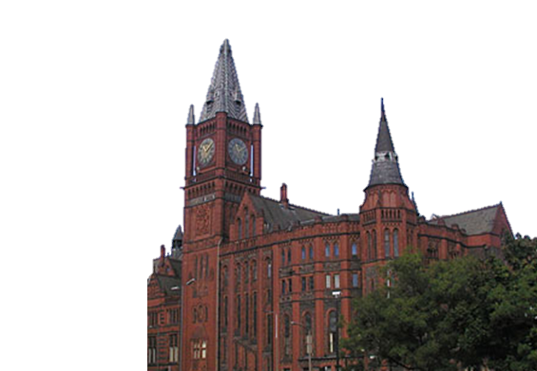
WHY IS RECORDS MANAGEMENT IMPORTANT?
For efficient working
To meet legal requirements
To meet audit requirements
To meet policy requirements
To support strategic priorities
Notes:
Why is good records management important?
For efficient working
Records are vital for routine tasks and support decision-making. Well-managed records can be easily accessed and quickly retrieved when needed.
To meet legal requirements
Records provide evidence of the activities, decisions and policies of the University.
To meet audit requirements e.g. periodic reviews
To meet university policy requirements: We will be talking about these in more detail later
To support UoL strategic priorities
Records are one of the University’s most valuable assets
Records management is central to Information Systems, which has been identified as one of five key enablers in the Strategic Plan
Records Management systems which are comparable to, or better than those of competitor universities in the Russell Group will enable UoL to compete effectively in a tough marketplace
Support the UoL corporate image of the University which is presented to the outside world
Build up a collective memory for UoL
Current/Future projects: collaboration on Electronic Records Management systems and the University Research Data Management Project
Good records management begins at the point of creation - and is performed throughout the life of a document, so everyone who handles a record is partly responsible for its management.
Understanding the Records Lifecycle helps us to understand Records Management

Slide 8



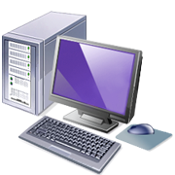
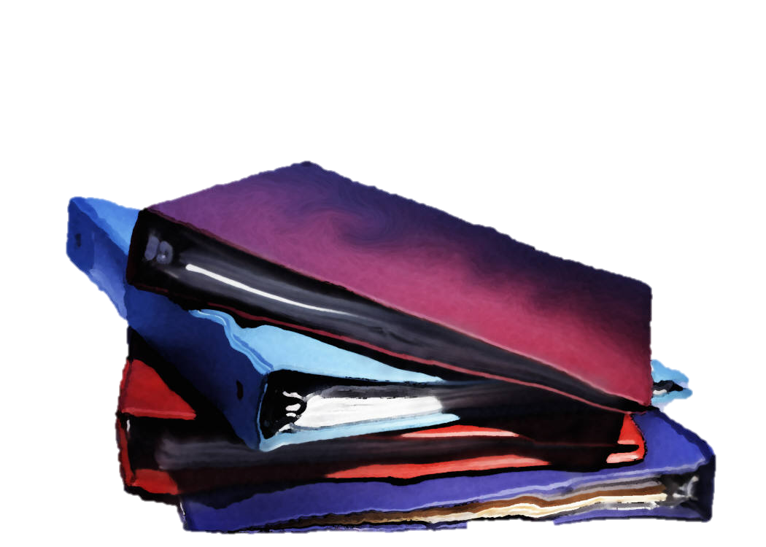
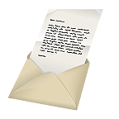
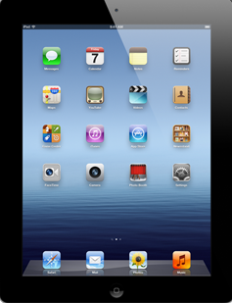


WHAT ARE RECORDS?
Records are ‘pieces of information created, received and maintained as evidence… by an organisation … in pursuance of legal obligations or in the transaction of business.’ (BS ISO 15489)
Any information that the University needs to
fulfil legal & regulatory requirements and/or
carry out its activities
Notes:
Examples include meeting minutes, emails, staff /student files, exam papers and correspondence.

Slide 9
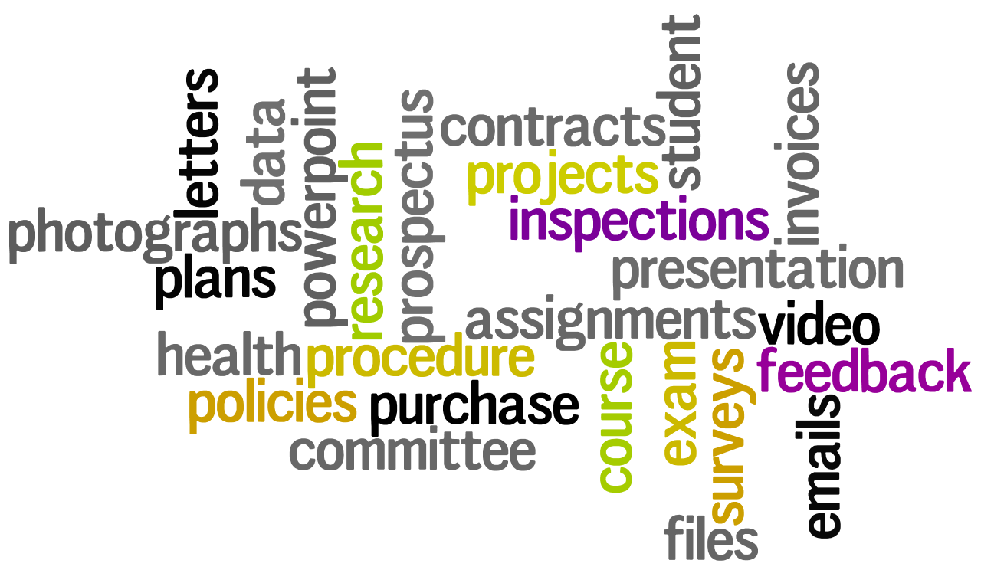
WHAT ARE THE RECORDS THAT YOU HANDLE?
Notes:
Examples include meeting minutes, emails, staff /student files, exam papers and correspondence.
student files
invoices
committee papers
exam papers
research data
emails
letters
photographs
plans
purchase orders
surveys
course notes

Slide 10
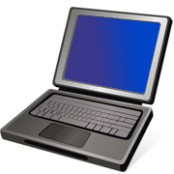

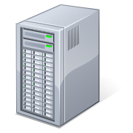

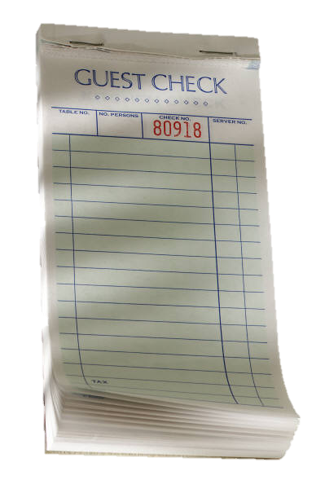
WHAT IS RECORDS MANAGEMENT?
More than just filing!
‘the efficient and systematic control of the creation, receipt, maintenance, use and disposition [disposal] of records, including processes for capturing and maintaining evidence of and information about business activities and transactions’ (BS ISO 15489)

Slide 11
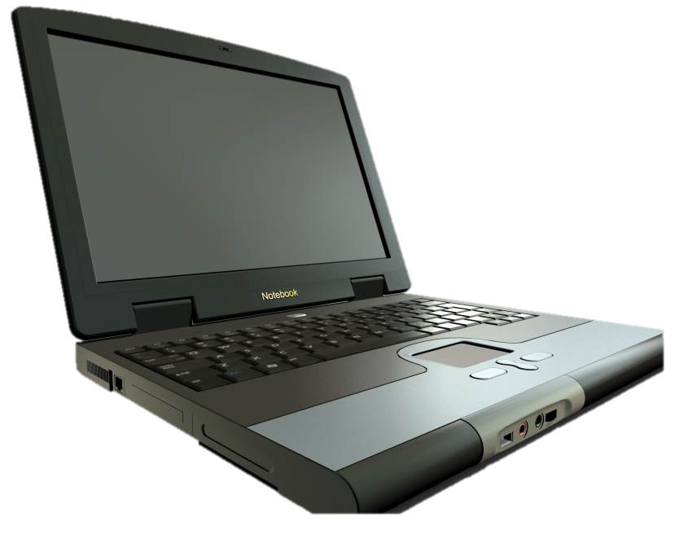
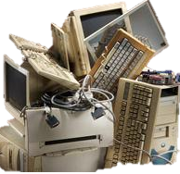
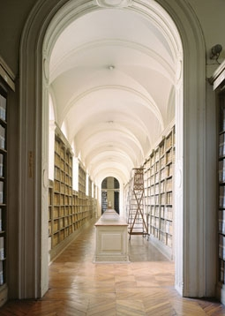

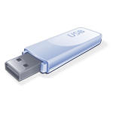
THE RECORDS LIFECYCLE
1. Creation or Receipt
2. Maintenance & Use
3. Disposition
Record
Heaven
Birth
Life
Death
Notes:
When thinking about how to manage our records, we often use a model called the RLC.
It’s the idea that records, like plants, animals, or people, have a life span.
In the records lifecycle, a record is born – it’s created or received. You might prepare a report, or you might receive a completed form, or an email from a customer.
Throughout its life, that record is stored, maintained, and used.
After a period of time, a record reaches its ultimate fate. Each record will either be destroyed or go on to live forever in the University Archives.
Let’s take a look at each of these steps

Slide 12
The Records Lifecycle
Good records management depends on the efforts of all staff!
Creation or Receipt (Birth)
Maintenance & Use (Life)
Disposition (Death)
Consider & create
Identify and capture
Connect
Identify retention requirements
Storage and retrieval
Use systems which
    balance access and security
    integrate paper and electronic formats
    all staff understand
Transfer semi-current records to the Records Centre
The ultimate “fate” of a record
Review files regularly
  Confidentiality destroy records no longer required or offer to archives
Notes:
Creation & Receipt
The first step, Creation and Receipt, is usually where we identify and capture records.
Consider the following points before creating a record:
is it necessary to create a record? (Are you duplicating other work?)
what will enable you to best carry out your work
Record creation is a critical step because things that we do initially help us ensure that the record can be found, used, and understood all throughout the rest of its life by us and our colleagues. For example, you might capture the title, author and date of a document, or the project number or name. You also need to identify which section of the Retention Schedule applies to the record. Referring to the Retention Schedule at this stage helps us to make better decisions about the management of our records throughout their lifecycle.
Maintenance & Use
When planning how you will maintain and use your records, you will want to make choices that help you and others to find and manage the information quickly and easily. You can set up good paper and electronic storage and filing systems and use tools like file plans to help everyone find what they need. It is best to integrate paper and electronic filing systems where possible. You should make sure that all staff are familiar with and use office filing procedures. You’ll also look for ways to protect and back up your records. Make sure access is balanced with appropriate security arrangements such as computer passwords, locked filing cabinets etc. Also, in the case of electronic records, remember to consider degrading effects/migration to accessible formats. Make sure that records are usable, and available to the people who need them for as long as they’re needed.
Disposition
Review files regularly, for example at the end of the year or the completion of a project. Refer to the University Retention Schedule to help ensure that records are kept for as long as necessary, and conversely, to avoid storing too much for too long. Transfer records which are no longer used regularly but need to be kept for legal/ financial reasons or for occasional reference to the Records Centre. The majority of university records can be destroyed at the end of their lifecycle. Use the confidential waste service where appropriate. A small but important percentage of University records (probably 2-5%) will go to the University Archives in Special Collections and Archives. They have significant historical or other value that makes them worth keeping forever.

Slide 13
Help managing records throughout the lifecycle
  Creation or Receipt
  Maintenance & Use
  Disposition
Guidance on naming, filing, version control etc.
Records Centre
Retention Schedule
Confidential Destruction
Offer to SCA
Records Management advice, guidance & training
University of Liverpool Policies & Retention Schedule

Slide 14
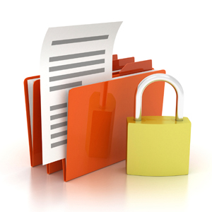
University of Liverpool Policies http://www.liverpool.ac.uk/csd/records-management/records-management-policy/
Records Management Policy
Research Data Management Policy
Data Protection Policy
Freedom of Information Policy
Information Security Policy and Sub Policies
Apply to all records created, received or maintained by staff, including researchers.
Notes:
UoL Policies on Records Management
The University of Liverpool recognizes that efficient management of its records is essential, both for effective administration and to enable it to comply with legal and regulatory requirements. These policies apply to all records created, received or maintained by all staff in the course of carrying out their duties, or by researchers engaged on internally or externally funded projects. The records may be in any format or medium, including electronic media
Records Management Policy & Records Retention Policy
The two Records Management Policies set out the responsibilities of staff and the Records Management team. Records are defined as any information resource providing evidence of the transactions and activities of the University.
Other University Policies
Research Data Management Policy
Legal Services are responsible for policies on Data Protection and Freedom of Information
Computing Services provides policies and advice on computer and information security
Website for policies

Slide 15
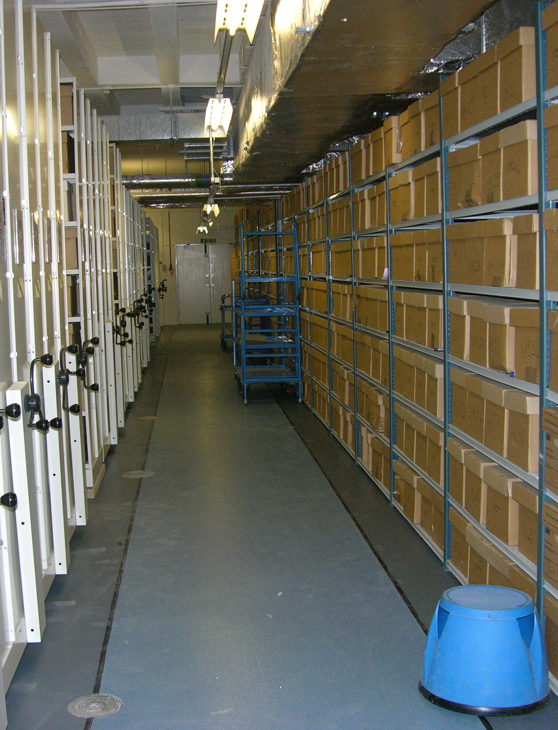
Records Centre Services www.liverpool.ac.uk/csd/records-management
Semi-current records
Collections
Storage
Retrievals and recalls
Reviews
Confidential destruction
Collections
On-site shredding
Waste consoles
Notes:
University Records Centre
The Records Centre is situated in specially adapted and secure premises within in University campus. The records are stored in standard-sized boxes on high-density mobile shelving.

Slide 16
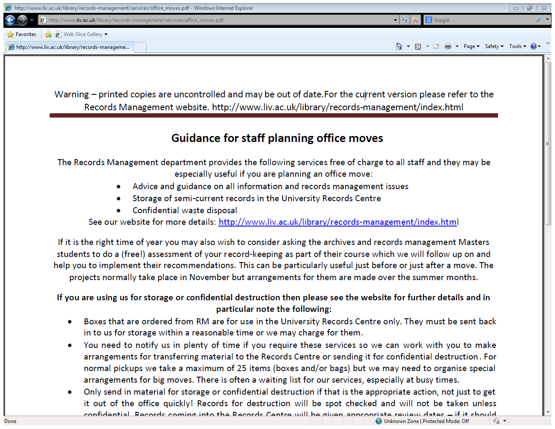
RM Guidance, Advice & Training www.liverpool.ac.uk/csd/records-management
Website
  General Advice
  Guidance Notes
Training for individuals or groups on request
Specific advice for departments and individuals
Student projects with the MARM course
Any suggestions?
Please get in touch
Notes:
Training for individuals or groups on request
Specific advice for departments and individuals
Email: recman@liv.ac.uk, telephone: x45675
Drop-in at RMS office in Harold Cohen Library
Series of meetings/visits
Student projects with the Master of Archives and Records Management (MARM) course
General advice on Records Management Website

Slide 17
Your Records Liaison Officer (RLO)
Most areas of the University now have Records Liaison Officers to:
Maintain and promote/enhance best practice in records and information management for their Faculty/ Institute/ School/ Professional Services area
Act as a central point of contact for colleagues to access Records Management services
Maintain and develop knowledge of records management and institutional requirements in this area
To find out more, see our website.

Slide 18
Records Management www.liverpool.ac.uk/csd/records-management
What should you do?
Visit the Records Management website
Read the University Records Management and Retention Policies
Be aware of the University Retention Schedule
Set aside time regularly to review your records and keep them up-to-date
Make contact with your RLO to access services such as storage or confidential destruction
Any queries, contact Records Management x45675, or recman@liverpool.ac.uk
And remember, good records management relies on the efforts of ALL University staff.

