Slide 1



ESRC Seminar Series on Microsimulation
Seminar 3: “Beyond tax-benefit modelling”
School of Geography, University of Leeds, 2 July 2009
Happiness
Dimitris Ballas
Social and Spatial Inequalities (SASI) group,
Department of Geography, University of Sheffield
http://sasi.group.shef.ac.uk/
RES-163-27-1013

Slide 2
Outline
What is happiness? Can it be measured?
The socio-economic and demographic determinants of happiness
Spatial microsimulation
Spatial microsimulation models of happiness
Concluding comments

Slide 3
What is happiness? Can it be measured?
Human perceptions of happiness vary and depend on a wide range of factors
What is the good life for man? The question of what is a full and rich life cannot be answered for an individual in abstraction from the society in which he lives
(Aristotle, Nicomachean Ethics)
Can happiness be measured?
Happiness is subjective and no objective theory about the ordinary concept of happiness has the slightest plausibility
(Sumner, 1996)

Slide 4
Can happiness be measured and modelled?
A person who has had a life of misfortune, with very little opportunities, and rather little hope, may be more easily reconciled to deprivations than others reared in more fortunate and affluent circumstances. The metric of happiness may, therefore, distort the extent of deprivation in a specific and biased way.
(Sen, 1987: 45, my emphasis)
Andrew Oswald and colleagues: statistical regression models of happiness measuring the impact of different factors and life events upon human well being
World Database of Happiness (Ruut Veenhoven)

Slide 5
General Health Questionnaire (1) Have you recently:
Been able to concentrate on whatever you are doing?
Lost much sleep over worry?
Felt that you are playing a useful part in things?
Felt capable of making decisions about things?
Felt constantly under strain?
Felt you could not overcome your difficulties?

Slide 6
General Health Questionnaire (2) Have you recently:
Been able to enjoy your normal day-to-day activities?
Been able to face up to your problems?
Been feeling unhappy or depressed?
Been losing confidence in yourself?
Been thinking of yourself as a worthless person?
Been feeling reasonably happy all things considered?

Slide 7
General happiness Self Completion (4)
Question Number and Text KS1L :
Have you recently....been feeling reasonably happy, all things considered?
Value Label
%
More so than usual 1
13.2
Same as usual 2
72.8
Less so than usual 3
11.8
Much less than usual 4
2.2
Source: The British Household Panel Survey, 1991

Slide 8
Factors and variables linked to subjective happiness (individual level studies)
Age
Education
Social Class
Income
Marital status/relationships
Employment
Leisure
Religion
Health
Life events and activities

Slide 9
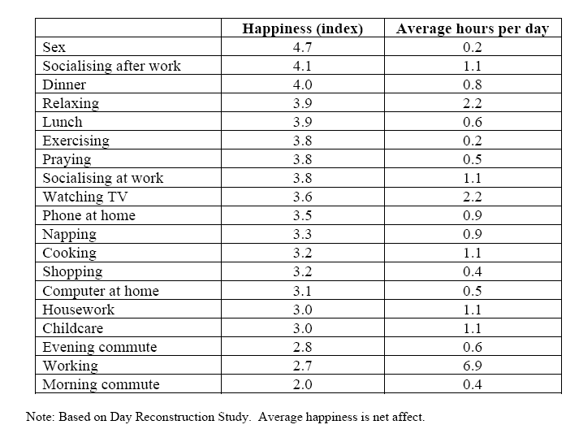
Happiness in different activities (after Layard, 2005)

Slide 10
Happiness in different activities (after Layard, 2005)

Slide 11
Can happiness be measured?
Positive and negative feelings are inversely correlated
Happiness can be thought of as a single variable (Layard, 2005; Frey and Stutzer, 2002)

Slide 12
Research questions :
What are the factors and life events that influence different types of individuals’ happiness?
Is the source of happiness or unhappiness purely personal or do contextual factors matter? (and if they do, to what extent?)
Happy People or Happy Places?

Slide 13
Geographies of happiness in Britain
Region / Metropolitan Area * GHQ: general happiness Crosstabulation
% within Region / Metropolitan Area
GHQ: general happiness
Missing
Proxy
More than
Same as
or wild
respondent
usual
usual
Less so
Much less
Total
Region /
Inner London
4.5%
4.3%
14.4%
66.7%
7.7%
2.4%
100.0%
Metropolitan
Outer London
2.8%
5.7%
10.6%
68.6%
10.2%
2.1%
100.0%
Area
R. of South East
2.2%
5.0%
11.9%
70.2%
9.1%
1.6%
100.0%
South West
1.7%
3.5%
11.3%
74.1%
8.0%
1.4%
100.0%
East Anglia
2.1%
1.3%
10.0%
77.4%
8.5%
.8%
100.0%
East Midlands
2.2%
1.4%
10.9%
76.0%
8.3%
1.3%
100.0%
West Midlands
6.6%
4.6%
11.5%
66.0%
9.9%
1.3%
100.0%
Conurbation
R. of West Midlands
.8%
2.2%
10.7%
73.7%
10.7%
2.0%
100.0%
Greater Manchester
1.0%
2.6%
11.1%
75.2%
7.7%
2.4%
100.0%
Merseyside
.4%
4.7%
9.9%
75.5%
8.6%
.9%
100.0%
R. of North West
1.3%
4.0%
14.5%
70.7%
8.1%
1.3%
100.0%
South Yorkshire
1.0%
1.7%
11.3%
71.0%
13.3%
1.7%
100.0%
West Yorkshire
2.7%
2.7%
10.7%
73.9%
8.5%
1.4%
100.0%
R. of Yorks & Humberside
1.2%
5.5%
10.1%
76.5%
5.5%
1.2%
100.0%
Tyne & Wear
.4%
3.8%
14.0%
72.7%
6.8%
2.3%
100.0%
R. of North
1.8%
2.3%
10.8%
72.3%
11.5%
1.5%
100.0%
Wales
3.9%
1.5%
8.8%
70.9%
12.6%
2.3%
100.0%
Scotland
1.8%
2.3%
10.8%
74.0%
9.9%
1.3%
100.0%
Total
2.2%
3.4%
11.3%
72.2%
9.2%
1.6%
100.0%
Source: The British Household Panel Survey, 1991

Slide 15
Spatial Microsimulation:
Reweighting approaches (1)
PERSON | AHID | PID | AAGE12 | SEX | AJBSTAT | … | AHLLT | AQFVOC | ATENURE | AJLSEG | …
1 | 1000209 | 10002251 | 91 | 2 | 4 | … | 1 | 1 | 6 | 9 | …
2 | 1000381 | 10004491 | 28 | 1 | 3 | … | 2 | 0 | 7 | -8 | …
3 | 1000381 | 10004521 | 26 | 1 | 3 | … | 2 | 0 | 7 | -8 | …
4 | 1000667 | 10007857 | 58 | 2 | 2 | … | 2 | 1 | 7 | -8 | …
5 | 1001221 | 10014578 | 54 | 2 | 1 | … | 2 | 0 | 2 | -8 | …
6 | 1001221 | 10014608 | 57 | 1 | 2 | … | 2 | 1 | 2 | -8 | …
7 | 1001418 | 10016813 | 36 | 1 | 1 | … | 2 | 1 | 3 | -8 | …
8 | 1001418 | 10016848 | 32 | 2 | -7 | … | 2 | -7 | 3 | -7 | …
9 | 1001418 | 10016872 | 10 | 1 | -8 | … | -8 | -8 | 3 | -8 | …
10 | 1001507 | 10017933 | 49 | 2 | 1 | … | 2 | 0 | 2 | -8 | …
11 | 1001507 | 10017968 | 46 | 1 | 2 | … | 2 | 0 | 2 | -8 | …
12 | 1001507 | 10017992 | 12 | 2 | -8 | … | -8 | -8 | 2 | -8 | …

Slide 16
Spatial Microsimulation:
Reweighting approaches (2)
Small area table 1 (household type) | Small area table 2 (economic activity of household head) | Small area table 3 (tenure status)
Area 1 | Area 1 | Area 1
60 "married couple households" | 80 employed/self-employed | 60 owner occupier
20 "Single-person households" | 10 unemployed | 20 Local Authority or Housing association
20 "Other" | 10 other | 20 Rented privately
Area 2 | Area 2 | Area 2
40 "married couple households" | 60 employed/self-employed | 60 owner occupier
20 "Single-person households" | 20 unemployed | 20 Local Authority or Housing association
40 "Other" | 20 other | 20 Rented privately

Slide 17
Levels of happiness data
World → Nation → Region → District→Electoral Wards → Neighbourhood → Household → Individual

Slide 18
Levels of happiness data
World → Nation → Region → District→Electoral Wards → Neighbourhood → Household → Individual

Slide 19
Combining Data
1991 & 2001 Census of UK population:
100% coverage
fine geographical detail
small area data available only in tabular format with limited variables to preserve confidentiality
British Household Panel Survey:
sample size: more than 5,000 households
annual surveys since 1991
individual data
more variables than census
coarse geography
household attrition

Slide 20
Multilevel modelling happiness and well-being (Ballas and Tranmer, 2008)
“Null model” – extent of variation
Socio-economic variables and health – random intercepts
Social context – interaction variables
Ballas, D., Tranmer, M. (2008), Happy people or happy places? A multilevel modelling approach to the analysis of happiness and well-being, arXiv e-print archive, http://eprintweb.org/S/article/stat/0808.1001

Slide 21
Model 2 and 3 significant main effects (1)
Happiness and well-being determinants | Model 2 | Model 3
Age | HLGHQ1(-),GHQL(-) | HLGHQ1(-),GHQL(-)
Female (Reference = Male) | HLGHQ1(-),GHQL(-) | HLGHQ1(-),GHQL(-)
Health good (reference = health excellent) | HLGHQ1(-),GHQL(-) | HLGHQ1(-),GHQL(-)
Health fair (reference = health excellent) | HLGHQ1(-),GHQL(-) | HLGHQ1(-),GHQL(-)
Health poor (reference = health excellent) | HLGHQ1(-),GHQL(-) | HLGHQ1(-),GHQL(-)
Health very poor (reference = health excellent) | HLGHQ1(-),GHQL(-) | HLGHQ1(-),GHQL(-)
Employment status: unemployed (reference = employed or self employed) | HLGHQ1(-),GHQL(-) | HLGHQ1(-),GHQL(-)
Employment status: family care (reference = employed or self employed) | HLGHQ1(-),GHQL(-)
Employment status: sick/disabled (reference = employed or self employed) | HLGHQ1(-),GHQL(-)

Slide 22
Model 2 and 3 significant main effects (2)
Happiness and well-being determinants | Model 2 | Model 3
Employment status: on maternity leave (reference = employed or self employed) |  | GHQL(+)
Employment status: on a government scheme (reference = employed or self employed) |  | GHQL(-)
Employment status: other job status (reference = employed or self employed)
Has lived at current address for more than 5 years (reference = lived at current address for less than one year) | HLGHQ1(+) | HLGHQ1(+)
Household type: couple no children (reference = single) | HLGHQ1(+),GHQL(+) | GHQL(+)
Household type: lone parent with dependent child(ren) (reference = single) | HLGHQ1(-) | HLGHQ1(-)
Household type: lone parent with non dependent child(ren) (reference = single)
Household type: other (reference = single) | GHQL(+)
Household tenure: private renting (reference = owner occupier) |  | GHQL(+)
Household tenure: LA/HA renting (reference = owner occupier) | HLGHQ1(-)
Unemployment status (individual level) x unemployment rate (district level) | Not included | HLGHQ1(+),GHQL(+)

Slide 23
Higher level variance components
When the explanatory variables were added to the model, district level variation was estimated at close to, but not exactly, zero.
Significant between-household variation remained.

Slide 24
Spatial Microsimulation
Reweight the first wave of the BHPS microdata to fit small area “constraints”
Dynamically simulate this population for the years 1991, 2001, 2011, 2021 (“groundhog day” scenario)
What-if dynamic simulations
Ballas, D. (forthcoming), “Geographical modelling of subjective happiness and well-being”, in Stillwell, J, Norman, P., Thomas, C., Surridge, P., Understanding Population Trends and Processes, volume 2: Spatial and Social Disparities, Springer
Ballas, D. , Clarke, G.P., Dorling, D., Eyre, H. and Rossiter, D., Thomas, B. (2005)
SimBritain: a spatial microsimulation approach to population dynamics.
Population, Space and Place, 11, 13 – 34. doi: 10.1002/psp.351

Slide 25
Deterministic Reweighting the BHPS - a simple example (1)
A hypothetical sample of individuals (list format)
Hypothetical Census data for
a small area:
In tabular format:

Slide 26
Reweighting the BHPS - a simple example (2)
Calculating a new weight,
so that the sample will fit into the Census table
In tabular format:
Hypothetical Census data for
a small area:

Slide 27
Modelling approach
Establish a set of constraints
Choose a spatially defined source population
Repeatedly sample from source
Adjust weightings to match first constraint
Adjust weightings to match second constraint
…
Adjust weightings to match final constraint
Go back to step 4 and repeat loop until results converge
Save weightings which define membership of SimBritain

Slide 28
MODEL CONSTRAINTS
1971, 1981 and 1991 Census Small Area Statistics (SAS)
6 constraint tables with 3 categories
projected forward for 2001, 2011 and 2021
ward level projections

Slide 29
CONSTRAINT TABLES

Slide 30
Simulated geography of happiness in Scotland (%) happy more than usual, 1991

Slide 31
Simulated geography of happiness in Scotland (%) happy more than usual, 2001

Slide 32
Simulated geography of happiness in Scotland (%) happy more than usual, 2011

Slide 33
Simulated geography of happiness in Scotland (%) happy more than usual, 2021

Slide 34
Estimated geography of happiness in Wales (%) happy more than usual, 1991

Slide 35
Estimated geography of happiness in Wales (%) happy more than usual, 1991

Slide 36
Estimated geography of happiness in Wales (%) happy more than usual, 2001

Slide 37
Estimated geography of happiness in Wales (%) happy more than usual, 2001

Slide 38
Estimated geography of happiness in Wales (%) happy more than usual, 2011

Slide 39
Estimated geography of happiness in Wales (%) happy more than usual, 2011

Slide 40
Estimated geography of happiness in Wales (%) happy more than usual, 2021

Slide 41
Estimated geography of happiness in Wales (%) happy more than usual, 2021

Slide 42
Estimated geography of happiness in London (%) happy more than usual, 1991

Slide 43
(%) “affluent households”, 1991

Slide 44
(%) “average” households, 1991

Slide 45
(%) “poor” households, 1991

Slide 46
(%) much less happy than usual, 1991

Slide 47
Concluding comments
Some district level variation in happiness – but the differences from place to place (at district level) do not appear to be statistically significant.
Spatial microsimulation can be used to disaggregate geographically the analysis further
But the reliability of the results may be significantly affected by the small area constraints and “Place/individual variable interactions”
On-going work:
  further refinement of the static models/simulated annealing
  Longitudinal analysis
  Environmental variables

Slide 48
On-going and future work
Public Policy Analysis and Happiness
Modelling the environmental determinants of happiness
International happiness comparisons
Subjective Happiness and Human-Scale Visualisations

Slide 49
Combining spatial microsimulation model outputs with remote sensing data
Spatial microsimulation output:
No. of residents in household (as a proxy to house size)
House type
Number of cars (as a proxy to house size)
Number of rooms in household space (as a proxy to house size)
Remotely sensed data:
land use
property size
house type
“visibility” data

Slide 50
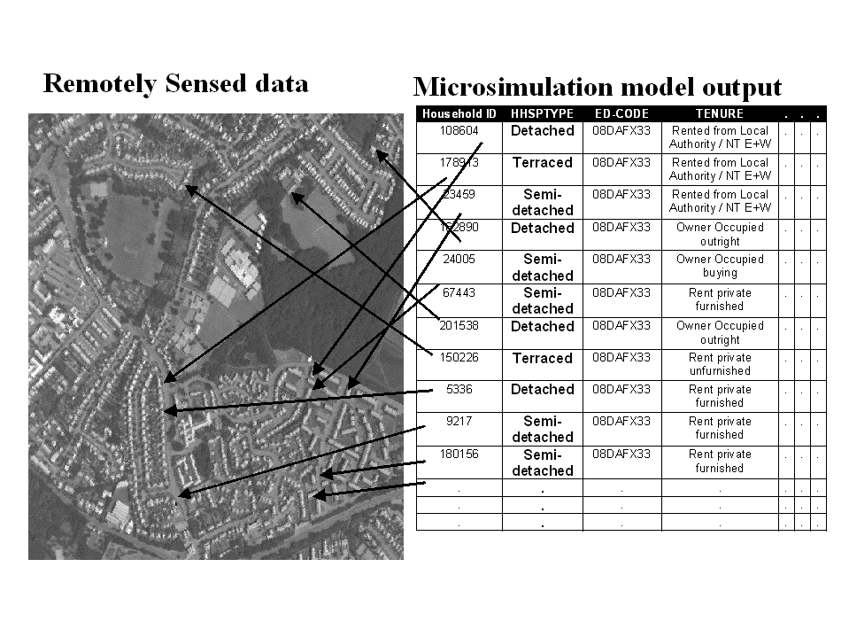

Slide 51
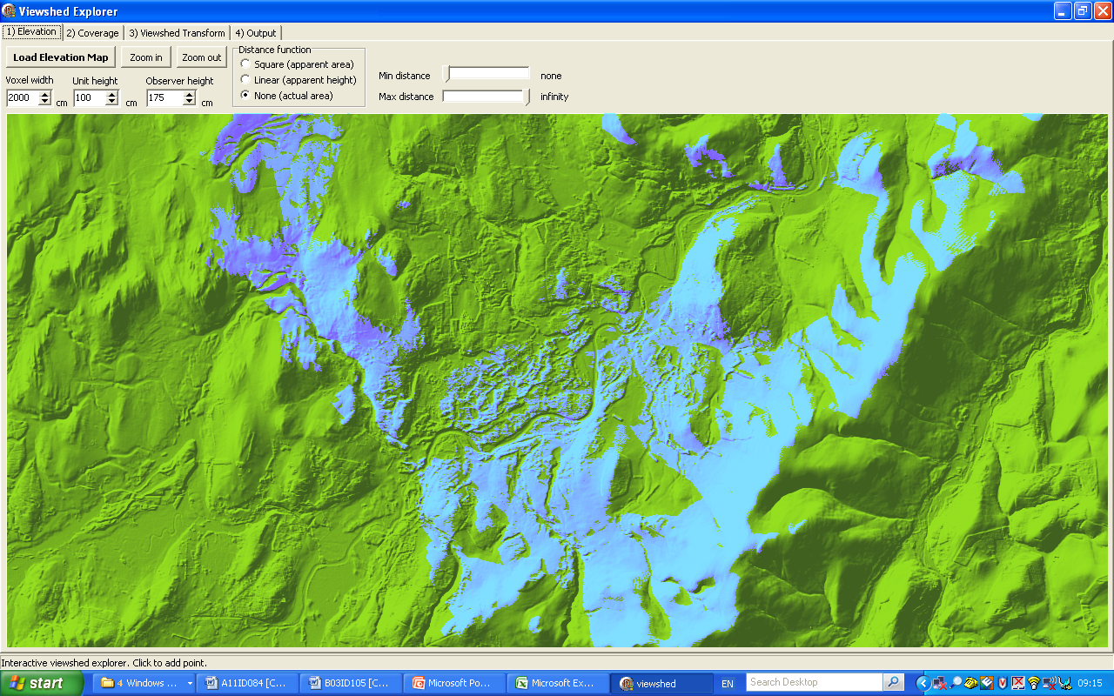
The view from here

Slide 52
Life-events and happiness
BHPS: What has happened to you (or your family) which has stood out as important?
145,408 major life events recorded between 1992-1995
Ballas, D., Dorling, D. (2007) Measuring the impact of major life events upon happiness,
International Journal of Epidemiology, 36, 1244-1252. doi:10.1093/ije/dym182

Slide 53
Life Event | Coefficient | P value
RELATIONSHIPS (MINE ENDING 36,43) | -0.178 | 0.00
DEATH (PARENT, 45) | -0.166 | 0.00
HEALTHPARENT (1-9) | -0.139 | 0.00
DEATH (OTHER 45) | -0.137 | 0.00
EMPLOYMENT JOB LOSS 24 | -0.129 | 0.00
HEALTH MINE (1-9) | -0.117 | 0.00
DEATH (FAMILY 45) | -0.098 | 0.00
HEALTH PARTNER (1-9) | -0.092 | 0.00
HEALTH CHILD (1-9) | -0.084 | 0.00
HEALTH OTHER (1-9) | -0.073 | 0.00
EDUCATION CHILD (12-19) | -0.029 | 0.12
EMPLOYMENT OTHER (23,26-29) | -0.028 | 0.13
OTHER EVENT (10-11;32-34;37-39;90-95) | -0.026 | 0.14
NOTHING IMPORTANT HAPPENED | -0.022 | 0.11
RELATIONSHIPS (WITH PET 54 AND SUBJECT) | -0.020 | 0.44
FINANCE (OTHER 60-69;73-79) | -0.019 | 0.27
RELATIONSHIPS FAMILY (46-53;55-59) | -0.014 | 0.39

Slide 54
Life Event | Coefficient | P value
RELATIONSHIPS (FAMILY 35. 41-42) | 0.002 | 0.91
LEISURE (OUR HOLIDAY 30) | 0.010 | 0.61
MOVING HOME (44;80-81) | 0.013 | 0.46
EDUCATION OTHER (12-19) | 0.024 | 0.27
FINANCE (CAR 70) | 0.027 | 0.22
LEISURE (MY HOLIDAY 30) | 0.029 | 0.07
PREGNANCY (OTHER 40) | 0.031 | 0.56
PREGNANCY (FAMILY 40) | 0.034 | 0.09
RELATIONSHIPS (CHILD'S STARTING 35, 42) | 0.037 | 0.10
EMPLOYMENT JOB CHANGE (20-21) | 0.040 | 0.02
LEISURE (OTHER 30-31) | 0.043 | 0.02
EDUCATION MINE(12-19) | 0.052 | 0.00
PREGNANCY (CHILD'S 40) | 0.053 | 0.01
PREGNANCY (MINE 40) | 0.084 | 0.00
FINANCE (HOUSE 71) | 0.097 | 0.00
EMPLOYMENT JOB GAIN 22 | 0.097 | 0.00
RELATIONSHIPS (MINE STARTING 35. 42) | 0.160 | 0.00

Slide 56
Acknowledgements
Funding from the Economic and Social Research Council (RES-163-27-1013) is gratefully acknowledged.
The British Household Panel Survey data were made available through the UK Data Archive. The data were originally collected by the ESRC Research Centre on Micro-social Change at the University of Essex, now incorporated within the Institute for Social and Economic Research.
The Census Small-area Statistics used in some of the work presented here are Crown Copyright and are provided through the Census Dissemination Unit of the University of Manchester, with the support of the ESRC/JISC/DENI 1991 Census of Population Programme.

