Slide 1
Molecular coevolution
Steve Paterson

Slide 2
Host-parasite interactions
Drive diversity within species
Drive divergence between species

Slide 3
JBS Haldane

Slide 4
Haldane 1949 – Disease and Evolution
‘genetical diversity as regards resistance to disease is vastly greater than that regards resistance to predators’
‘it is much easier for a mouse to get a set of genes which enable it to resist Bacillus typhi murium than a set which enable it to resist cats’
Reprinted in ‘Evolution’ Mark Ridley

Slide 5
frequency-dependent selection
selective sweeps

Slide 6
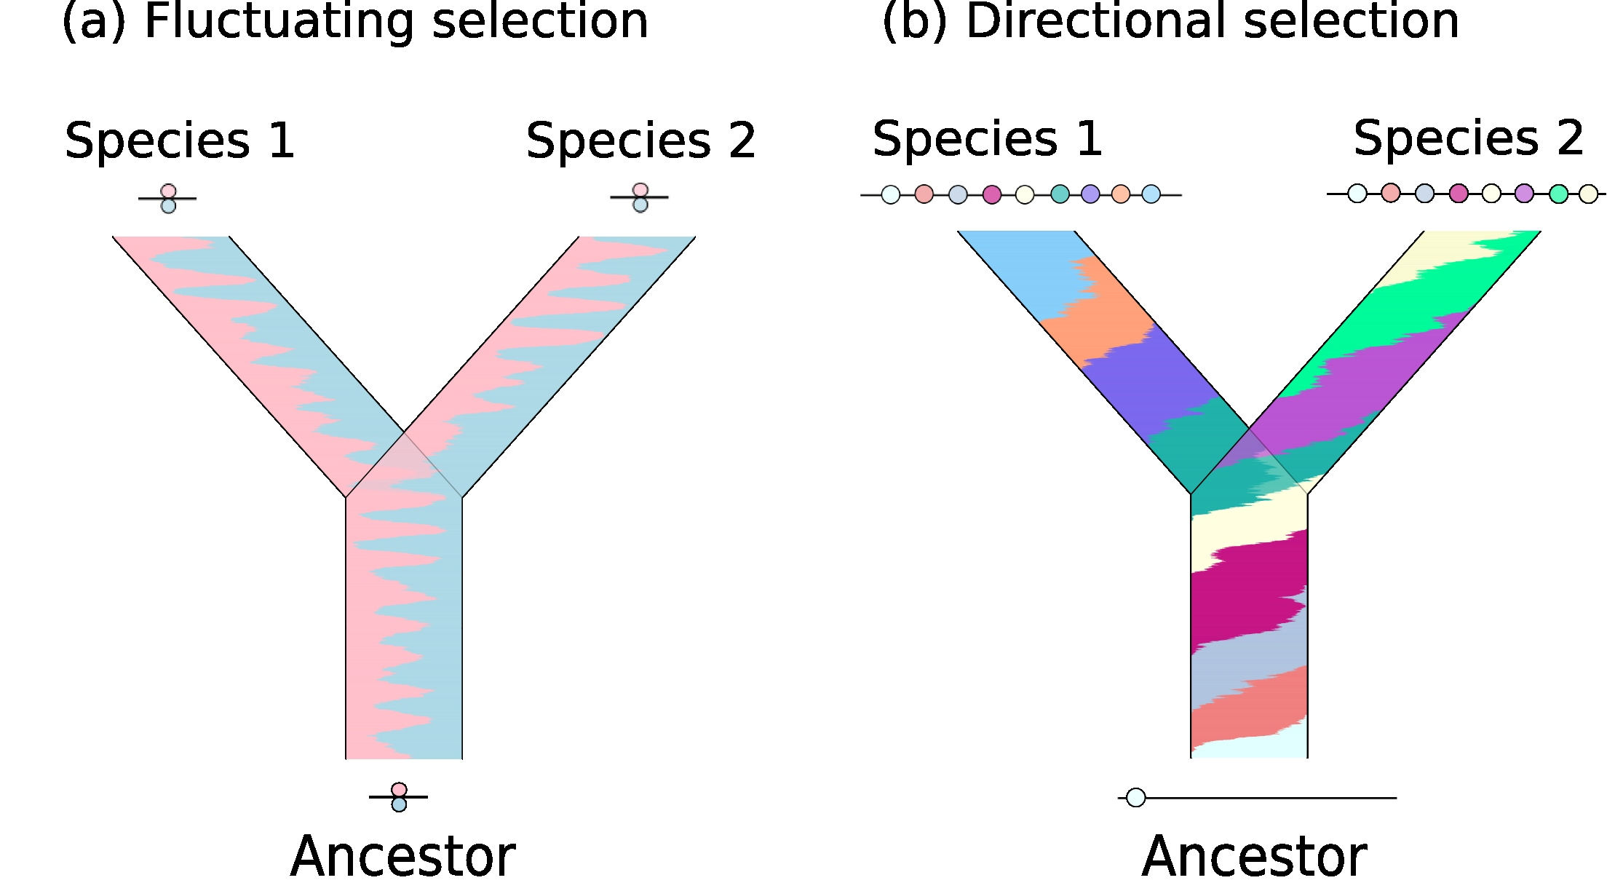

Slide 7
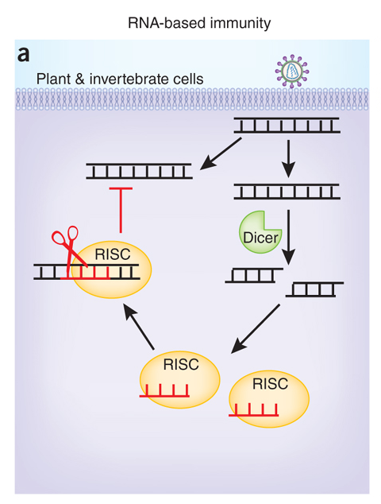
Anti-viral immunity in Drosophila
Yan and Chen (2012)
Nature Immunology 13, 214–222

Slide 8
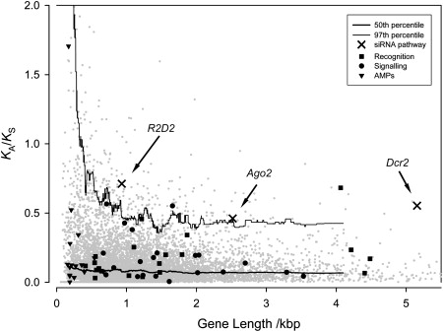
Evolution of anti-viral genes in Drosophila
d_{N}/d_{S}
Obbard et al (2006) Current Biology 16: 580-585

Slide 9
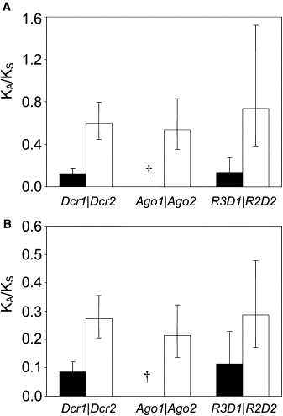
Comparison of anti-viral genes (open bars) with their housekeeping paralogs (black bars)
d_{N}/d_{S}
D. melanogaster and D. simulans
d_{N}/d_{S}
D. yakuba and D. erecta

Slide 10
Polymorphism vs divergence
Can use polymorphism within a species to generate null hypothesis for divergence between species
Null hypothesis
(MacDonald-Kreitman)

Slide 11
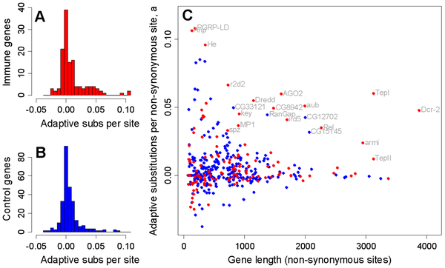
Obbard et al (2009) Quantifying adaptive evolution in the Drosophila immune system
PlosGenetics 5: e10000698

Slide 13
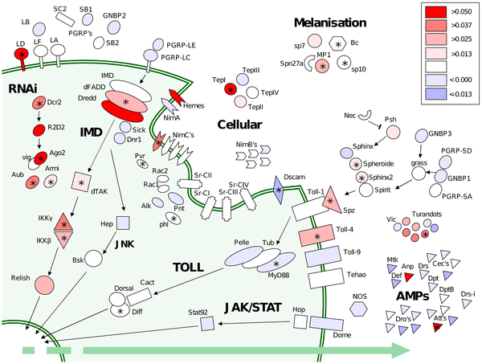

Slide 14
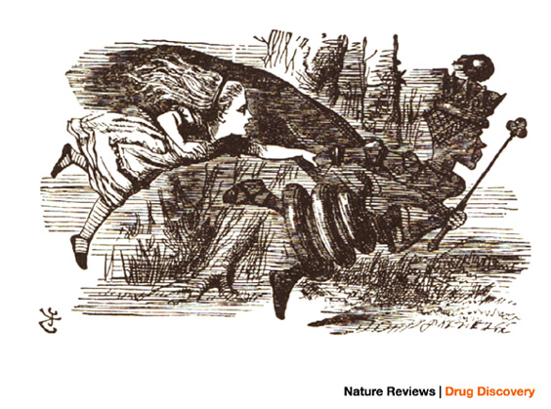
Red Queen Theory
"Now, here, you see", said the Red Queen to Alice in Lewis Carroll's Through the Looking Glass, "it takes all the running you can do, to keep in the same place".

Slide 15
Pseudomonas & phage
Past phage
Current phage
Bacterial resistance
Future phage
Past bact
Current bact
Phage infectivity
Future bact
Time

Slide 16
Pseudomonas & phage
Current phage
Bacterial resistance
Current bact
Phage infectivity
Time

Slide 17
Experimental evolution
Φ2 phage
Phage adapt to hosts
and hosts adapt to phage
‘co-evolution’
host
Phage adapt to fixed host genotype ‘evolution’

Slide 18
Next-gen sequencing
454 sequencing of replicate populations
c. 200x coverage
Measure frequencies of variants arising by mutation and subsequently selected
Rate of molecular evolution with and without Red Queen?
Diversity within and divergence between populations?
What genes?

Slide 19
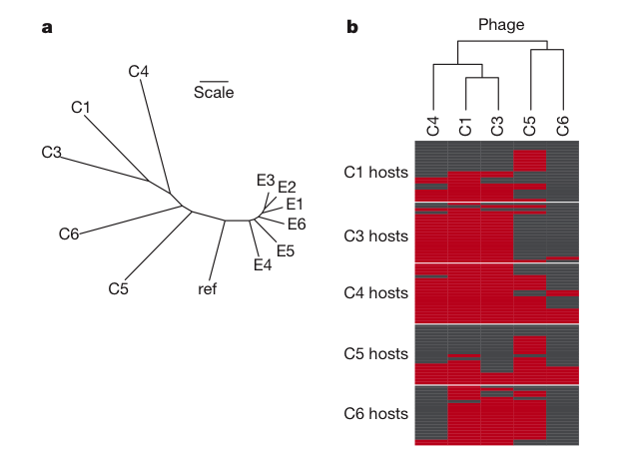
Paterson et al (2010) Antagonistic coevolution accelerates molecular evolution Nature 464: 275-278

Slide 20
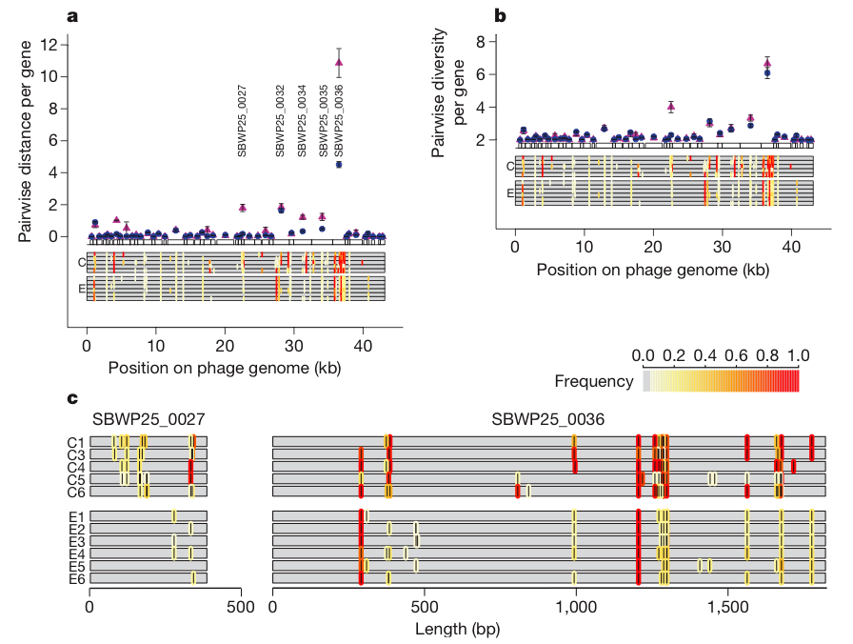
Divergence from ancestor
Diversity within population

Slide 21
