Slide 1

Planetary Magnetic Fields
Richard Holme

Slide 2
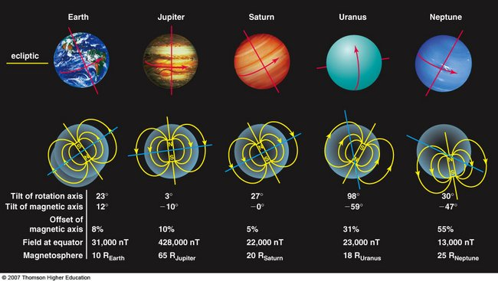
A Simple Picture
A very simplistic model – understand planetary
fields in terms of the Geomagnetic field

Slide 3
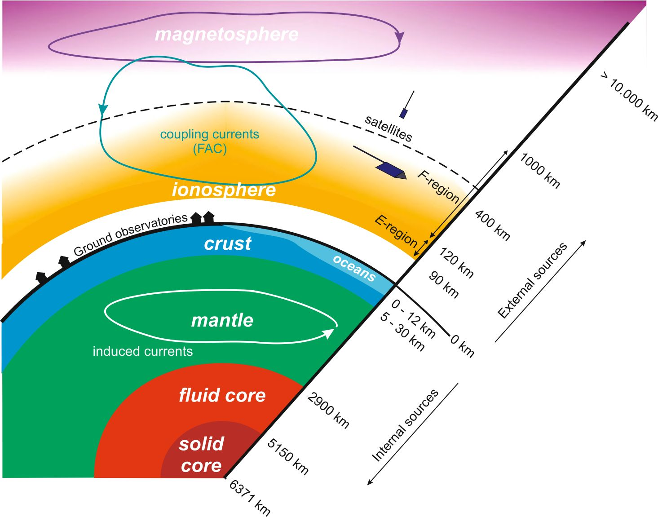
Multiple Field Sources

Slide 4
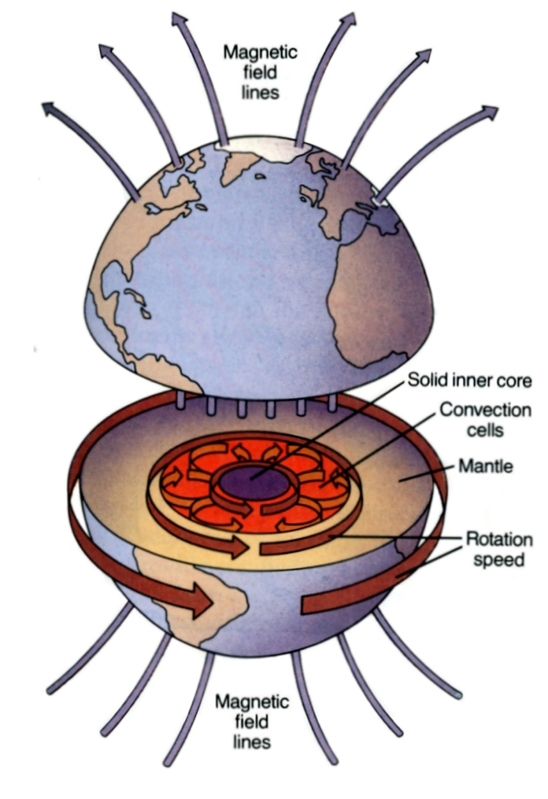
Origin of the Main field
Hydromagnetic dynamo in
Earth’s core
Earth’s core is molten iron (plus other stuff)
Motions in the core bend and stretch magnetic field, producing more magnetic field!
Therefore, field structure at core surface is particularly interesting
We can use surface observations to make a field model to map core surface field.
We can’t observe what is happening in the core.

Slide 5
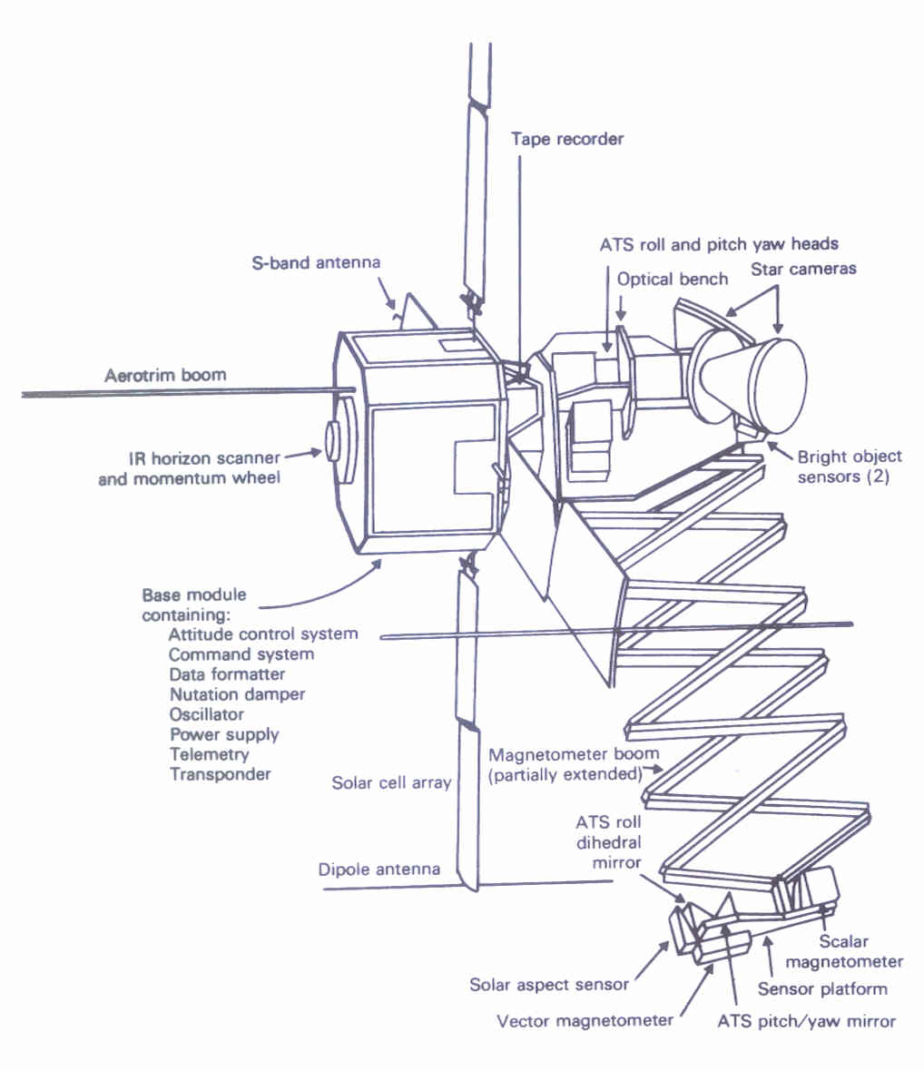
The Founder of Modern
Observational Geomagnetism

Slide 6
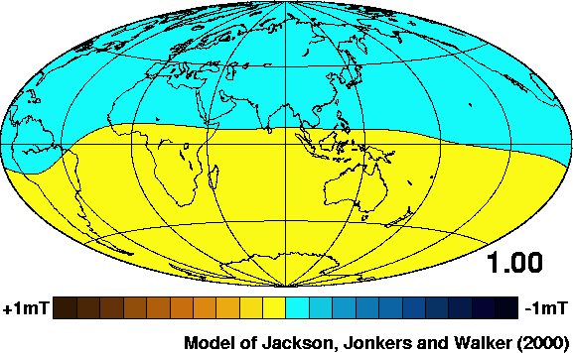
Downward Continuation Movie
Gets complicated at depth of fluid iron core –
0.547 Earth radii - where the field is from
Number is distance from Earth centre
in Earth radii – watch detail appear!

Slide 7
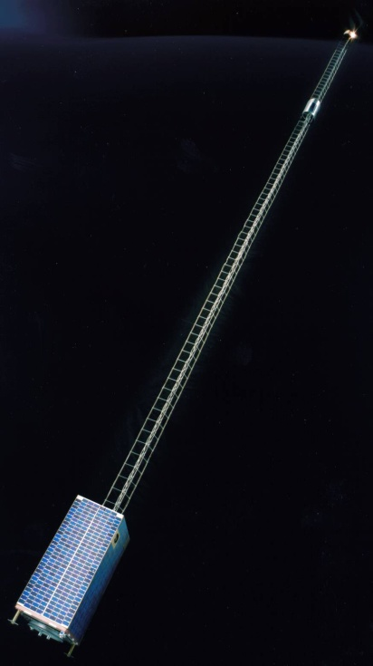
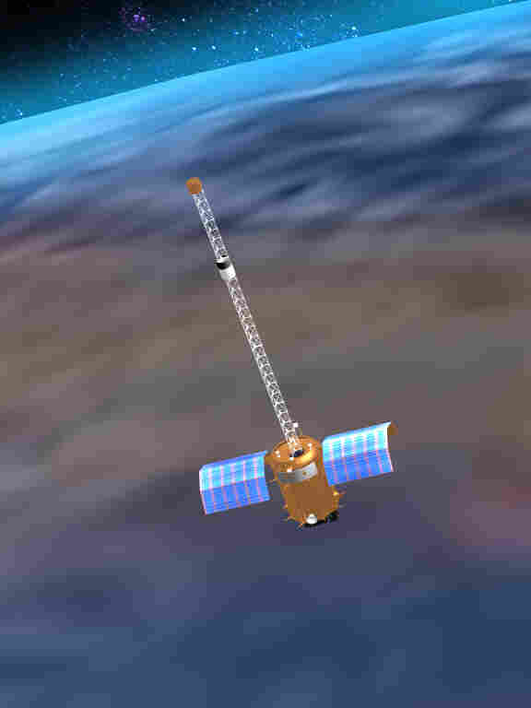
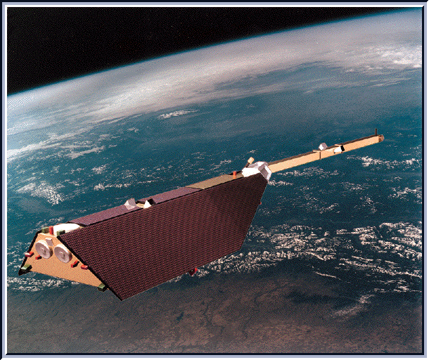
Recent Satellites
Ørsted
Champ
SAC-C
Active from 1999 to 2010

Slide 8
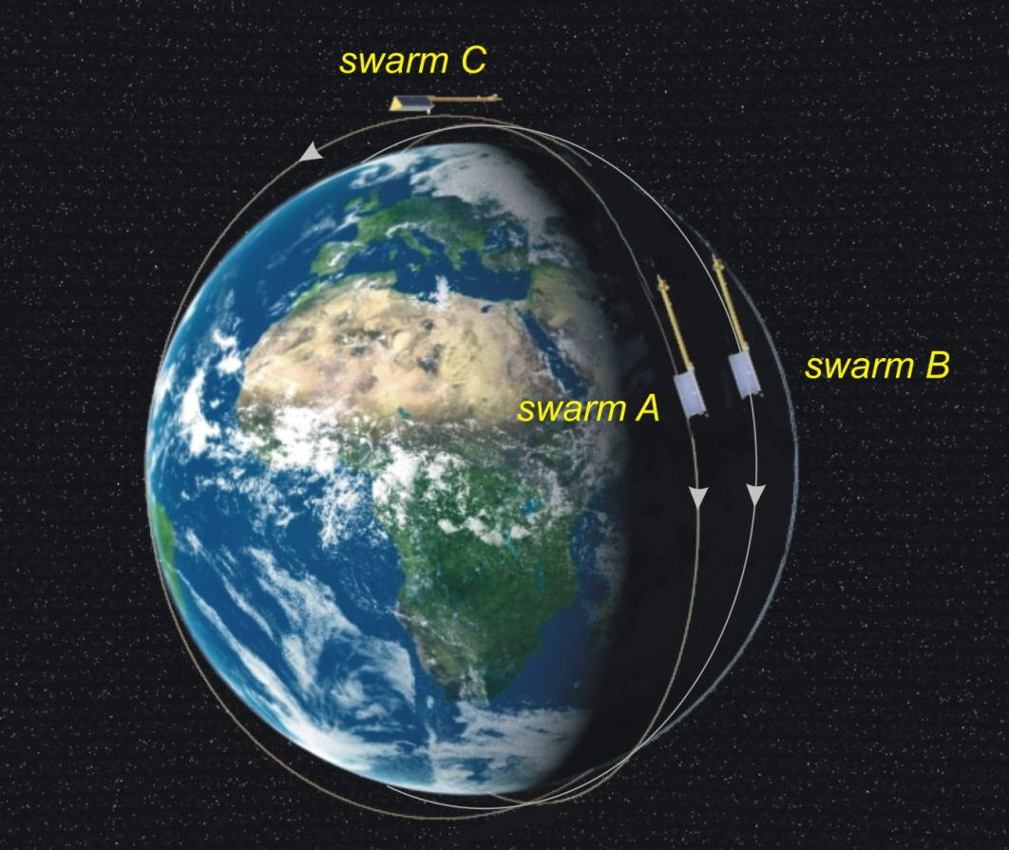
The Future - Swarm

Slide 9
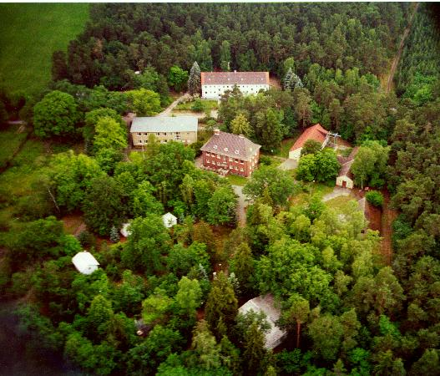
Ground stations

Slide 10
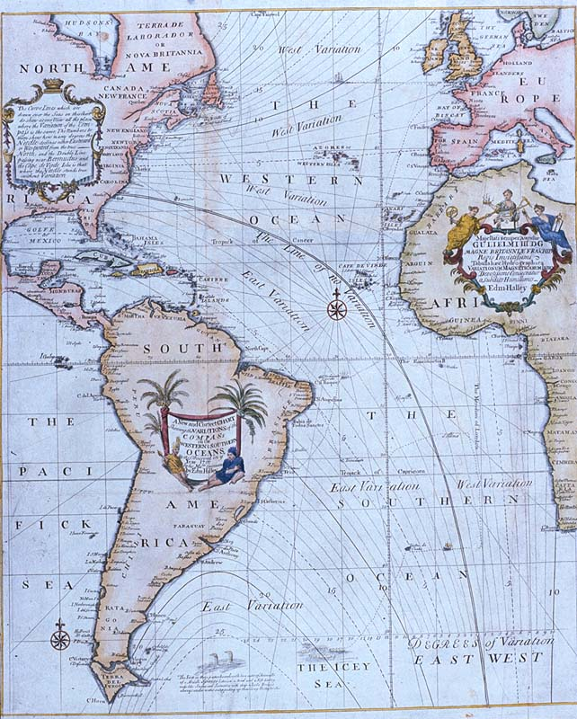
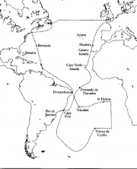
The Historical Record
Second voyage
Edmond Halley’s map
of Declination, 1700

Slide 11
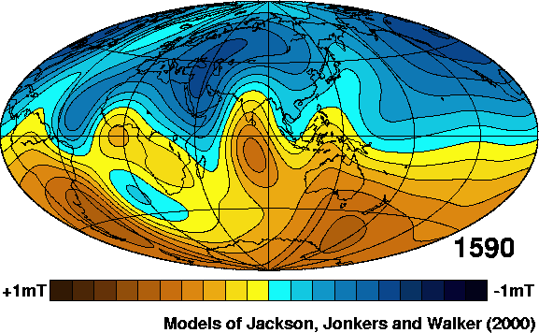
Radial Field at Core-Mantle Boundary

Slide 12
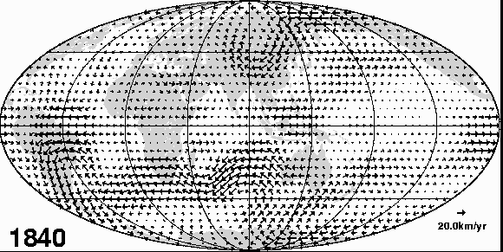
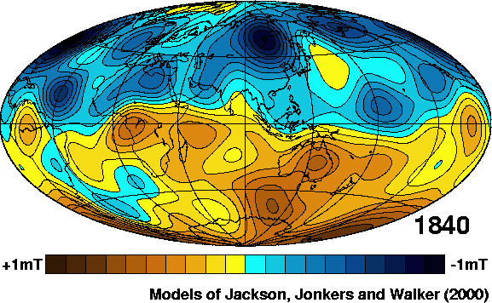
What causes the changes?
Field changes (secular variation) dominantly from flow at top of the core
Provides a window on the dynamo process
On geological time scales, variations include field reversals

Slide 13
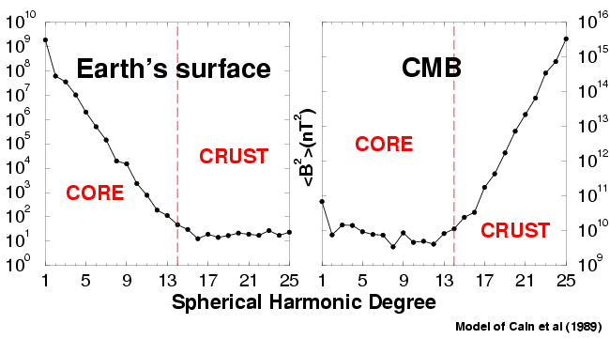
The Geomagnetic Field Spectrum
Mean-square field over a spherical surface as a function of length scale:
Conclusion: Large scale - core field, small scale - crustal field

Slide 14
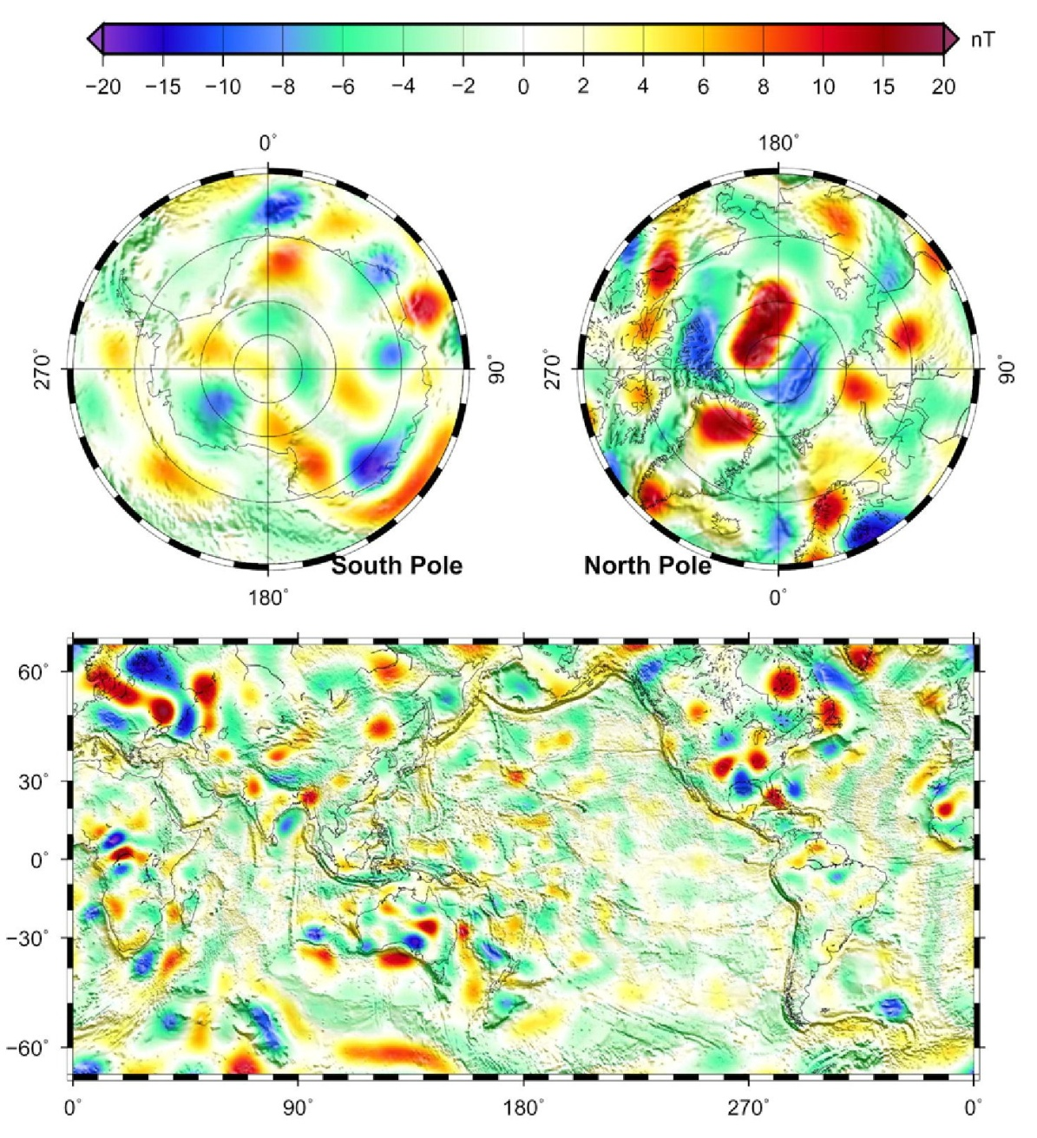
Crustal field
On Earth, difficult to interpret because large scale not seen
Nevertheless, insight into tectonic processes / crustal composition / thermal profile with depth

Slide 15
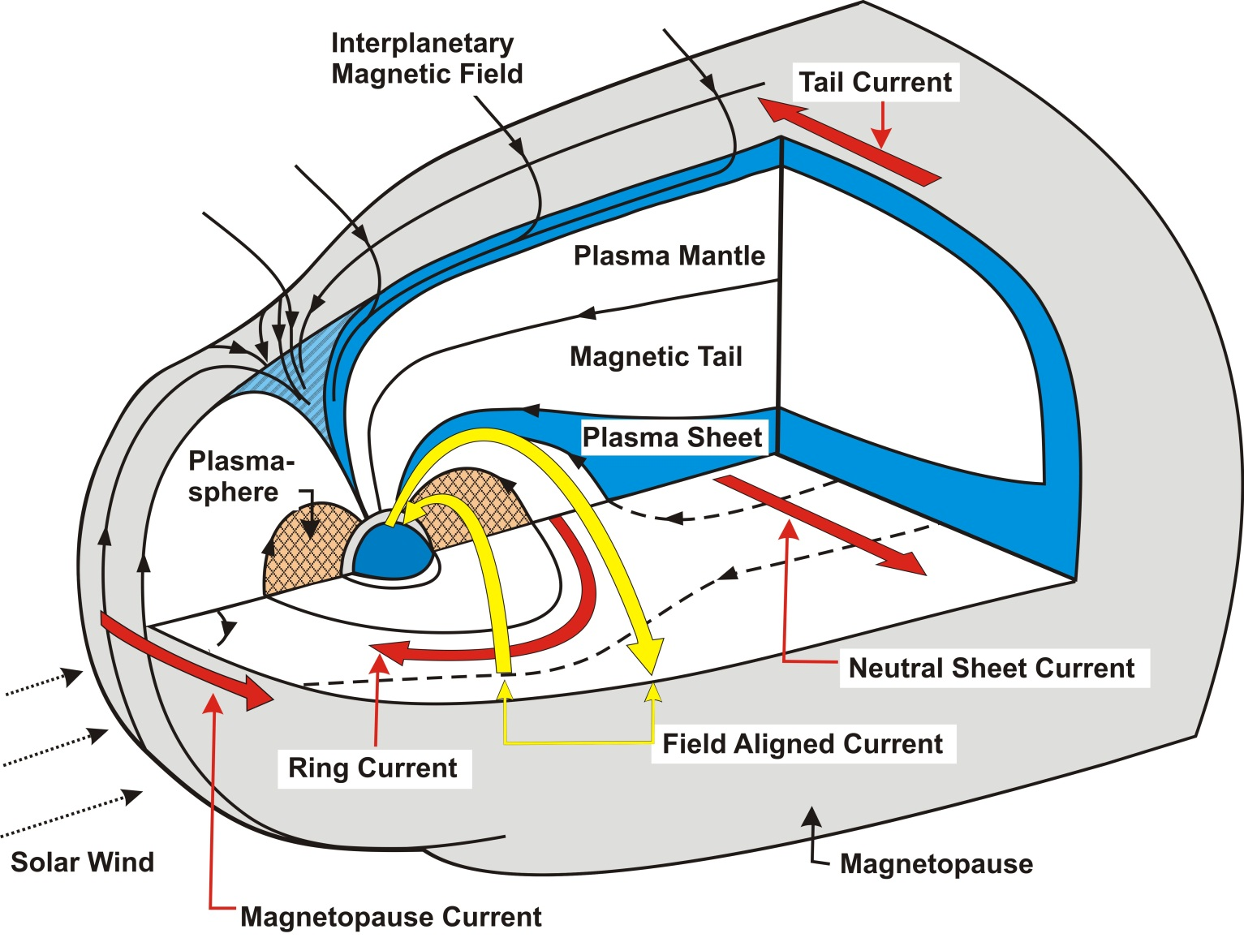
External Field

Slide 16
Summary
Major part of field from dynamo in Earth’s core
Powered by convection due to planetary cooling
Looks like a dipole because we are far from source
Changes with time – information about dynamics
Shorter length scales, crustal field (magnetised rocks)
External field (Ionosphere and Magnetosphere) – interaction of solar wind with internal field
Motion of charged particles within the Earth’s field
Observable phenomena – Aurora and electromagnetic radiation
Other planets:
Need a highly conducting fluid region
If no internal field, can still have remanent crustal field

Slide 17
Solar System Fields
Body | Surface Field rms (nT) | Source
Jupiter | 580,000 | Active Dynamo
Earth | 42,000 | Active Dynamo
Uranus | 32,000 | Active Dynamo
Saturn | 31,000 | Active Dynamo
Neptune | 18,000 | Active Dynamo
Mars | 10,000 | Extinct Dynamo
Io | 1,000 | Jupiter Induced?
Ganymede | 700 | Active Dynamo
Mercury | 450 | Active Dynamo
Europa | 100 | Jupiter Induced
Venus | 10 | No Dynamo

Slide 18
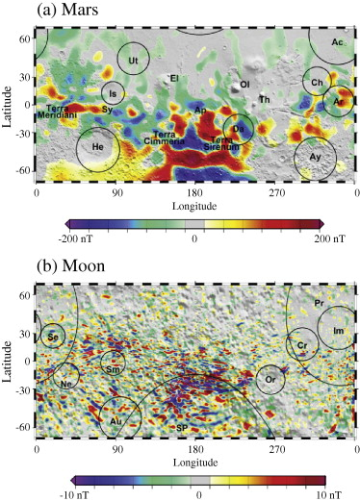
Terrestrial Planets
Mars, Moon show strong crustal field – no main field
Mars field much stronger than Earth crustal field – non-uniform
Magnetic field directly measured in lunar rocks (and some Martian meteorites)
Past dynamos which have died
No magnetic field for Venus – despite most Earthlike!
Can’t lose heat? Core is stably stratified?
Mercury currently of great interest – Messenger spacecraft

Slide 19
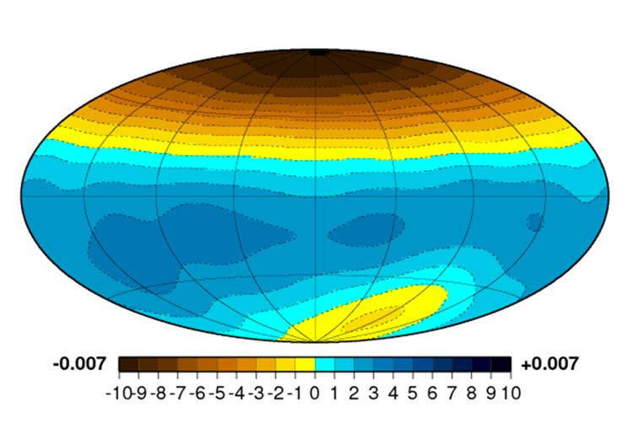
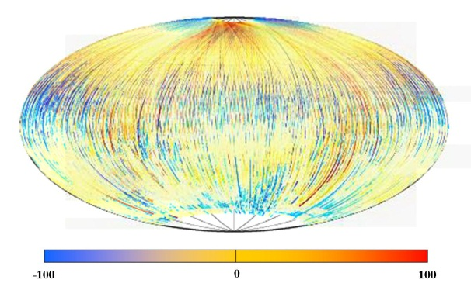
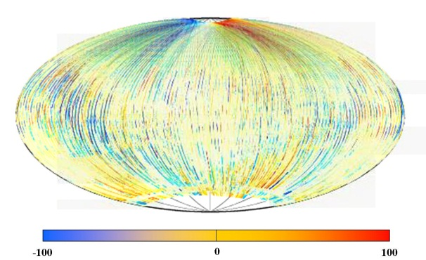
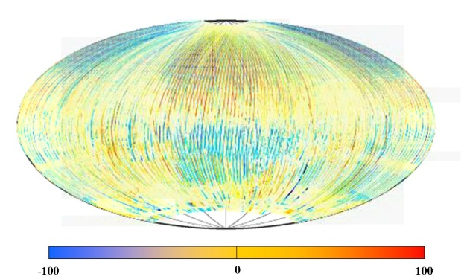
Mercury Models
X
Y
Models from Jamie Richardson (Liverpool)
Match Messenger team
Weak dipole field – screened by conducting
layer in planet?
Lots of signal still to explain (residual to right)
Z

Slide 20
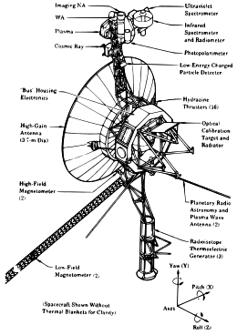
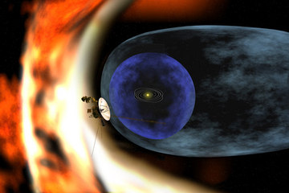
Giant Planet Data:
Pioneer / Voyager

Slide 21
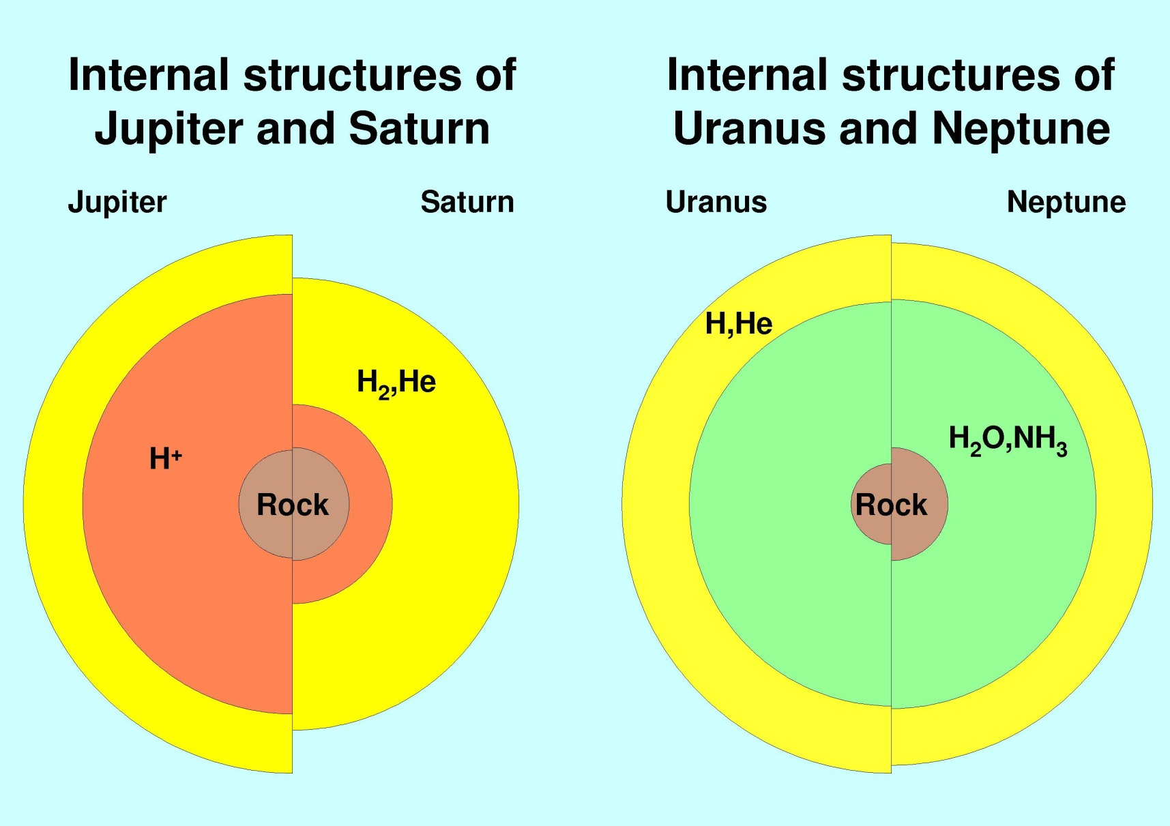
Giant Planet Structures

Slide 22
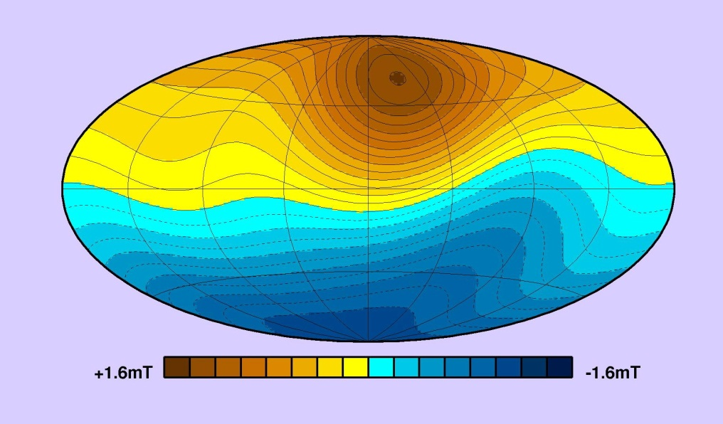
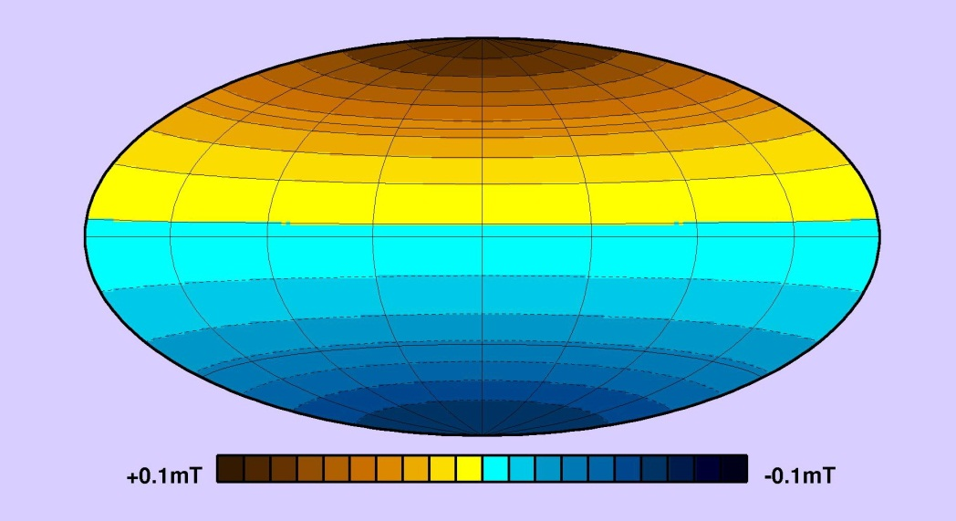
Jupiter and Saturn Surface Fields
Jupiter
Saturn
Jupiter field Earth-like, if stronger
Saturn field weaker – from deeper in the planet
Saturn field apparently axially symmetric
This is impossible!

Slide 23
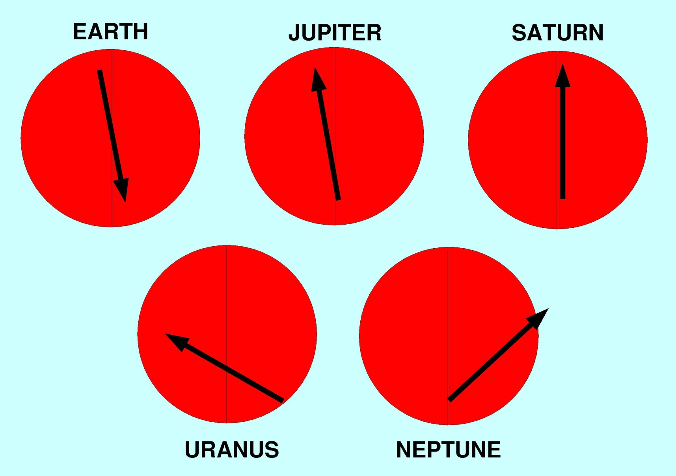
Dipole structures again

Slide 24
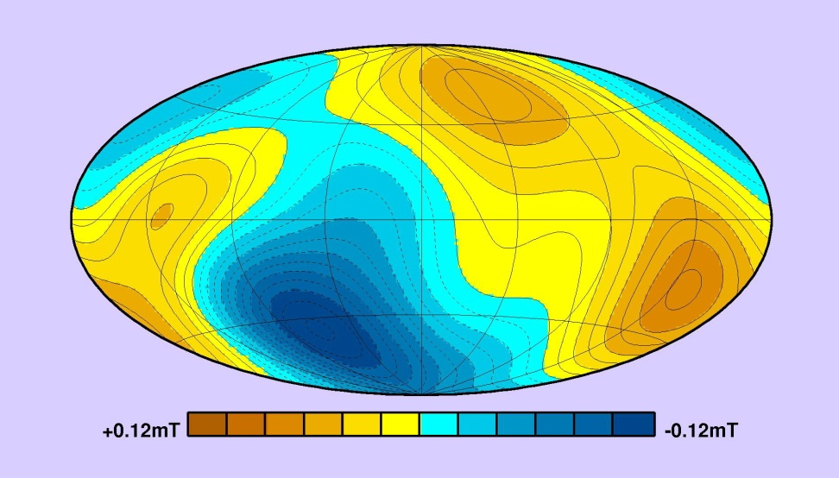
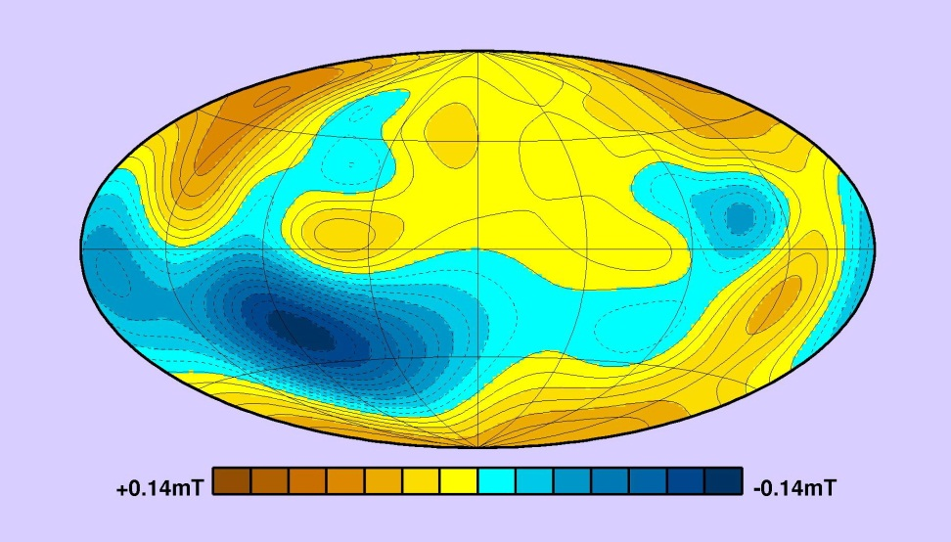
Jupiter and Saturn Surface Fields
Uranus
Neptune
Very un-Earth-like – not dipolar even at surface
Very different kind of field structure – differences in
  Electrical conductivity?
  Dynamical regime?
  Energetics?

Slide 25
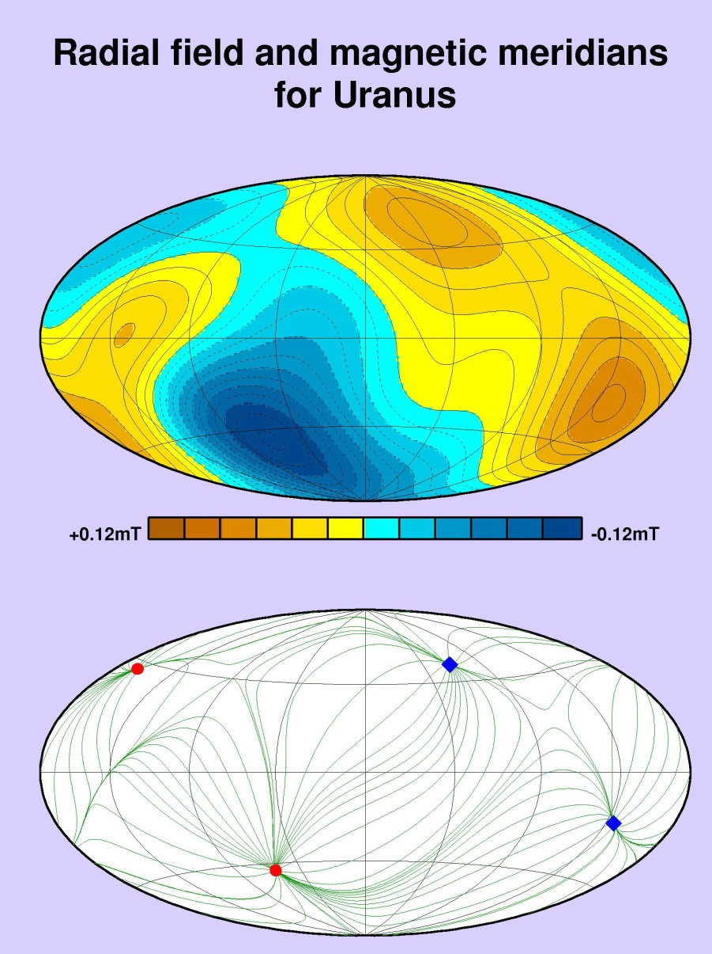
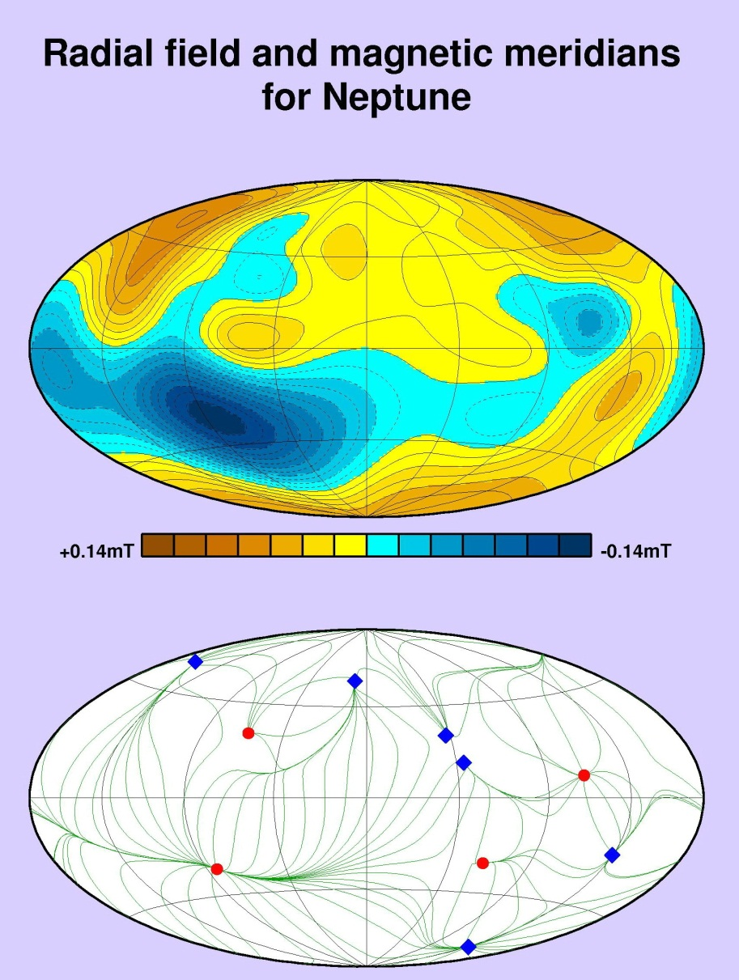
How different are Uranus/Neptune?

Slide 26
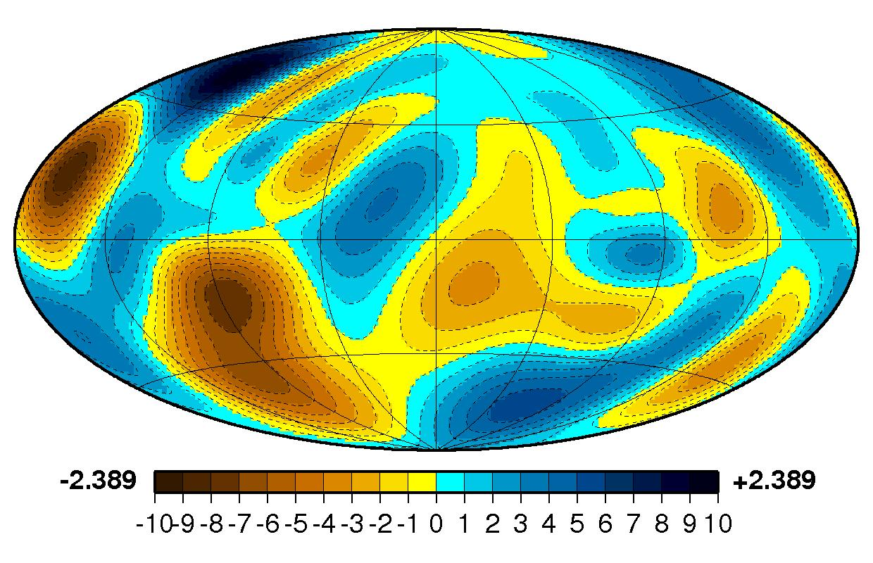
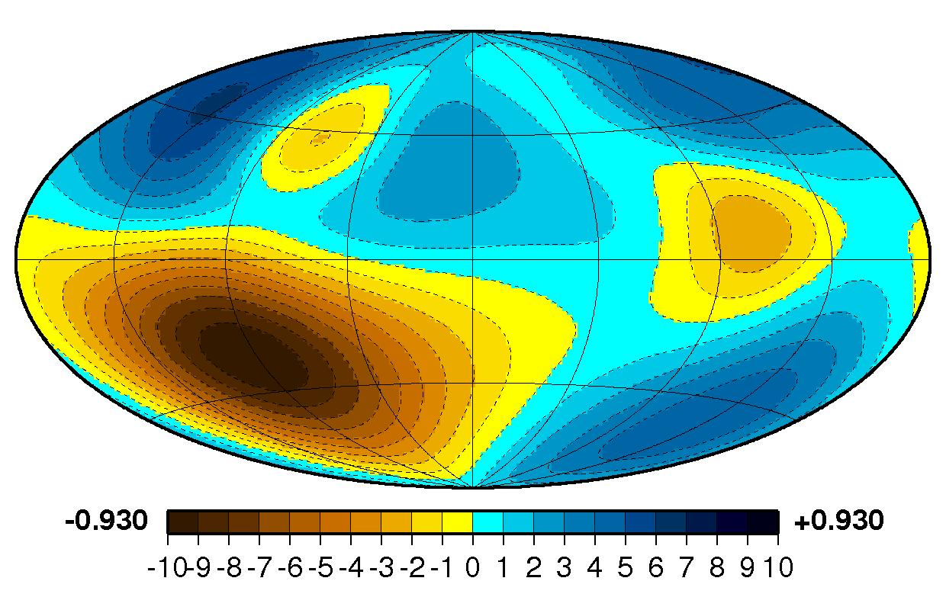
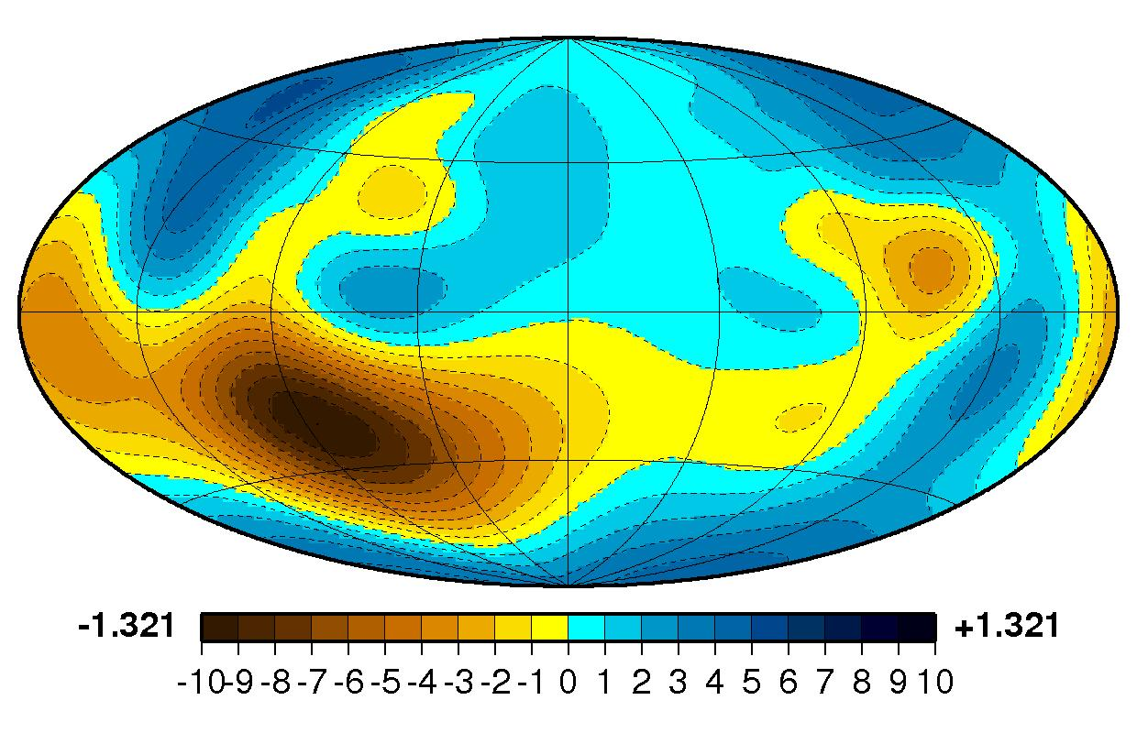
But take with a pinch of salt…
Three different models of surface field of Neptune
All three models fit the data
Decision for the modeller:
  More complex model fits the data better, but is this detail required?
  Simpler model fits well enough
  Seek trade-off between explaining data and complexity
Beware of scientists bearing exciting colour pictures!

Slide 27
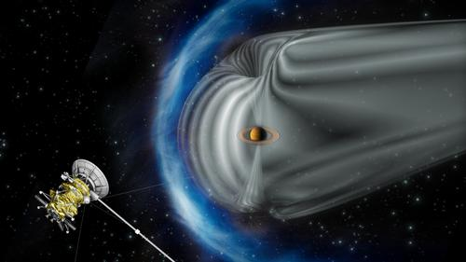
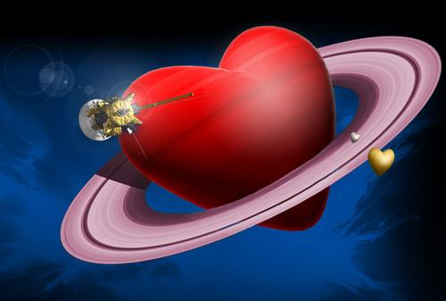
More Saturn detail - Cassini

Slide 28
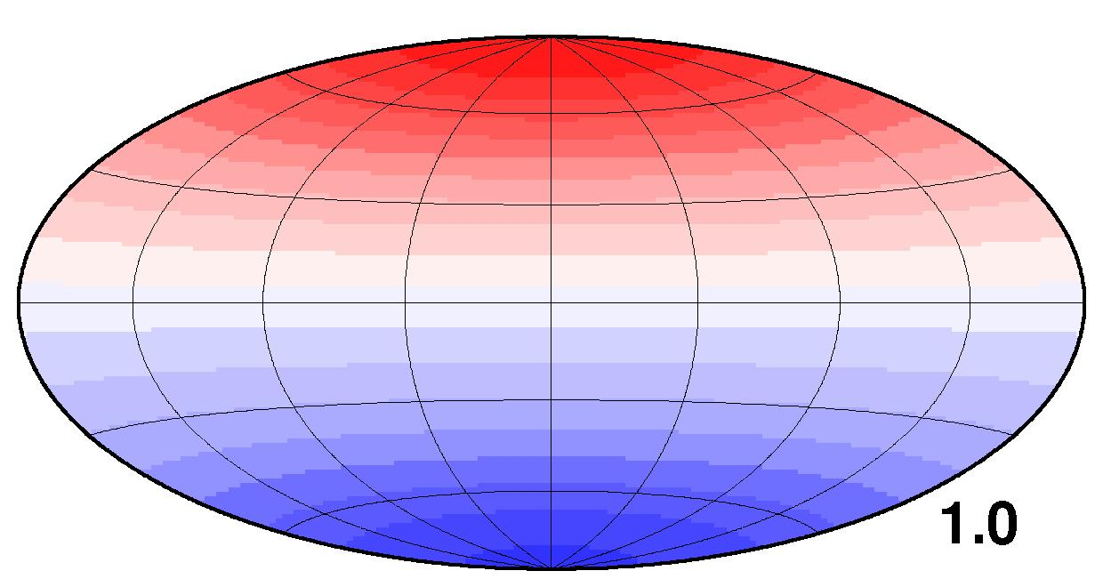
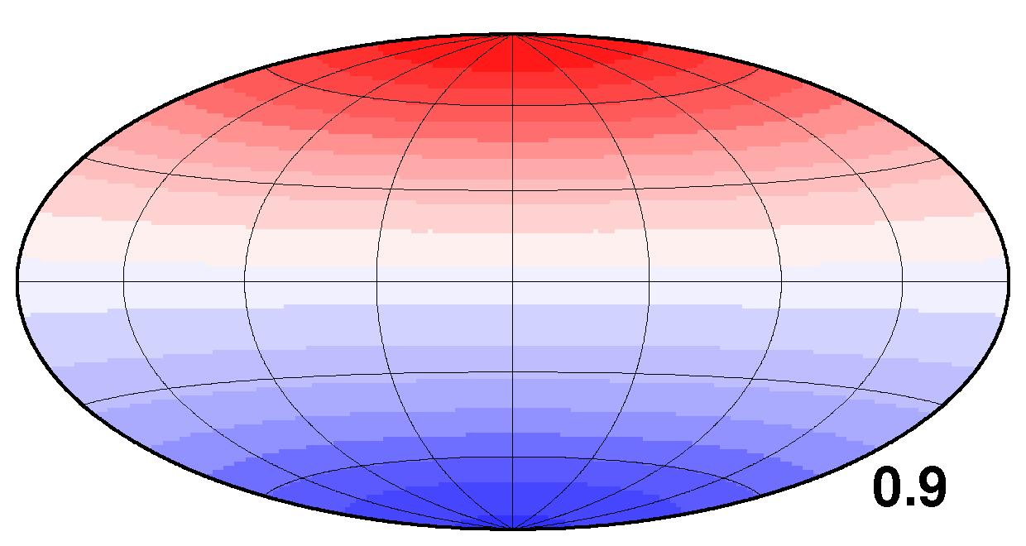
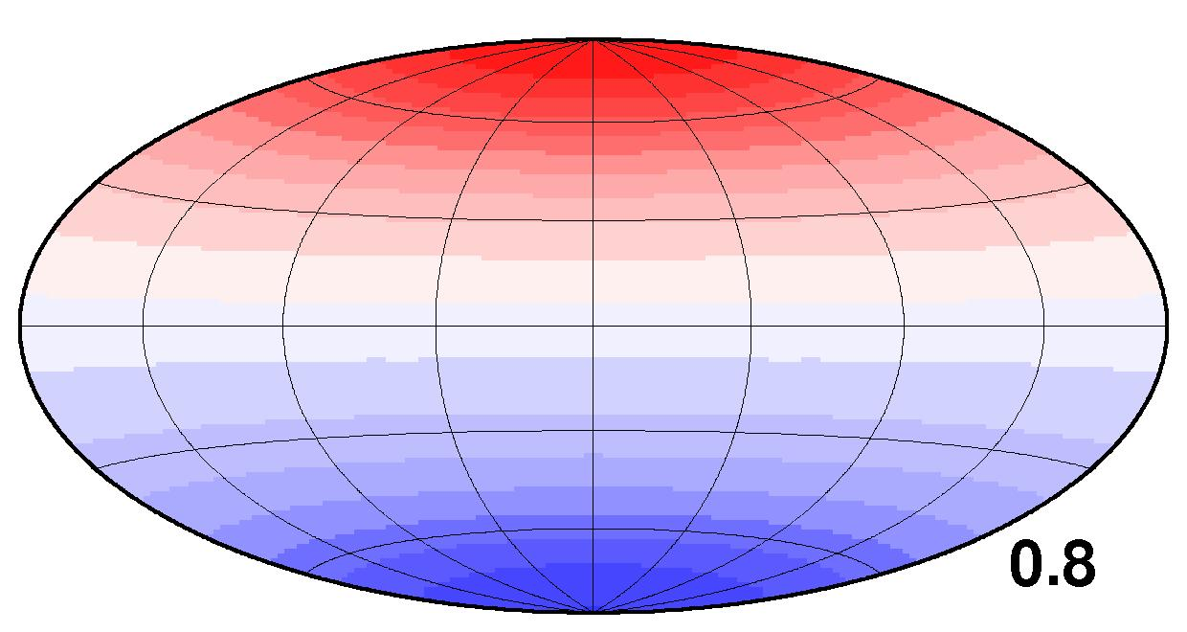
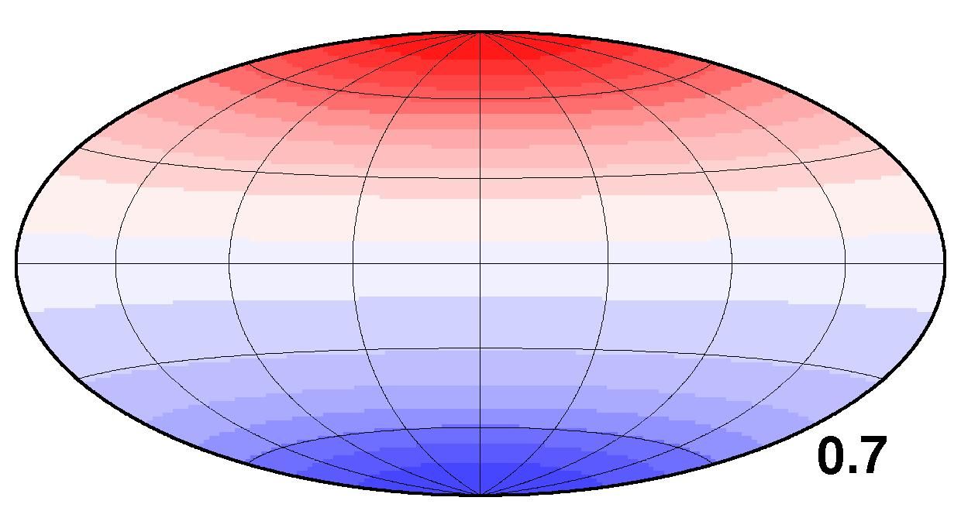
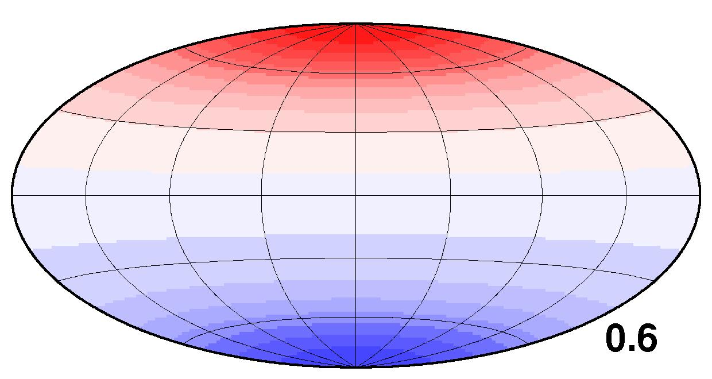
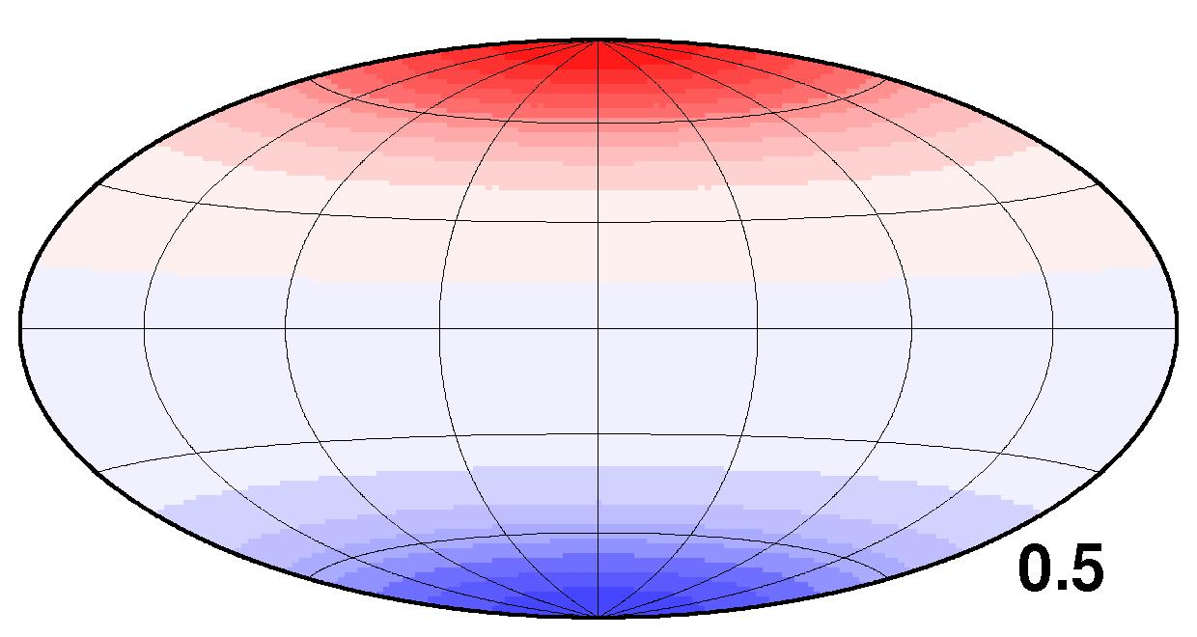
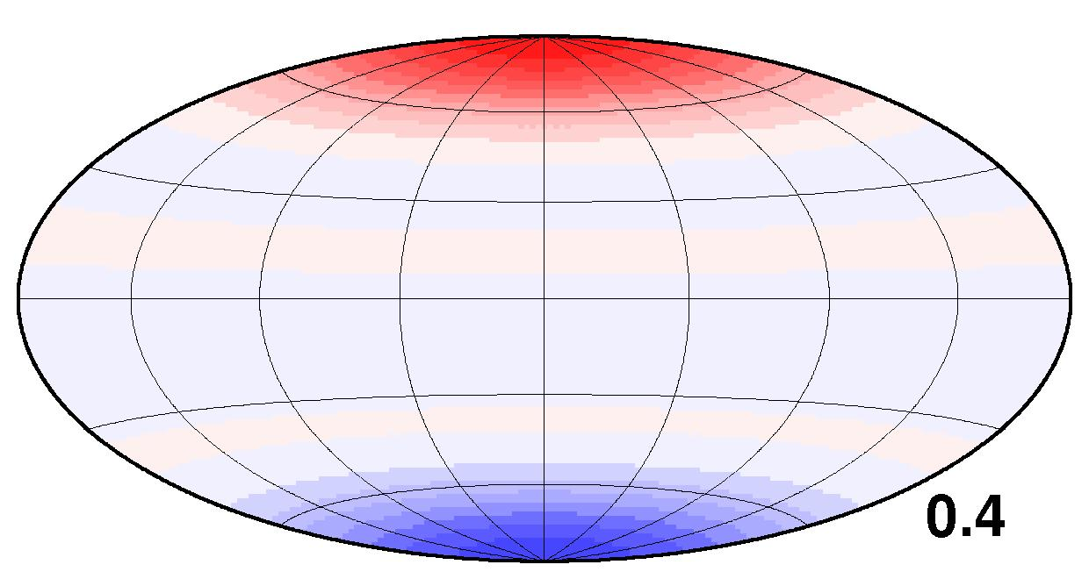
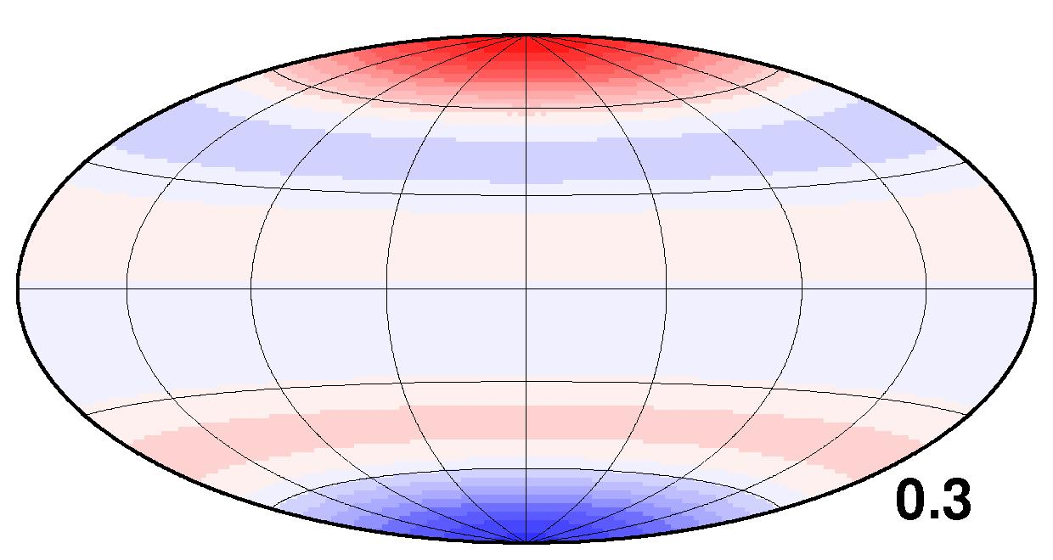
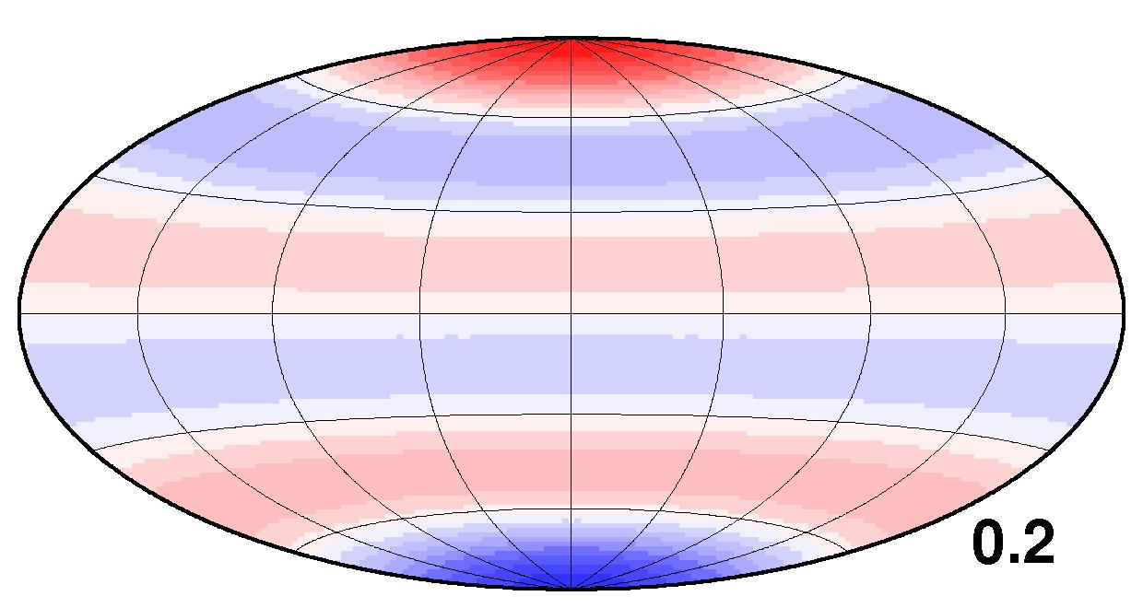
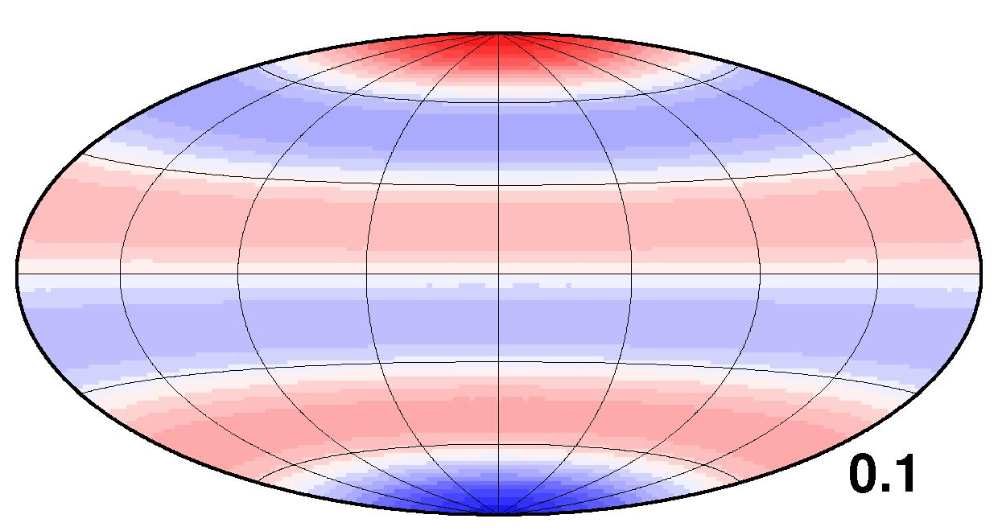
Recent Saturn Field Model
Following Geomagnetic analysis, look within the planet:
Modelling from UCLA group – Cao, Russell et al

Slide 29
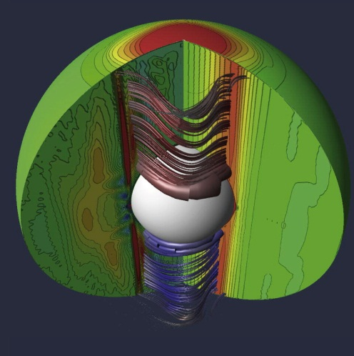
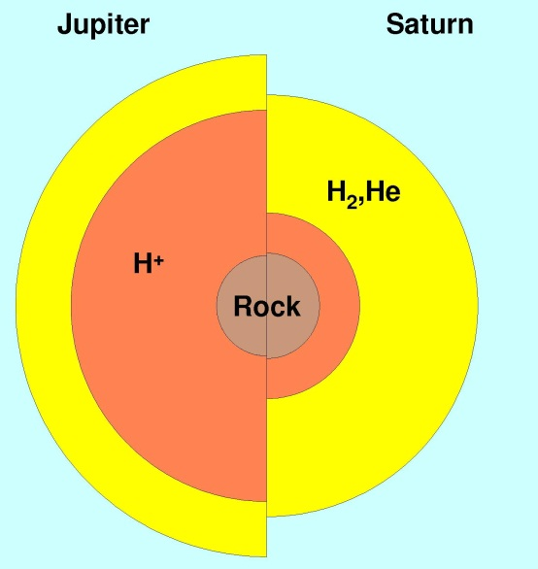
Saturn’s Dynamo?
Strong magnetic field restricted to region above inner core
Numerical dynamo models can produce this, but very different dynamo to Earth’s core
Can this also explain Saturn’s axisymmetry?

Slide 30




Models of Jovian Field Change
Over 30 years of data from Pioneer to Galileo
Dipole SV optimal model 0.042% yr⁻¹ (Earth ~ 0.06% yr⁻¹)
Time variation
not required –
improvement in
model better
than increased
spatial complexity.
(Models of Victoria
Ridley, Liv/BGS)

Slide 31

Jovian Flow Modelling
From SV models, can infer flow at top of core – 0.85R_{J}
Require detailed flow structure to explain SV
Cannot result from rotation alone
Flow must be only close to surface – if deep, Jupiter rotation period would change

Slide 32




Jovian Moons
Approached by Galileo spacecraft
Magnetic fields observed at all four Galilean moons
Originally thought to be internal fields – dynamos?
Even more exciting – induced fields. Ganymede both!
Highly electrically conducting near surface of moon
Surface water layer under ice? Life??!!

Slide 33



New Jupiter Missions
Juno and JUICE

Slide 34


And even beyond?

Slide 35

How can we see fields of Exoplanets?
Planet radio emissions / aurora – detect radiation?
Example of Jupiter from Hubble Space Telescope
Perhaps we should do this for our planets first?!

Slide 37


Uranus and Neptune Sampling
Uranus – good coverage in latitude, not very close approach
  Model not detailed, similar in quality over planet
Neptune – close approach in north, no south data
  Model detailed near closest approach, poorly resolved in south

Slide 38


Bounding the Dipole Axis
Separate reflected and transmitted energy by spectrum
Earthlike dipole for Uranus would require a dynamo needing more driving heat than is available

