Slide 1
BASCD Trainers’ Pack for Caries Prevalence Studies
Updated: June 2011
for 5 yr old UK Training & Calibration Exercise

Slide 2
Prepared by
Cynthia Pine and Girvan Burnside
Administrative assistance by
Lucy Fish
Tom Jirat
Rebecca Byrne
Clinical photographs by
Christopher Deery
Fadi Jarad
George Lee
Additional photographs from NDIP Scotland Training Pack by
Nicola Innes
Amid Ismail
Kim Ekstrand

Slide 3
Background
The British Association for the Study of Community Dentistry (BASCD) has co-ordinated and provided the standards for a programme of dental health surveys for many years.
The collected resources and guidance are available at
http://www.bascd.org/

Slide 4
This presentation is designed to support the training of dental examiners in the assessment of dental caries undertaken in the surveys.

Slide 5
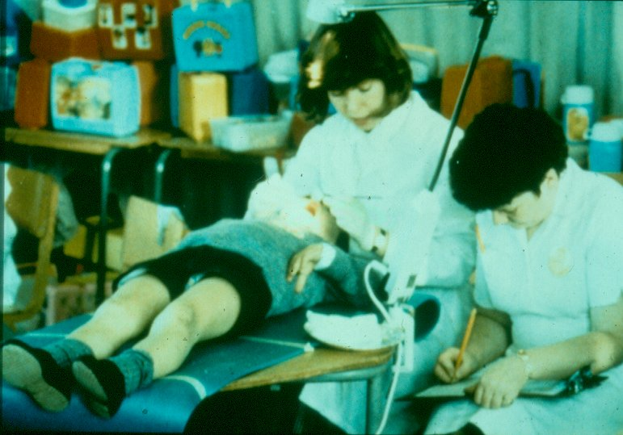
The Examination

Slide 6
The Examination
Dentist seated behind child
Child lying supine on table covered with soft mat or in reclined chair
Recorder seated next to dentist
Dentist can clearly see chart

Slide 7
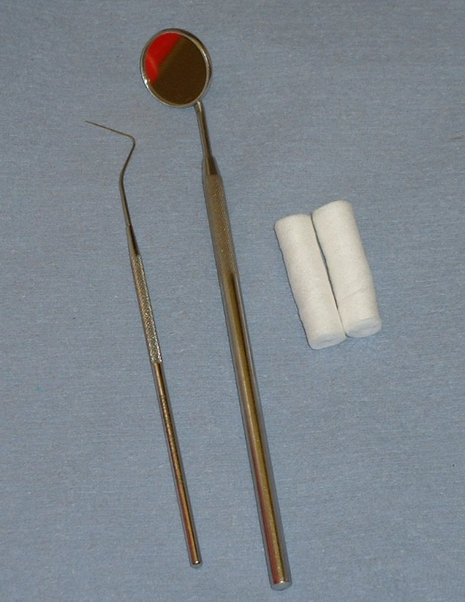
Dental instruments
Recommended dental instruments are:
Plane mouth mirror
Blunt ball-ended probe (CPITN) with an end diameter of 0.5 mm.
Cotton wool rolls or cotton buds for drying teeth
Fresh set of previously sterilised instruments for each subject.

Slide 8
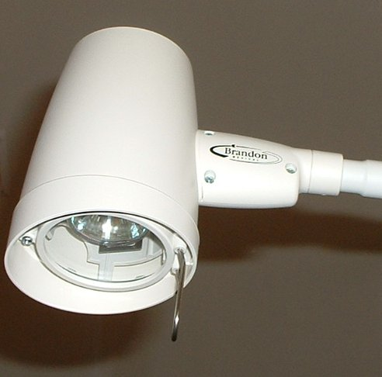
Lights
BASCD recommend a purpose built inspection light yielding 4000 lux at 1 metre
Examples of acceptable lights are:
Brandon Medical Company
MT608BASCD
Daray
X100 with PivotD desk mount
Ensure light is at highest setting

Slide 9
Oral cleanliness examination
Ask child to bite together
Lift upper lip
Look at buccal surfaces of upper canine to upper canine
Only score visible plaque
Ignore food remnants in an otherwise clean mouth

Slide 10
Oral cleanliness coding
0 | Teeth appear clean
1 | Little plaque visible
2 | Substantial amount of plaque visible
9 | Assessment cannot be made for upper anterior sextant; (Note: if incisors are missing and only canines present, score 9)

Slide 11
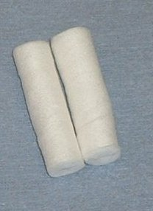
Drying Teeth
BASCD recommend cotton wool rolls, gauze or cotton wool buds.
For caries and fissure sealant diagnosis drying is recommended wherever diagnosis is in doubt and surfaces are obscured with saliva.

Slide 12
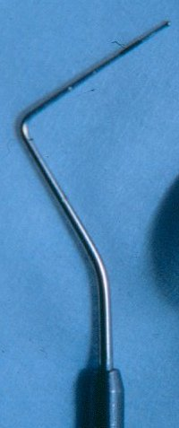
Use of Probe
NOT a diagnostic aid.
Probe is used for:
Removing plaque and debris
Checking for fissure sealants and tooth coloured fillings

Slide 13
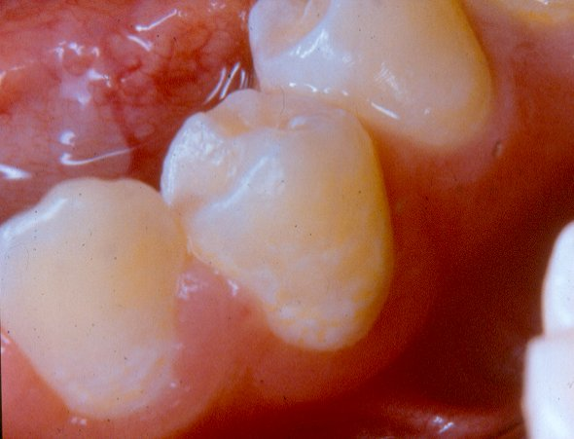
Plaque Removal

Slide 14
Plaque Removal
LL3 and LL4 –buccal surfaces of these teeth covered with plaque
Visibility is obscured
Therefore, plaque should be gently removed with the blunt ball-ended probe.

Slide 15
Caries examination Conventions (1) for surveys of 5 yr olds
To facilitate accurate recording, examine and score teeth in a consistent order
Only deciduous teeth are scored
Missing deciduous incisors are assumed exfoliated and coded Tooth Code 8
Where the permanent incisors have erupted, score as missing deciduous incisors Tooth Code 8

Slide 16
Caries examination Conventions (2)
Carious roots are coded 3 for all surfaces
Caries takes precedence over non-carious defects, e.g. Trauma
The threshold for recording lesions as caries is dentine involvement (d3)

Slide 17
The next set of slides show different tooth and surface conditions and the associated codes used in surveys

Slide 18
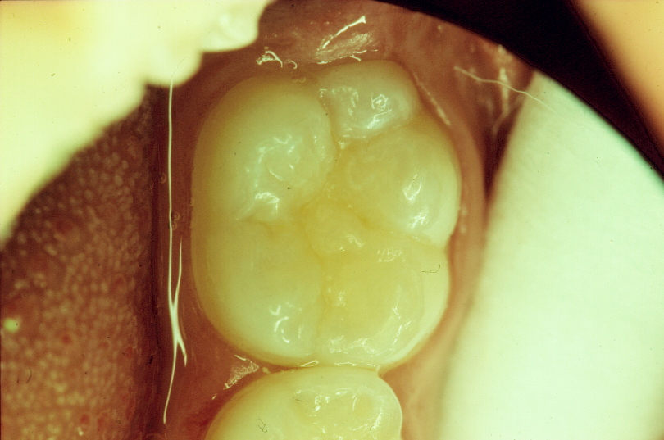
Surface boundaries viewed from occlusal
distal
Junction of buccal & distal surfaces
lingual
buccal
mesial

Slide 19
Surface boundaries viewed from occlusal
Single Surface Filling

Slide 20
Surface boundaries viewed from occlusal
Two Surface Filling

Slide 21
Surface boundaries viewed from occlusal
Three Surface Filling

Slide 22
The next series of slides presents examples of teeth which would be coded as trauma (code T)

Slide 23
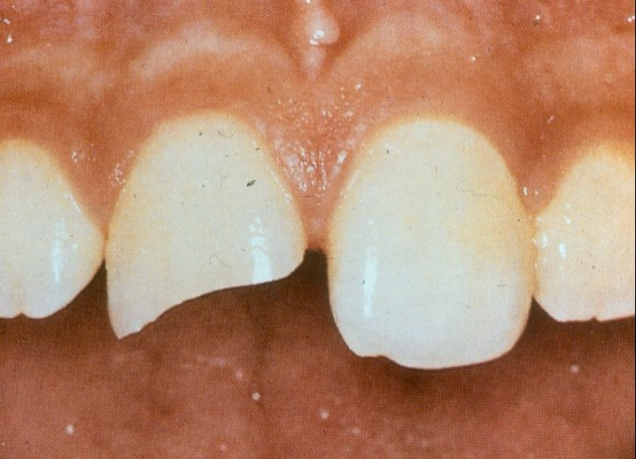
Surface code T – trauma

Slide 24
Surface code T – trauma
UR1 – mesial and buccal surfaces are fractured.
Fracture involves dentine
View from all sides to determine which other surfaces are traumatised
Surface code is T - trauma.
NB. If caries into dentine was also present on these traumatised surfaces, surfaces would be coded for caries as appropriate.

Slide 25
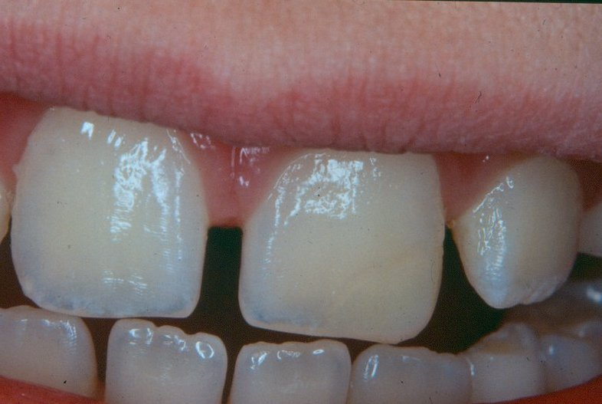
Surface code T – trauma

Slide 26
Surface code T – trauma
UL1 –tooth has been traumatised and repaired
Restoration involves the distal and buccal surfaces.
These surfaces would be coded as T.
NB. Surface code T includes both untreated and treated trauma. Trauma code only used in absence of treated or untreated caries

Slide 27
The next series of slides present examples of teeth which would be coded as sound (code 0)

Slide 28
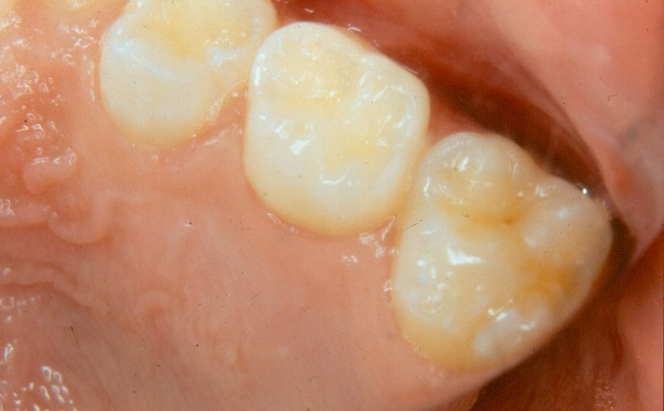
Surface code 0 – present and "sound"

Slide 29
Surface code 0 – present and "sound"
ULE –occlusal surface is sound and is coded as 0.

Slide 30
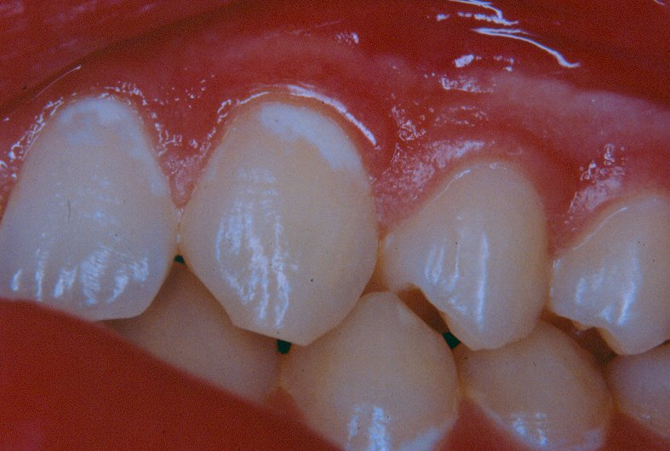
Surface code 0 – present and "sound"

Slide 31
Surface code 0 – present and "sound"
UL2 & UL3 buccal surfaces –white spot lesions in a band around the gingival 3rd
NB. These lesions represent one of the early stages of caries and are excluded from the caries scores, which record at the "caries into dentine" diagnostic threshold, therefore, these surfaces are scored as sound.

Slide 32
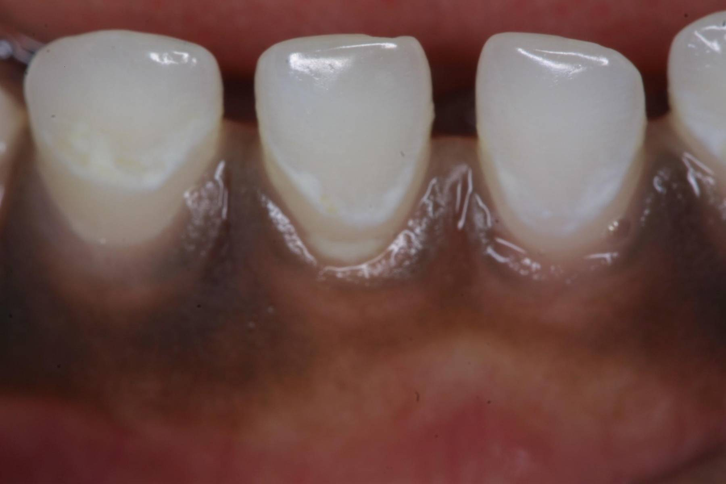
Surface code 0 – present and "sound"

Slide 33
Surface code 0 – present and "sound"
In these deciduous teeth, the demineralised areas probably correspond with plaque coverage at the original gingival margin.

Slide 34
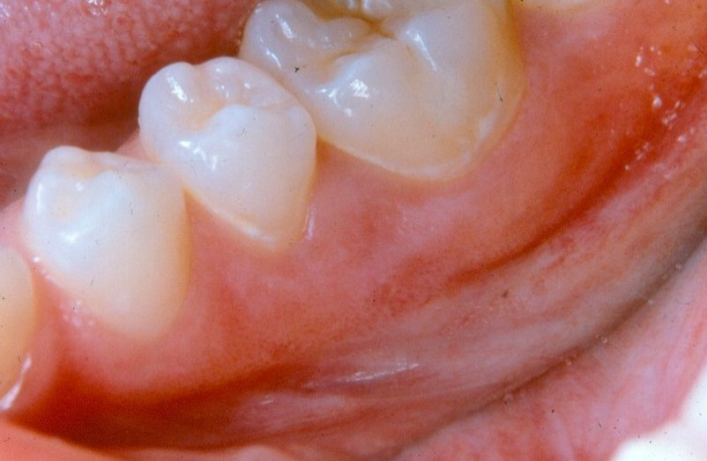
Surface code 0 – present and "sound"

Slide 35
Surface code 0 – present and "sound"
LL5 & LL6 buccal surfaces –white spot lesions around the necks of the teeth giving a band-like appearance.
Surfaces are scored as sound.

Slide 36
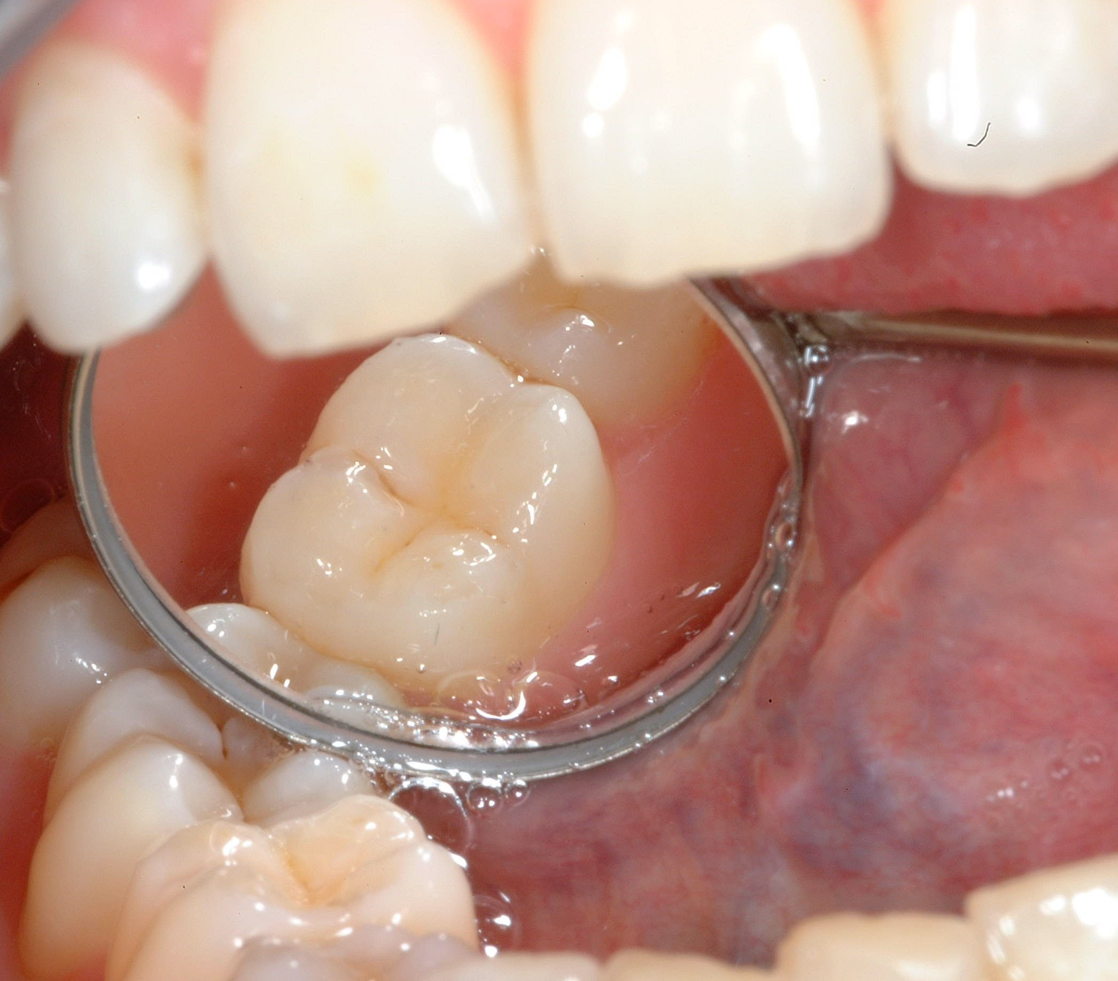
Surface code 0 – present and "sound"

Slide 37
Surface code 0 – present and "sound"
Stained fissure/enamel caries
Stained pits or fissures in the enamel not associated with a carious lesion into dentine are coded as sound.

Slide 38
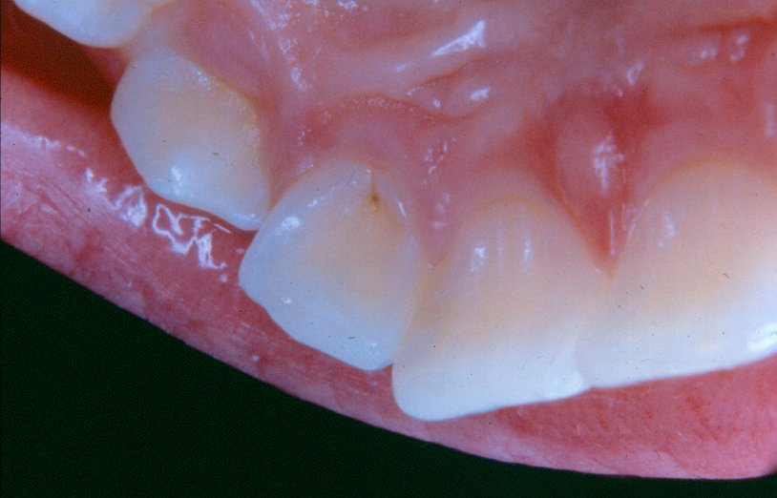
Surface code 0 – present and "sound"

Slide 39
Surface code 0 – present and "sound"
UL2 – lingual surface has stained pit.
No visible evidence of caries into dentine
Surface scored as sound.

Slide 40
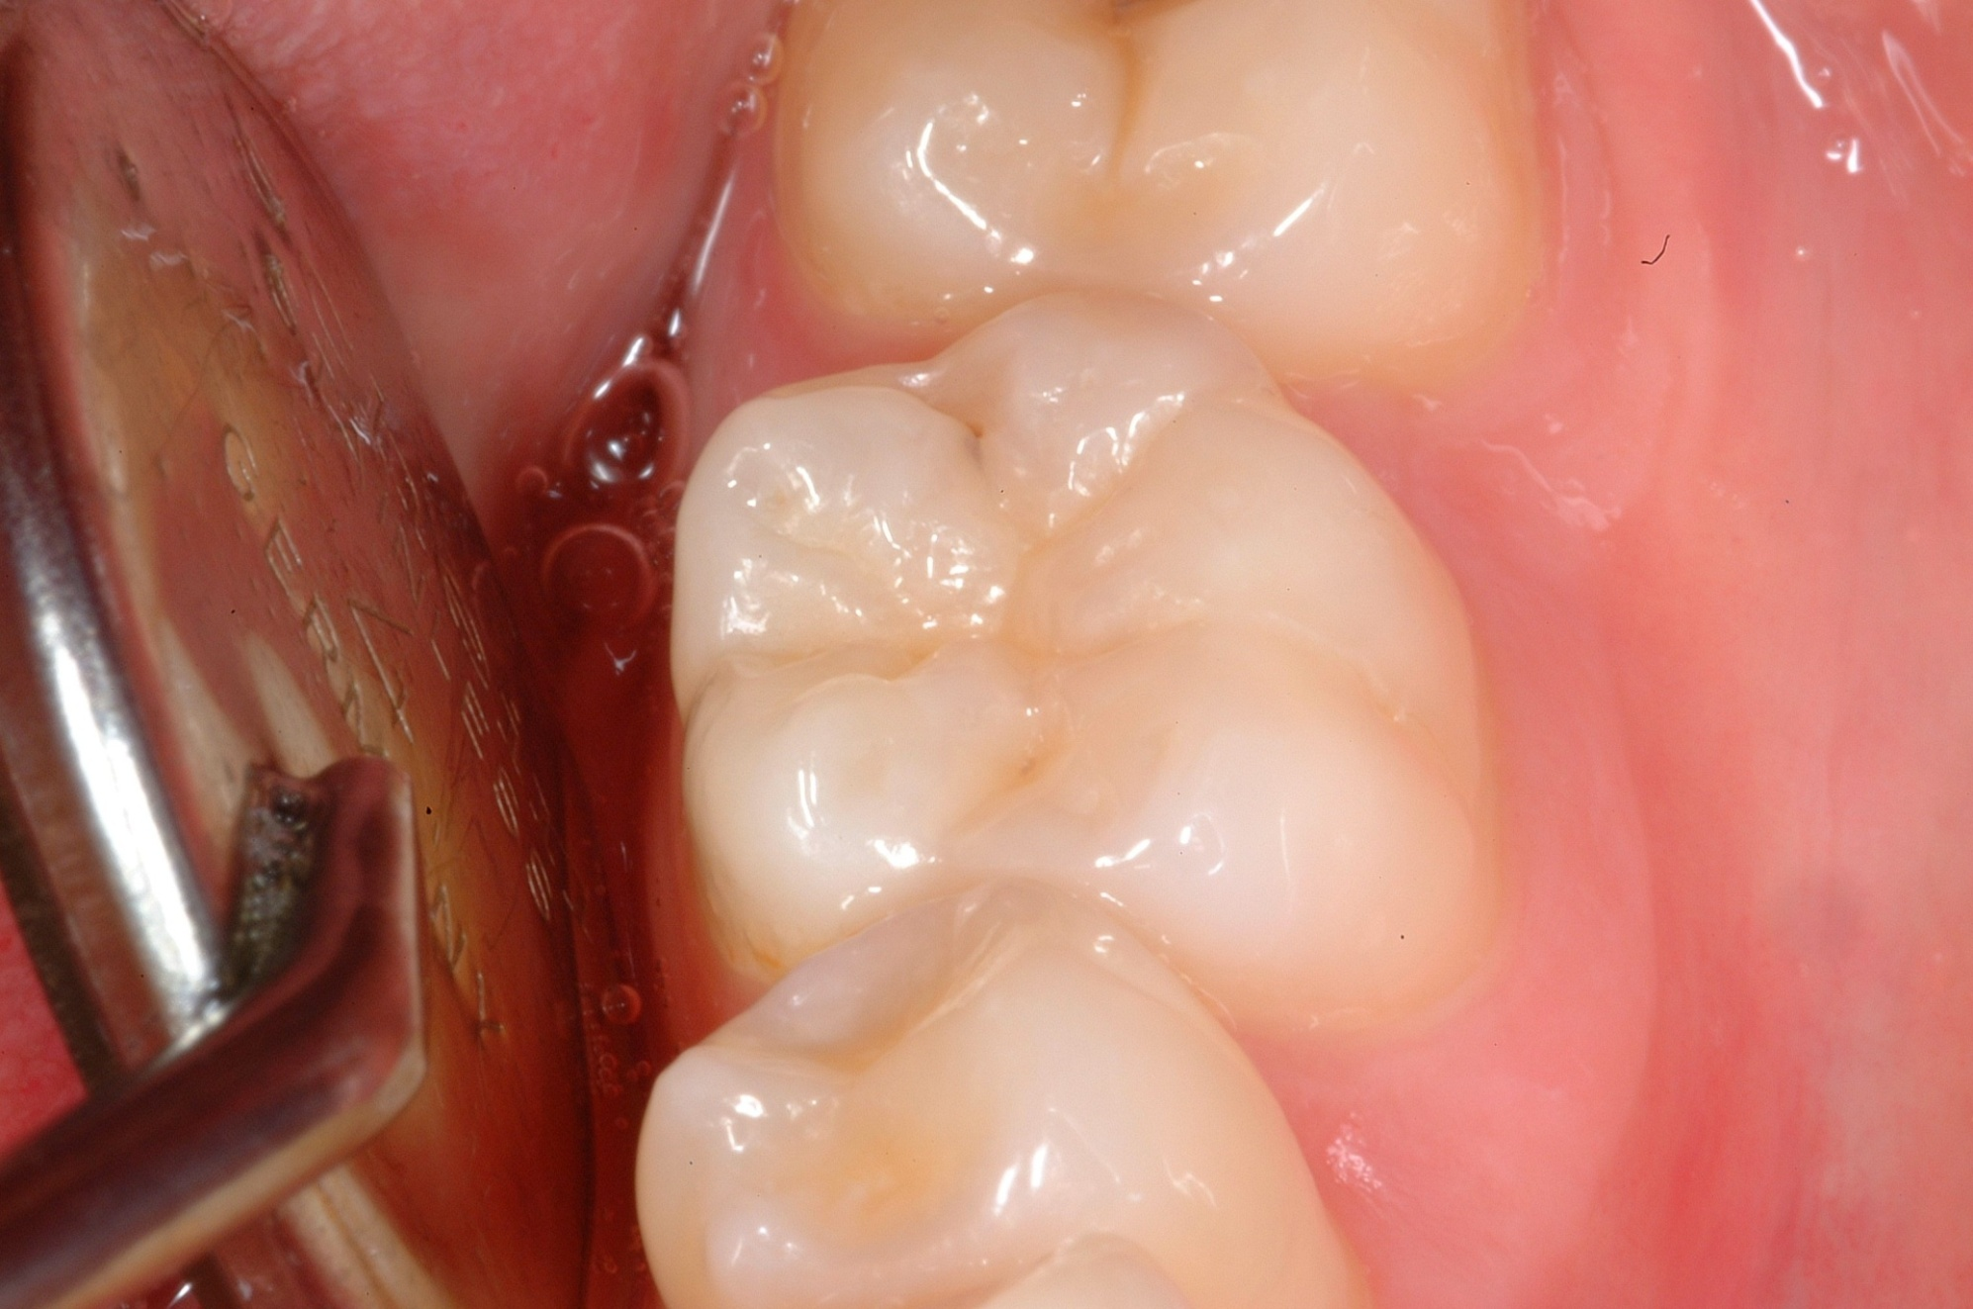
Surface code 0 – present and "sound"

Slide 41
Surface code 0 – present and "sound"
Distal fissure of molar has a small carious lesion in enamel
No visual evidence of dentine involvement
Scored as sound

Slide 42
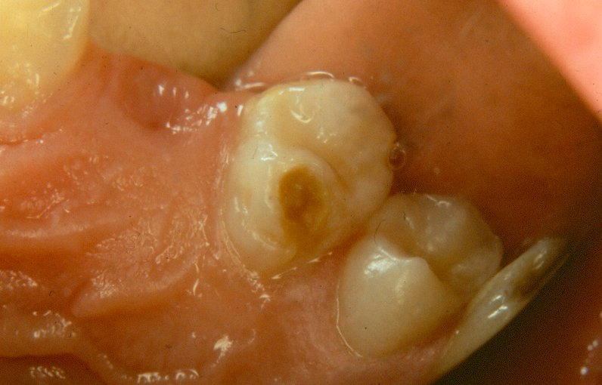
Surface code 0 – present and "sound"

Slide 43
Surface code 0 – present and "sound"
UL4 –lingual surface has enamel loss and an orange/brown lesion.
This is hypoplasia, a developmental defect of the enamel.
Surface is scored sound.

Slide 44
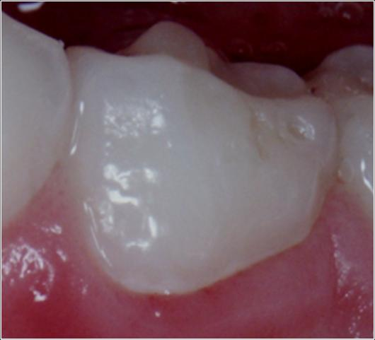
Surface code 0 – present and "sound"

Slide 45
Surface code 0 – present and "sound"
Deciduous molar has a hypoplastic pit on the buccal surface.
This is scored sound.

Slide 46
The next series of slides illustrate surfaces with decay

Slide 47
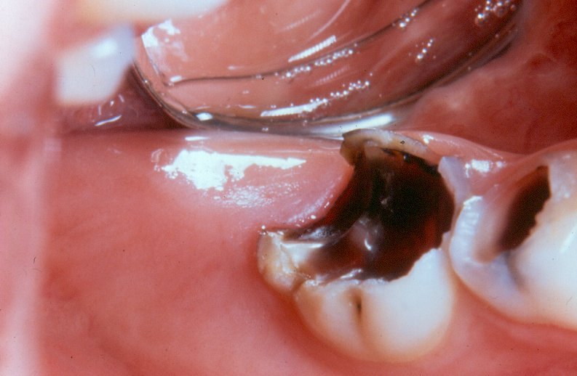
Surface code 1 – arrested dentinal decay

Slide 48
Surface code 1 – arrested dentinal decay
URE –occlusal surface has arrested dentinal caries
Distal, lingual and buccal surfaces would also be coded as 1.

Slide 49
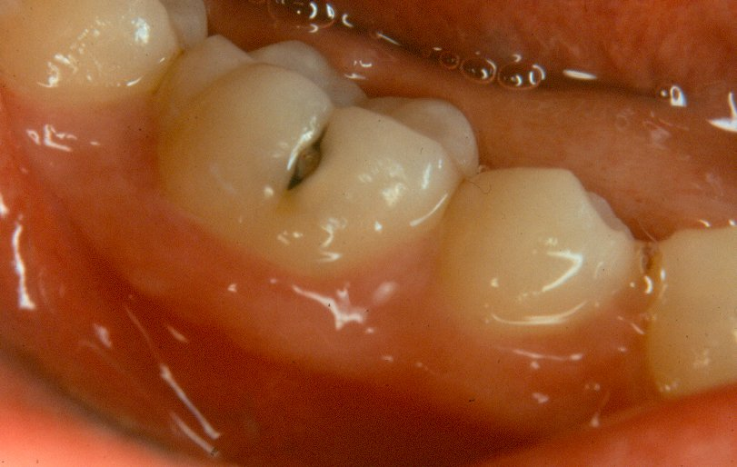
Surface code 2 – decayed into dentine

Slide 50
Surface code 2 – decayed into dentine
LR6 –buccal surface has a visible carious lesion within fissure
Surface is cavitated into dentine
Creamy shadowing beneath enamel (mesial aspect)
Grey shadowing beneath enamel (distal aspect)
Both areas are undermined enamel indicating extent of carious lesion into dentine.

Slide 51
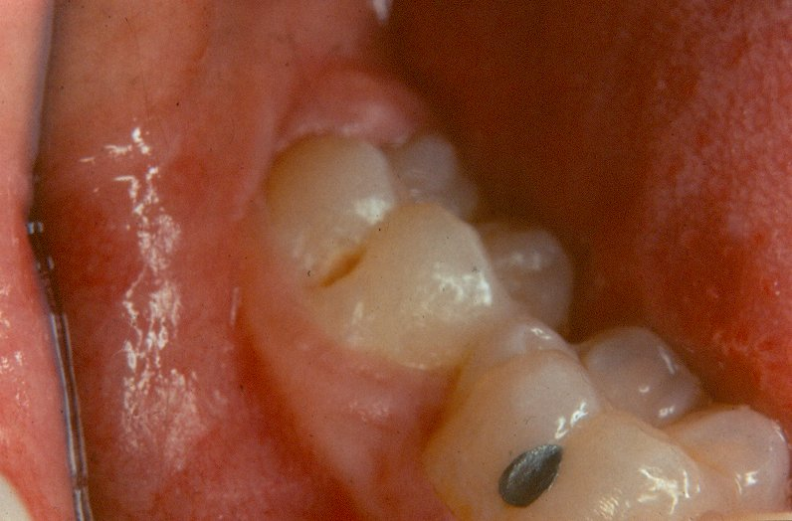
Surface code 2 – decayed into dentine

Slide 52
Surface code 2 – decayed into dentine
LR7 - buccal surface has an oval lesion at the base of the fissure.
Lesion extends into dentine and is coded 2.
LR6 –buccal surface has intact filling in fissure with no decay or loss in adequacy of filling material
This surface would be coded as 5 – filled with no decay

Slide 53
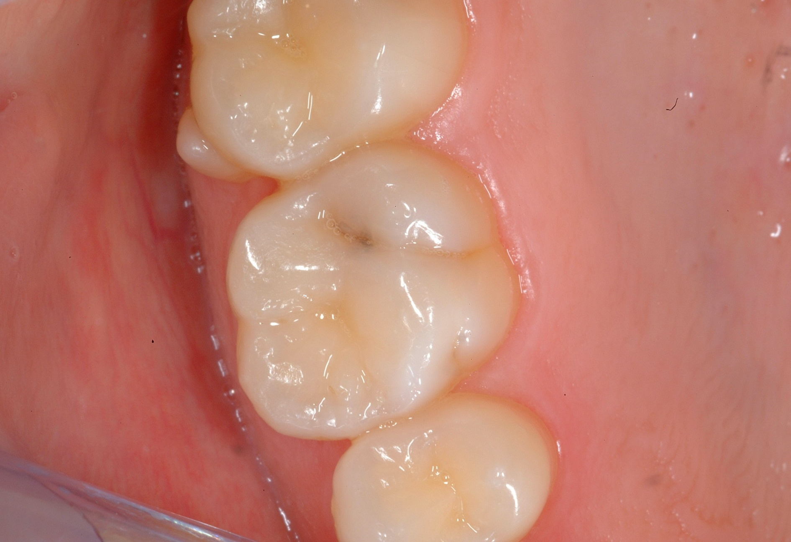
Surface code 2 – decayed into dentine

Slide 54
Surface code 2 – decayed into dentine
Distal fissure has
Break in enamel
Widened fissure
Grey shadow beneath the enamel
Lesion scored as 2 – decayed into dentine

Slide 55
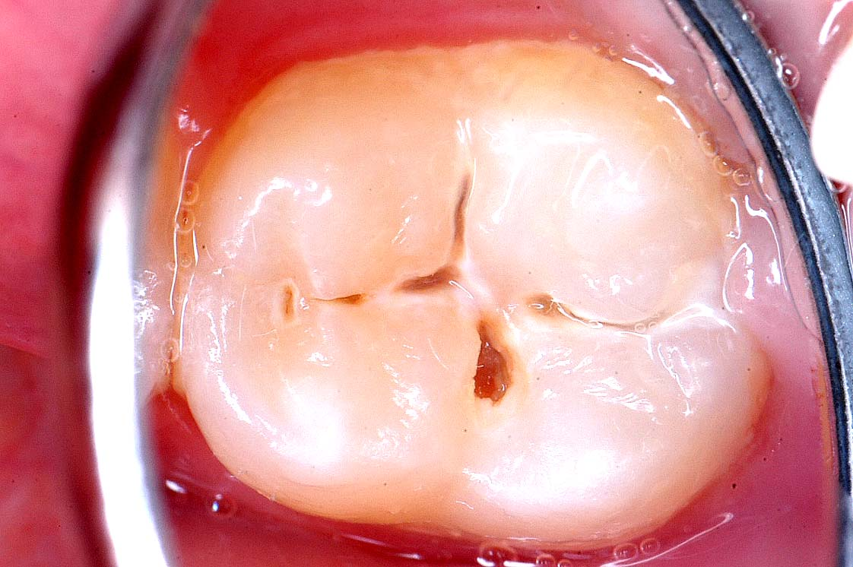
Surface code 2 – decayed into dentine

Slide 56
Surface code 2 – decayed into dentine
Molar has several areas of cavitation extending into dentine

Slide 57
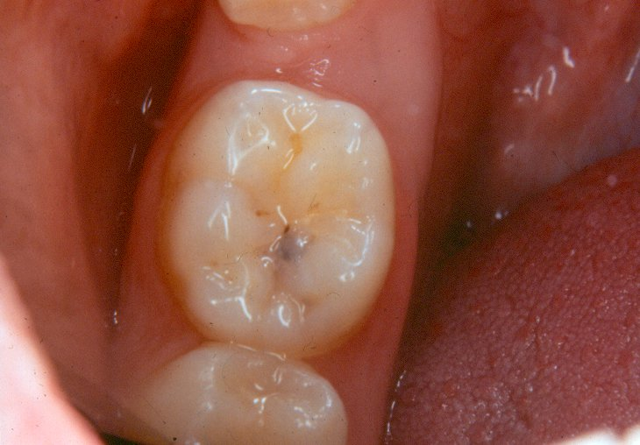
Surface code 2 – decayed into dentine

Slide 58
Surface code 2 – decayed into dentine
LL6 –occlusal surface has no evident cavitation but has grey shadow beneath the enamel
This lesion would be scored as code 2 – decayed.

Slide 59
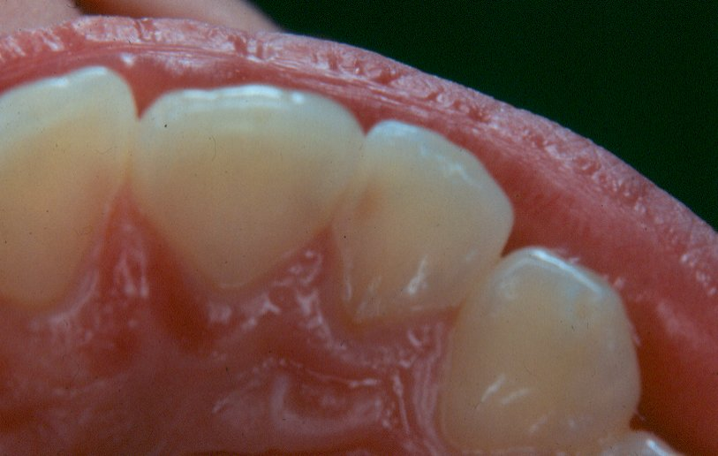
Surface code 2 – decayed into dentine

Slide 60
Surface code 2 – decayed into dentine
UL2 mesial surface –dark shadow beneath the enamel
Shadowing continues beyond the ADJ and into the dentine
This surface would be coded as 2.

Slide 61
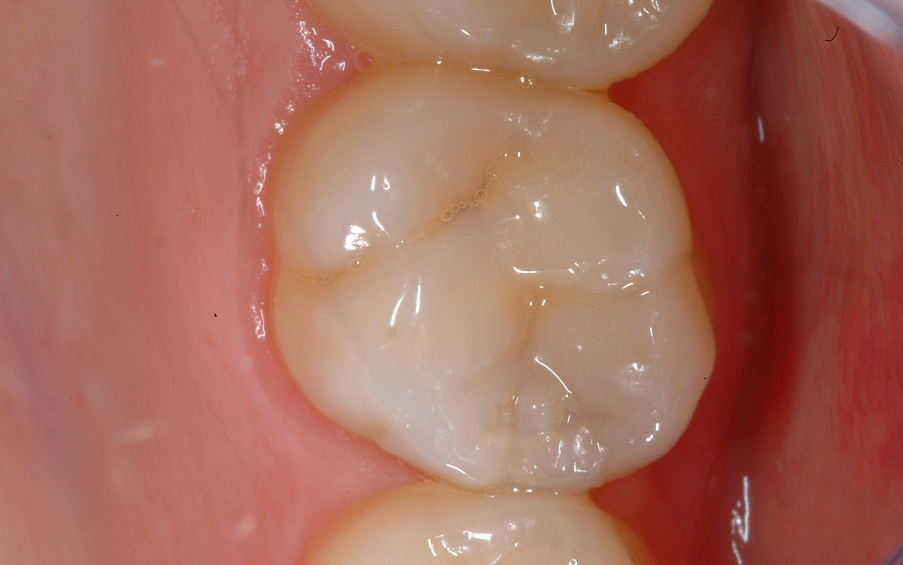
Surface code 2 – decayed into dentine - discuss

Slide 62
Surface code 2 – decayed into dentine - Discuss
Surface needs to be dried
Grey opacity beneath the mesial marginal ridge
Creamy opacity along ADJ
Appears to be caries into dentine
Occlusal and mesial surfaces both scored 2

Slide 63
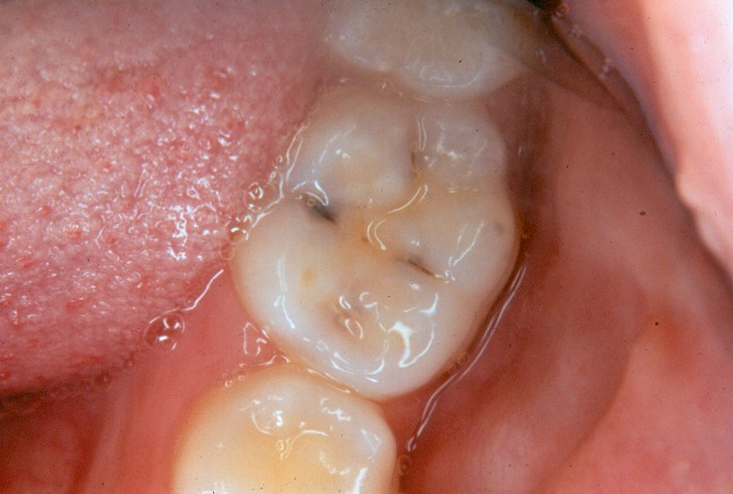
Surface code 2 – decayed into dentine

Slide 64
Surface code 2 – decayed into dentine
NB Surface is covered with saliva which can make diagnosis more difficult. Examiners are encouraged to dry surfaces with gauze, cotton wool rolls or cotton wool buds when visibility is obscured.

Slide 65
Surface code 2 – decayed into dentine
LL6 occlusal surface –lingual aspect has deeply stained fissure and dark shadowing beneath the enamel.
Mesial and distal aspects of the occlusal surface have lesions with cream and grey shadows beneath the enamel surface.
Surface would be coded as caries into dentine code 2
Smaller lesion into dentine also present on buccal aspect of the occlusal surface.

Slide 66
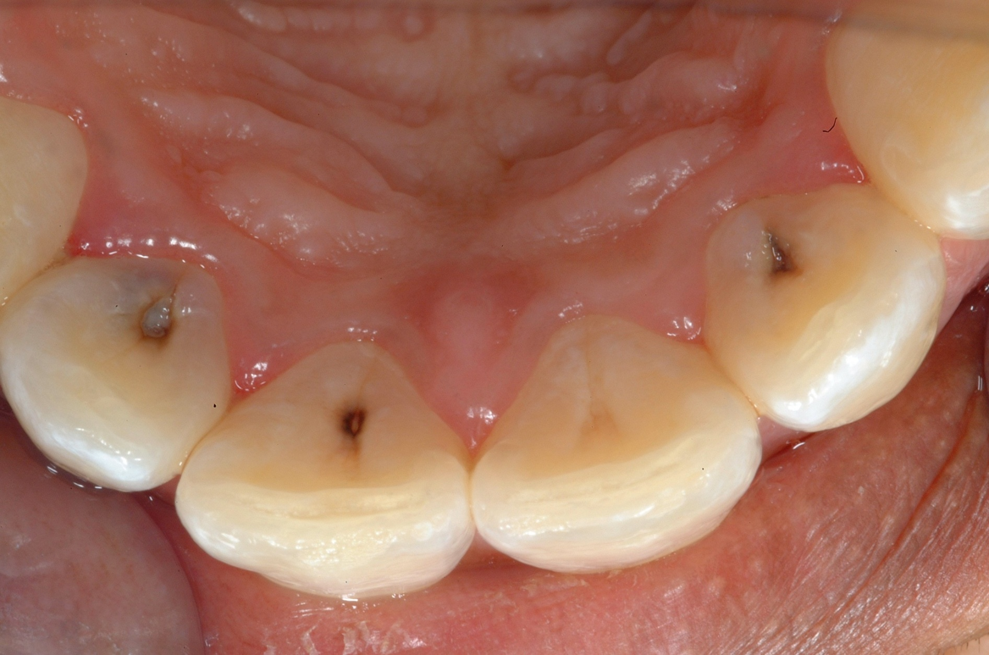
Surface code 2 – decayed into dentine

Slide 67
Surface code 2 – decayed into dentine
Carious lesions involving dentine on lingual surfaces of upper lateral incisors
Upper left central incisor has heavily stained pit
No apparent break in enamel of UL1, no opacities beneath enamel which are present in lesions on laterals

Slide 68
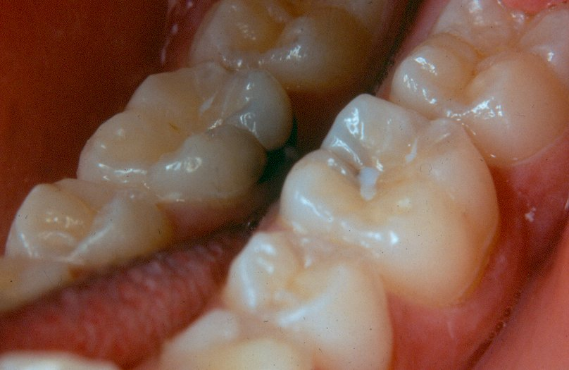
Surface code 2 – decayed into dentine

Slide 69
Surface code 2 – decayed into dentine
LL6 lingual and occlusal surfaces – look at lingual surface in mirror view first
Large carious lesion within the gingival 3rd extending around base of lingual surface
Presents as dark lesion cavitated into dentine with large associated area of grey shadowing beneath the enamel
Continued on next slide

Slide 70
Surface code 2 – decayed into dentine
Grey shadowing extends to involve the occlusal surface.
Occlusal surface has remnants of fissure sealant, but caries takes precedence and both lingual and occlusal scored as code 2.

Slide 71
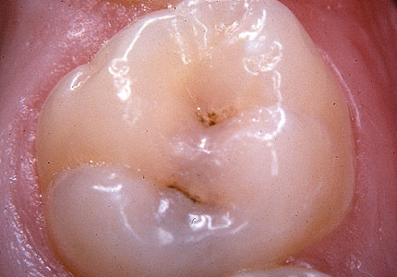
Surface code 2 – decayed into dentine

Slide 72
Surface code 2 – decayed into dentine
On the occlusal surface there is a grey shadow extending across into the distal
Both surfaces scored as code 2

Slide 73
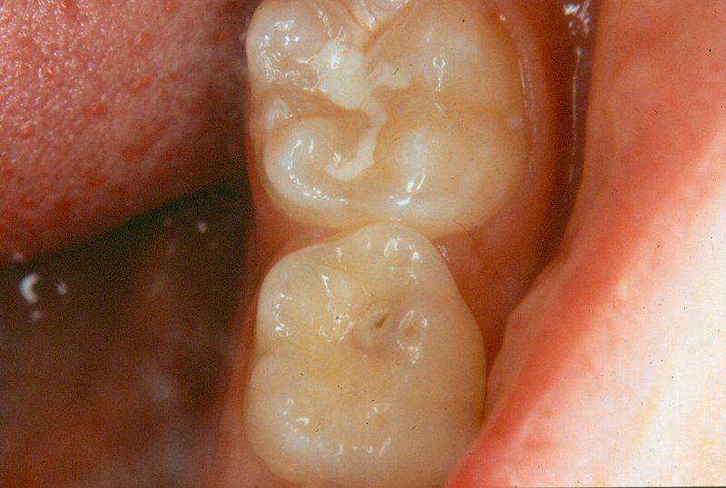
Surface code 2 – decayed into dentine

Slide 74
Surface code 2 – decayed into dentine
LLE –occlusal surface has a carious lesion into dentine
Lesion presents with small cavitated area in the centre surrounded by cream and grey shadowing beneath the enamel
Note that the tip of the cusp is worn and this would be regarded as normal.
Continued on next slide

Slide 75
Surface code 2 – decayed into dentine
LL6 – occlusal surface has a fissure sealant in place
Sealant is incomplete in that the distal part of the fissure is un-sealed.
However, as no caries into dentine or fillings are present, this surface would be coded as "$ - sealed surface, type unknown"

Slide 76
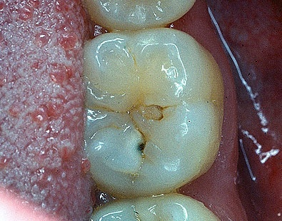
Surface code 2 – decayed into dentine

Slide 77
Surface code 2 – decayed into dentine
LL6 occlusal surface has a break in the enamel extending into dentine and a creamy shadowing
Occlusal code 2

Slide 78
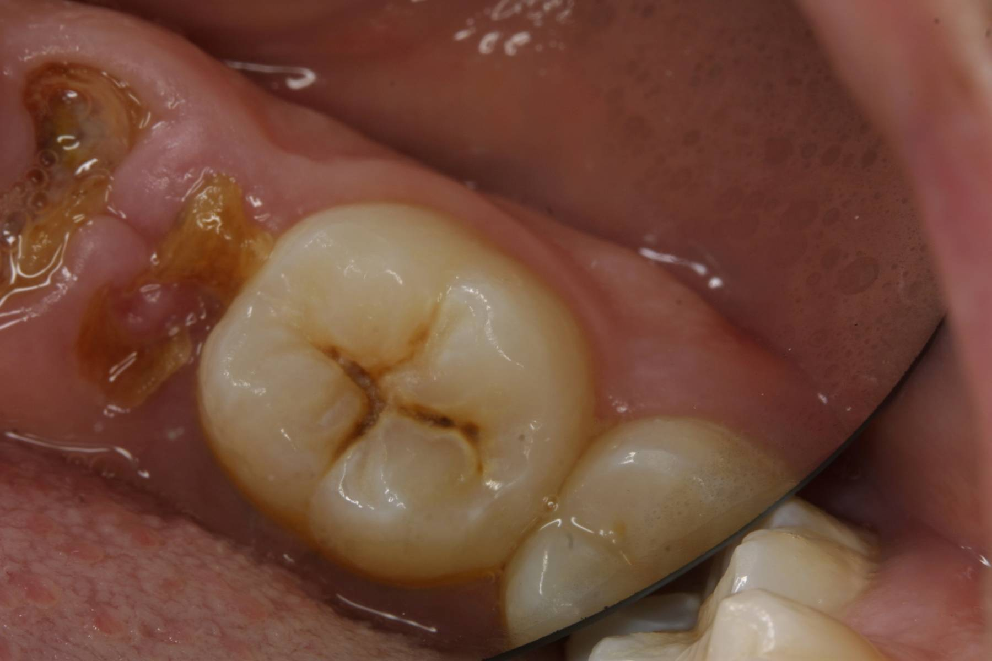
Surface code 2 – decayed into dentine

Slide 79
Surface code 2 – decayed into dentine
LLE is retained roots
LL6 has fissures which are widened due to carious breakdown
Occlusal scored 2

Slide 80
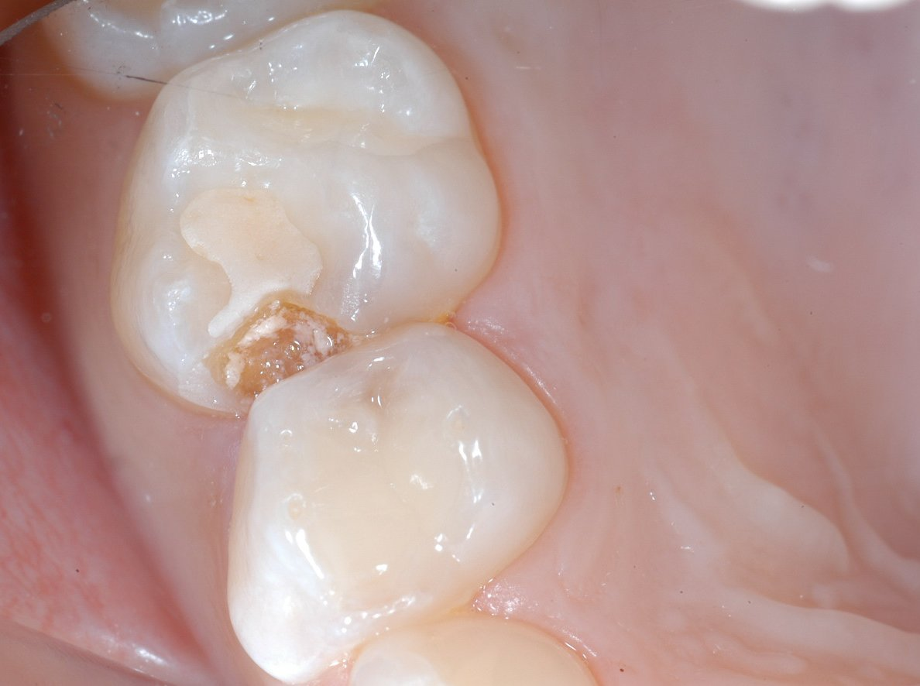
Surface code 2 – decayed into dentine

Slide 81
Surface code 2 – decayed into dentine
URE - glass ionomer material on the occlusal surface
fissure sealant + large carious lesion into dentine
occlusal and mesial both code 2 - decayed
URD has grey shadow within distal surface, dry and check before coding

Slide 82
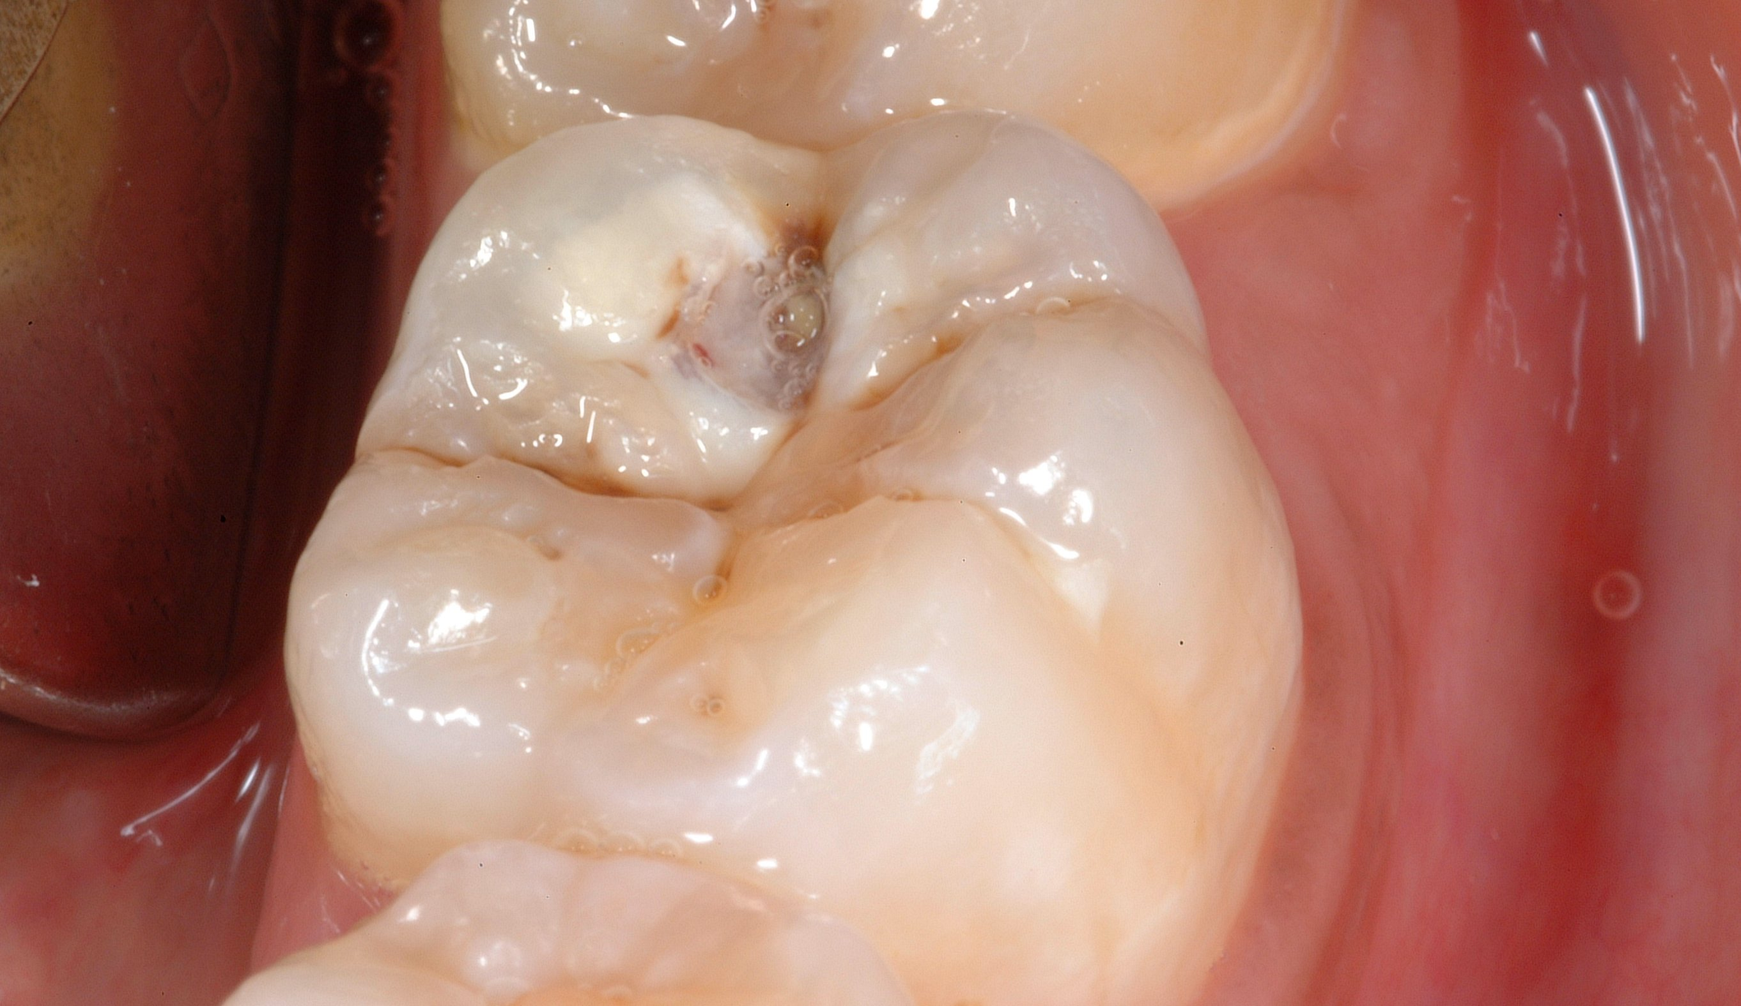
Surface code 2 into dentine OR code 3 decay with pulpal involvement ?- Discuss

Slide 83
Surface code 2 into dentine OR code 3 decay with pulpal involvement? - Discuss
Very large carious lesion into dentine
Large area of cavitation
Creamy opacity on lingual occlusal aspect
Grey shadowing involving most of disto-buccal cusp

Slide 84
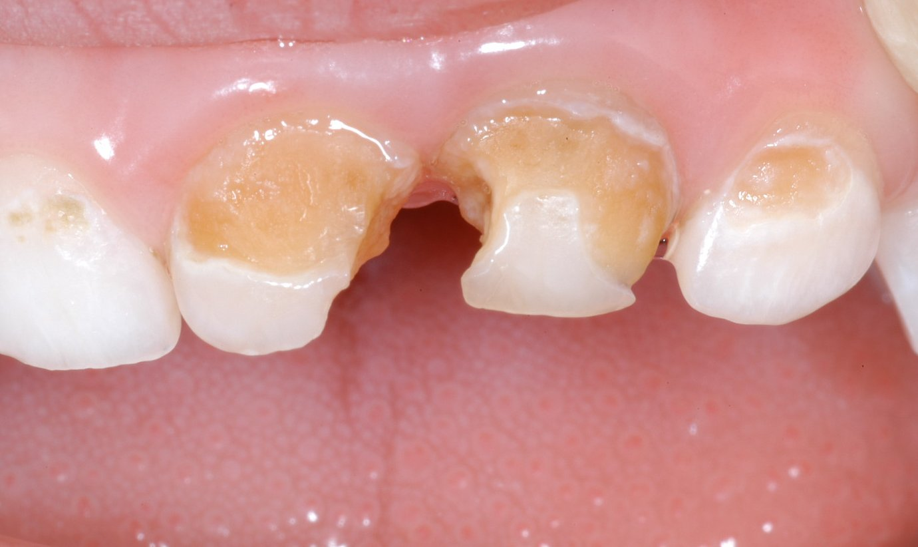
Surface code 3 – decay with pulpal involvement

Slide 85
Surface code 3 – decay with pulpal involvement
Upper anterior deciduous teeth decayed into dentine
Mesial surfaces of central incisors likely to be decayed with pulpal involvement, Code 3

Slide 86
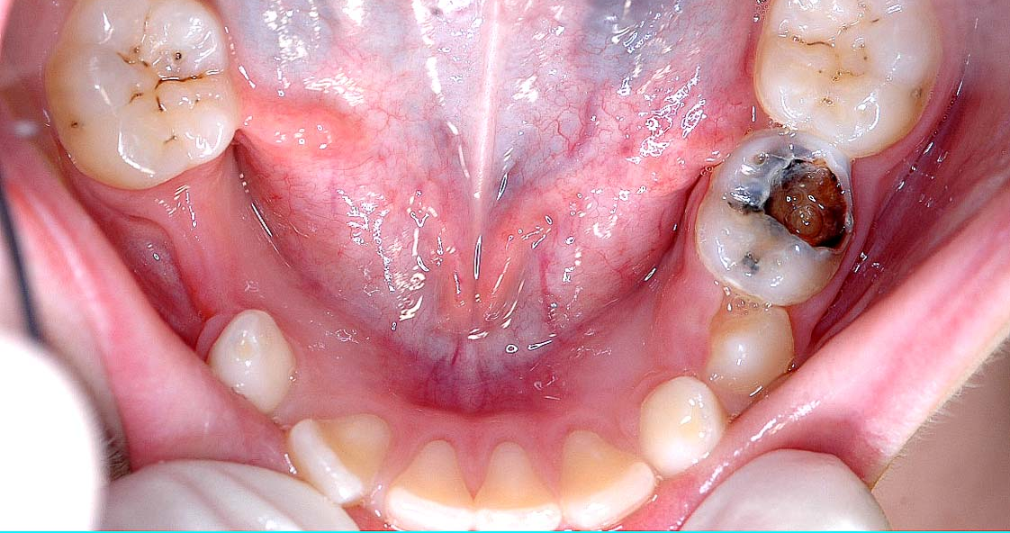
Surface code 3 – decay with pulpal involvement

Slide 87
Surface code 3 – decay with pulpal involvement
LLE is extensively decayed
Occlusal, buccal and distal code 3

Slide 88
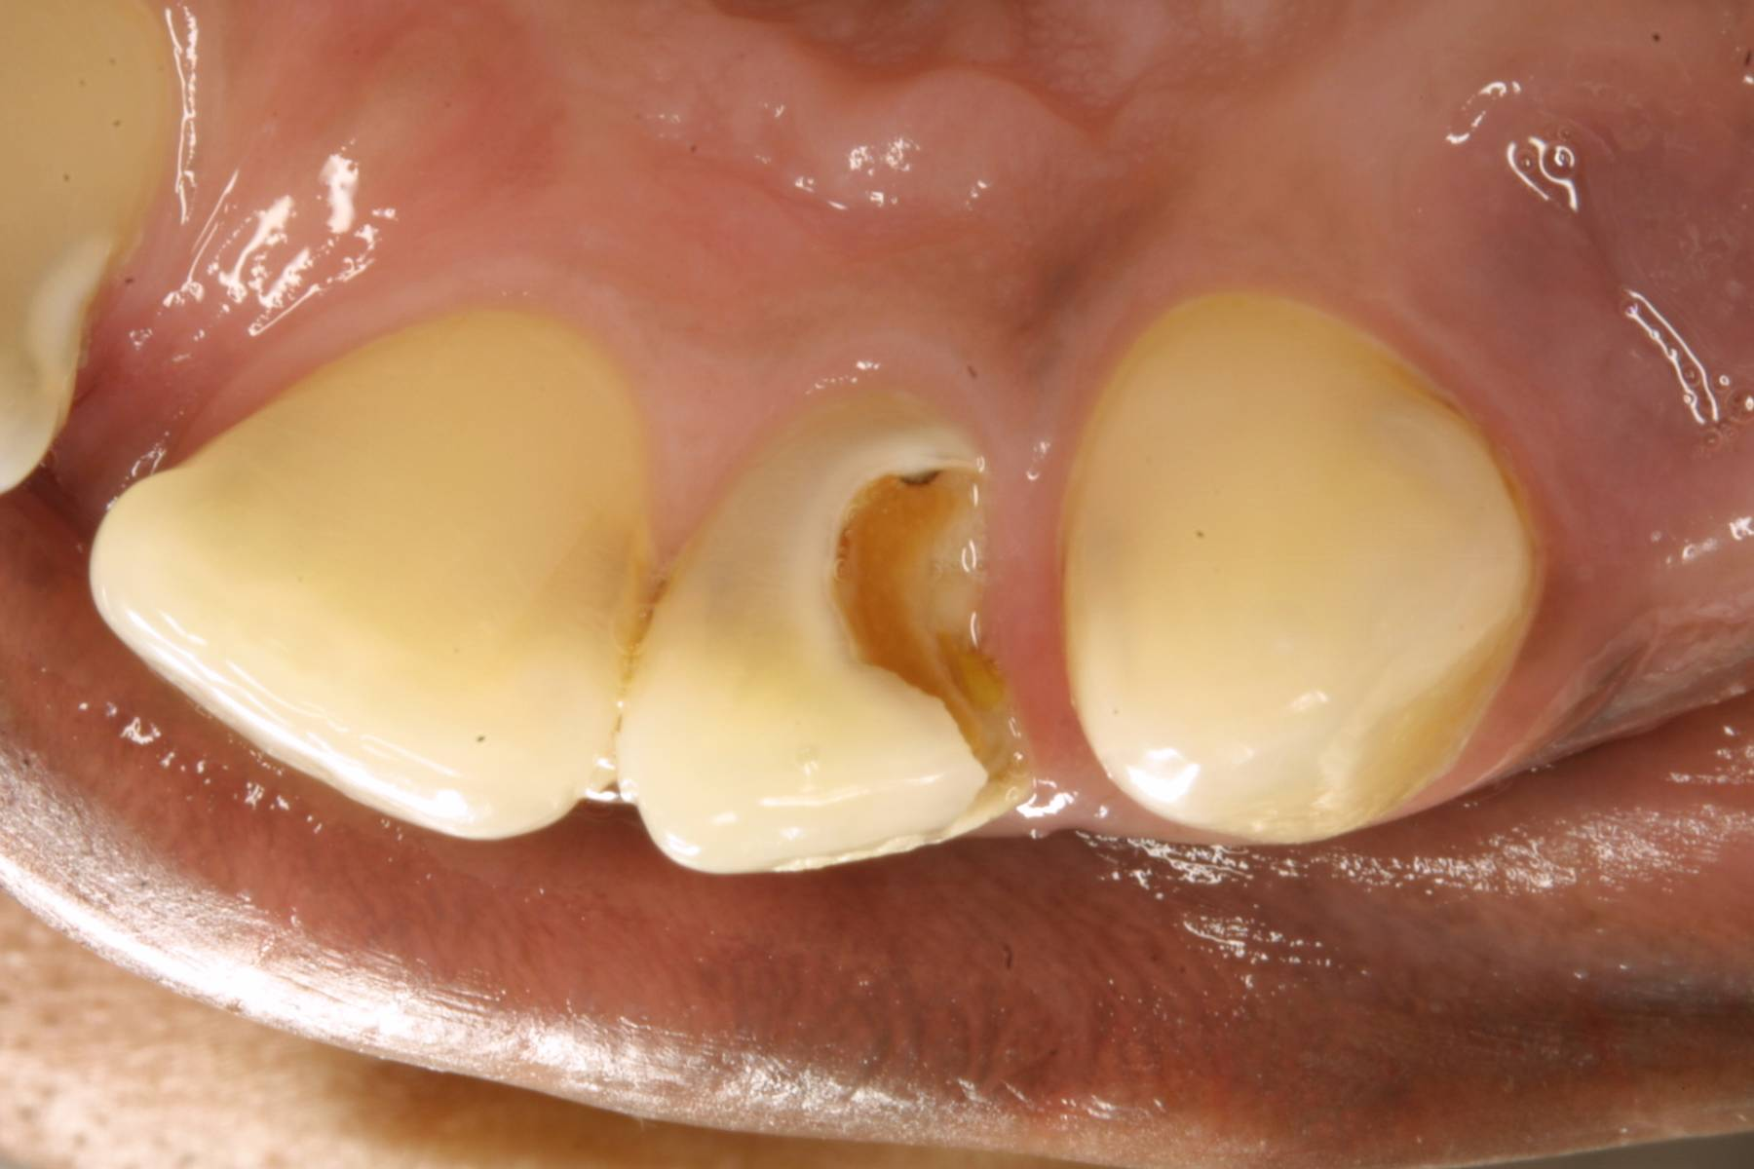
Surface code 3 – decay with pulpal involvement

Slide 89
Surface code 3 – decay with pulpal involvement
UR2 has a large carious lesion on the lingual and distal surfaces, code 3
Caries into dentine is present on adjacent teeth

Slide 90
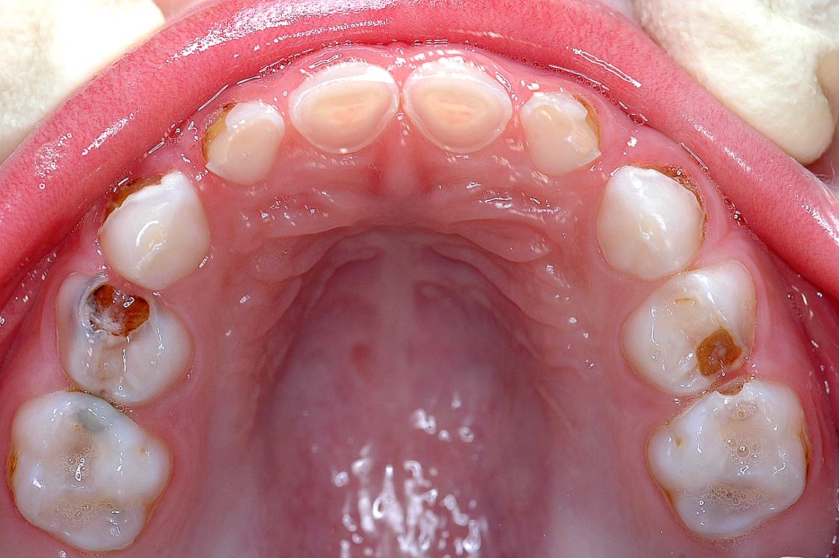
Surface code 3 – decay with pulpal involvement

Slide 91
Surface code 3 – decay with pulpal involvement
URD occlusal and mesial code 3
Discuss the many carious lesions on other teeth

Slide 92
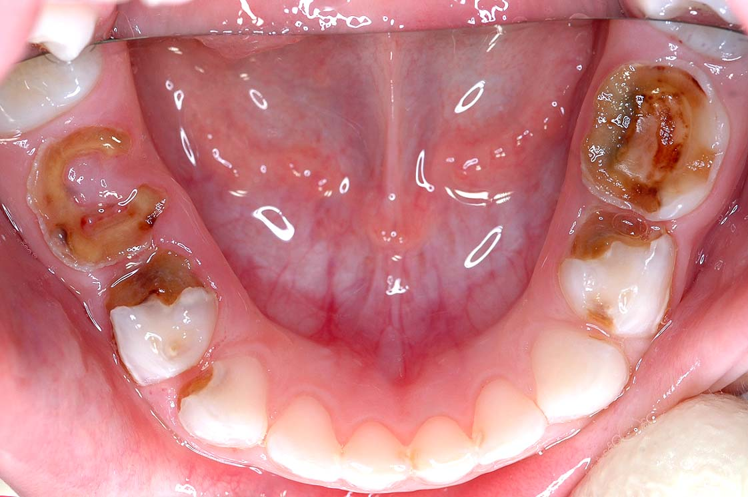
Surface code 3 – decay with pulpal involvement

Slide 93
Surface code 3 – decay with pulpal involvement
Lower molars all have lesions with pulpal involvement
Several lower incisors have approximal caries

Slide 94
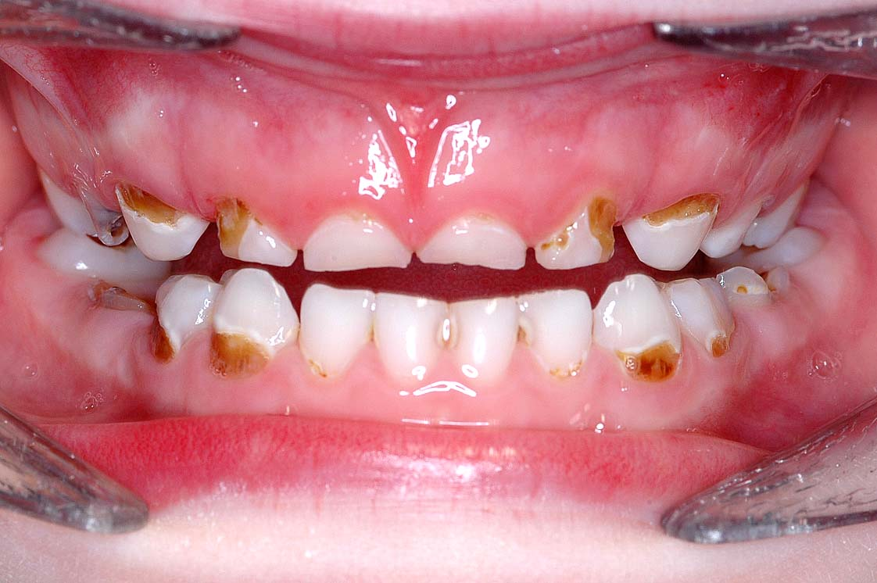
Surface code 3 – decay with pulpal involvement

Slide 95
Surface code 3 – decay with pulpal involvement
Crown of LRE is decayed to gingival margin
All other teeth (except upper As) have carious lesions into dentine

Slide 96
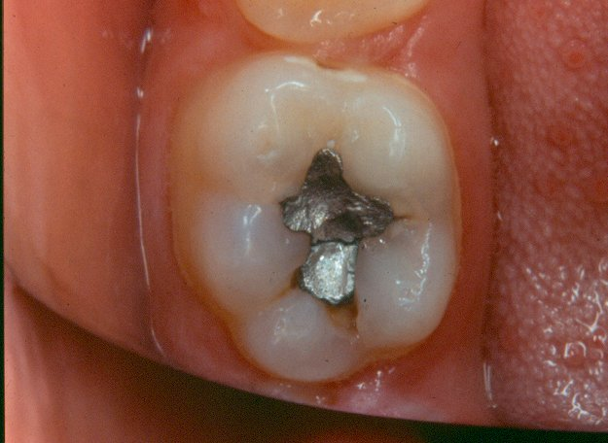
Surface code 4 – filled and decayed

Slide 97
Surface code 4 – filled and decayed
LL6 occlusal surface has been restored with amalgam which is fractured
There are 4 separate areas of secondary caries, i.e. caries associated with the filling.
Two of the carious areas are in the distal and disto-buccal parts of the fissure and are characterised by cavitation into dentine.
Continued on next slide

Slide 98
Surface code 4 – filled and decayed
Lingual aspect of occlusal surface has caries associated with the filling
This stained fissure has creamy shadowing beneath the enamel
Buccal aspect of occlusal filling has a cavitated area of secondary caries.
Surface is coded 4 – filled and decayed.
NB. If no caries was present and this filling presented with the complete fracture, the surface would have been coded R, which is filled needs replacing.

Slide 99
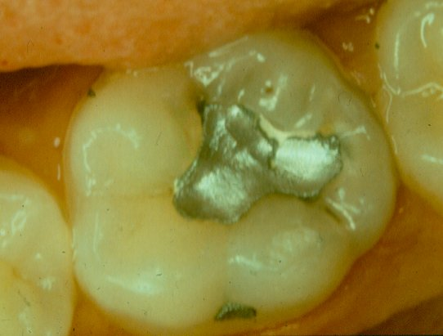
Surface code 4 – filled and decayed

Slide 100
Surface code 4 – filled and decayed
LL6 –occlusal surface is filled with amalgam.
Amalgam is chipped and fractured to expose the cement lining.
Lingual aspect of occlusal surface has creamy shadowing adjacent to the lost amalgam
Secondary caries associated with the filling – code 4

Slide 101
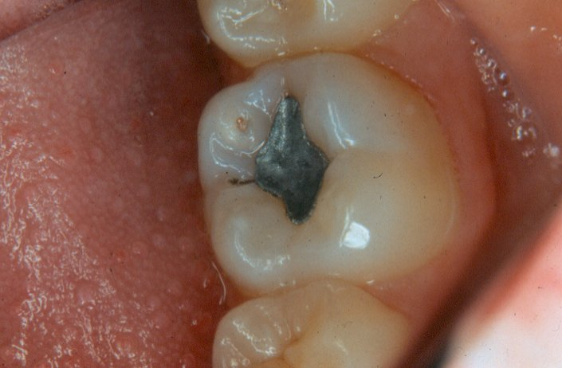
Surface code 4 – filled and decayed

Slide 102
Surface code 4 – filled and decayed
LL6 –occlusal surface has an amalgam filling
Filling is intact and there has been a separate second attack of caries on this surface
There is a small cavitated area with a cream shadow beneath the enamel indicating the extent of the lesion into dentine
Surface will be coded 4 – filled and decayed

Slide 103
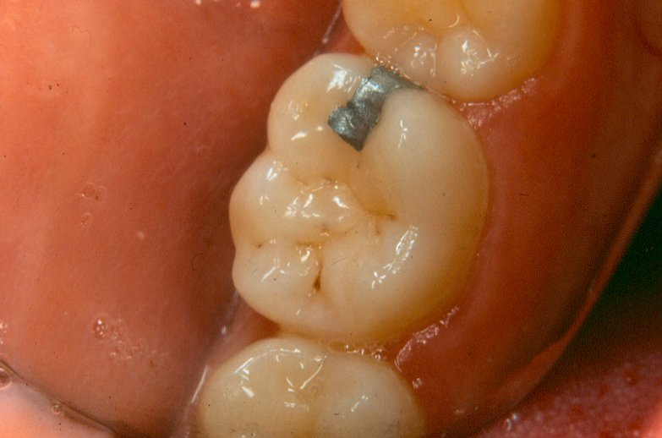
Surface code 5 – filled with no decay

Slide 104
Surface code 5 – filled with no decay
LL6 –amalgam filling on the mesial and occlusal surfaces
Filling is intact and there is no evidence of secondary caries.
Occlusal fissure system has areas of staining only.

Slide 105
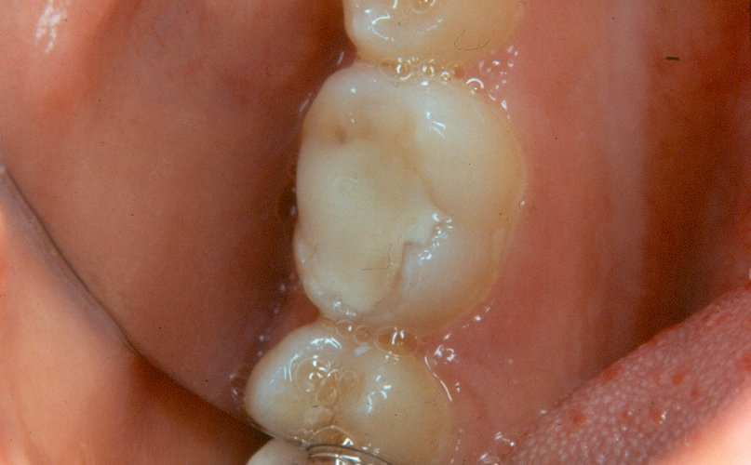
Surface code 5 – filled with no decay

Slide 106
Surface code 5 – filled with no decay
LR6 –occlusal surface has a conventional tooth coloured filling.
No evidence of decay and filling appears intact.
Occlusal surface will be coded 5.
Filling extends on to buccal surface but from this view, no judgement could be made as to the state of the filling and this surface would need to be viewed and scored separately.

Slide 107
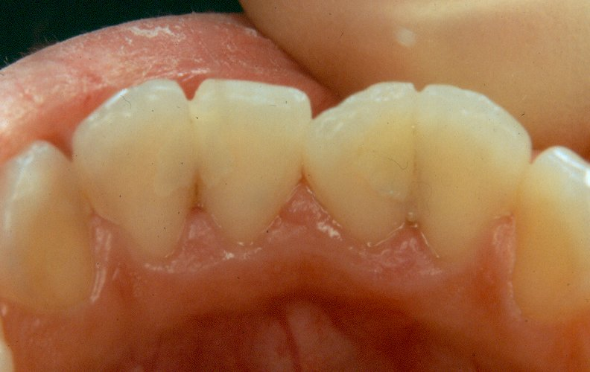
Surface code 5 – filled with no decay

Slide 108
Surface code 5 – filled with no decay
LR2, LR1, LL1 & LL2 – several intact tooth coloured fillings are present
e.g. mesial of LL2, distal of the LL1, distal of the LR1.
NB This slide should be used to emphasise the need for a careful systematic examination to avoid missing tooth coloured fillings and the call of “3 to 3 all surfaces sound” should be discouraged.

Slide 109
Surface code R – filled, needs replacing (not carious)
A filled surface which is judged to need replacing (not carious) is recorded as code R
Temporary dressings, with no decay into dentine present, are recorded as code R
Temporary dressings, with decay into dentine present, are recorded as code 4, filled and decayed

Slide 110
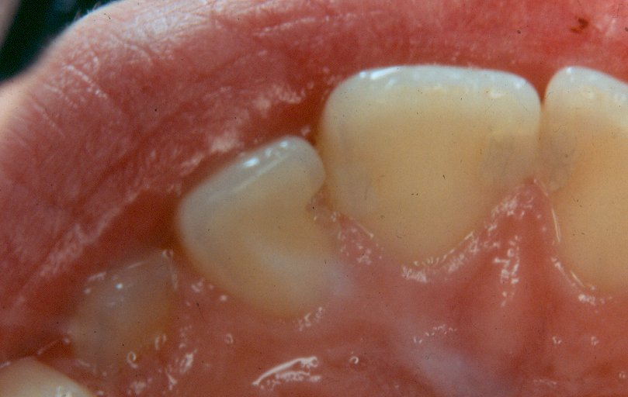
Surface code R – filled, needs replacing (not carious)

Slide 111
Surface code R – filled, needs replacing (not carious)
UR2 –mesial surface has had a filling which is completely lost
This is the most extreme form of a “defective” filling and would be scored as code R.
Additional features on this slide:
UR3 – all surfaces coded as sound.
UR1 – has a composite restoration on mesial surface -careful examination is needed to avoid missing these restorations.

Slide 112
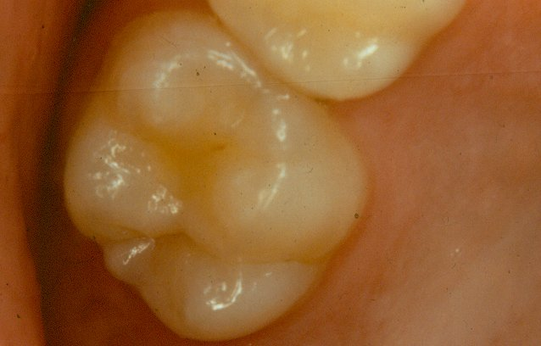
Surface code $ - sealed surface, type unknown

Slide 113
Surface code $ - sealed surface, type unknown
UR6 –anterior part of the occlusal fissure has been sealed with a tinted sealant
Surface would be coded $
Sealant appears to be lost from the posterior occlusal fissure.
NB Sealants can be difficult to distinguish from enamel and diagnosis may be aided by the use of drying and/or tactile use of the ball-ended probe.

Slide 114
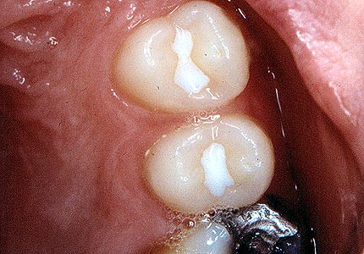
Surface code $ - sealed surface, type unknown

Slide 115
Surface code $ - sealed surface, type unknown
UL4 &UL5 –occlusal surfaces have been sealed
Surfaces would be scored $
It is impossible to be certain from a visual examination that no caries was removed before placement of the sealant.
However, there is no evidence of a defined cavity margin and therefore, the surfaces are coded $.

Slide 116
Surface code $ - sealed surface, type unknown

Slide 117
Surface code $ - sealed surface, type unknown
UL6 –occlusal surface would be scored as $ because there is evidence of a sealant in part of the anterior fissure
In the distal part of the occlusal fissure, staining is evident
However, there is no evidence of caries into dentine and occlusal surface would therefore be scored as $.

Slide 118
Surface code N – obvious sealant restoration

Slide 119
Surface code N – obvious sealant restoration
LL6 –occlusal surface has a sealant restoration
Anterior part of occlusal fissure has a tooth coloured filling material which has been placed and there is evidence of a defined cavity margin.
The rest of the fissure system is sealed.
NB Mesial surface has a carious lesion into dentine and would be scored as 2. Lesion presents as cream shadow beneath the enamel extending from the marginal ridge. Physical cavitation can be seen at base of lesion on the mesial aspect.

Slide 120
Code C, crown
Crowned teeth are scored all surfaces code C
A deciduous tooth covered with a stainless steel crown is recorded as all surfaces Code C, not Code 5

Slide 121
Sepsis
Following the caries exam, check for sepsis
If an abscess or sinus is present - code 1
If no abscess or sinus present – code 0
All sepsis must be recorded regardless of cause. No attempt will be made to identify the cause of the infection.

Slide 122
Example of sepsis
This slide shows an abscess above the deciduous incisor.
This is scored positively for sepsis.

Slide 123
The examination completed

Slide 124
The examination completed
Please remember that at the end of every diagnostic decision on every tooth is a child
Call the child by their name, thank the child and as the examination is completed, talk to the child until the next examiner is ready

