Slide 1
What you see depends on the spectacles you wear.
David Taylor
dcmt@liv.ac.uk
http://www.liv.ac.uk/~dcmt

Slide 2
Quantitative or qualitative?
How do you choose?
Personal preference/comfort
World view

Slide 3
World view
If you think there is always an objective truth then
Either use quantitative research
Or qualitative research that gives clear answers
In Moses and Knutsen’s view (2007) this is “naturalism”
If you are looking for a more subjective understanding –where the answer depends upon the circumstances then you are more likely to be drawn towards qualitative methodology.
In Moses and Knutsen’s view (2007) this is “constructivism”

Slide 4
But
The true picture is probably only understood when both are used.
This is partly to do with overview and
partly to do with detail.

Slide 5
Student expectations
Started off with Focus groups
To identify the items of interest from school leavers, mature students and overseas students
The did a Q-sort of the items with 20 individuals
Then designed a Likert-style questionnaire including the most popular/controversial ideas
Delivered to all students in the first year cohort.

Slide 6
Q-sort

Slide 7
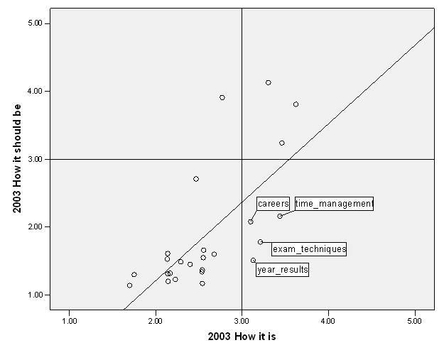
Several ways to look at the data

Slide 8
Professionalism
Started off with focus groups
Thematically coded the answers
Designed a Q-sort delivered to students in years 1,3 and 5.
Did a factor analysis on the results
Identified the three main domains
Designed a questionnaire for self-evaluation

Slide 9
Face validity, construct validity

Slide 10
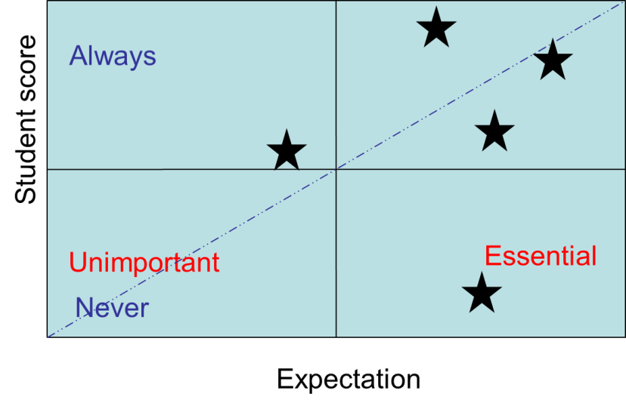
Factor analysis and instrument

Slide 11
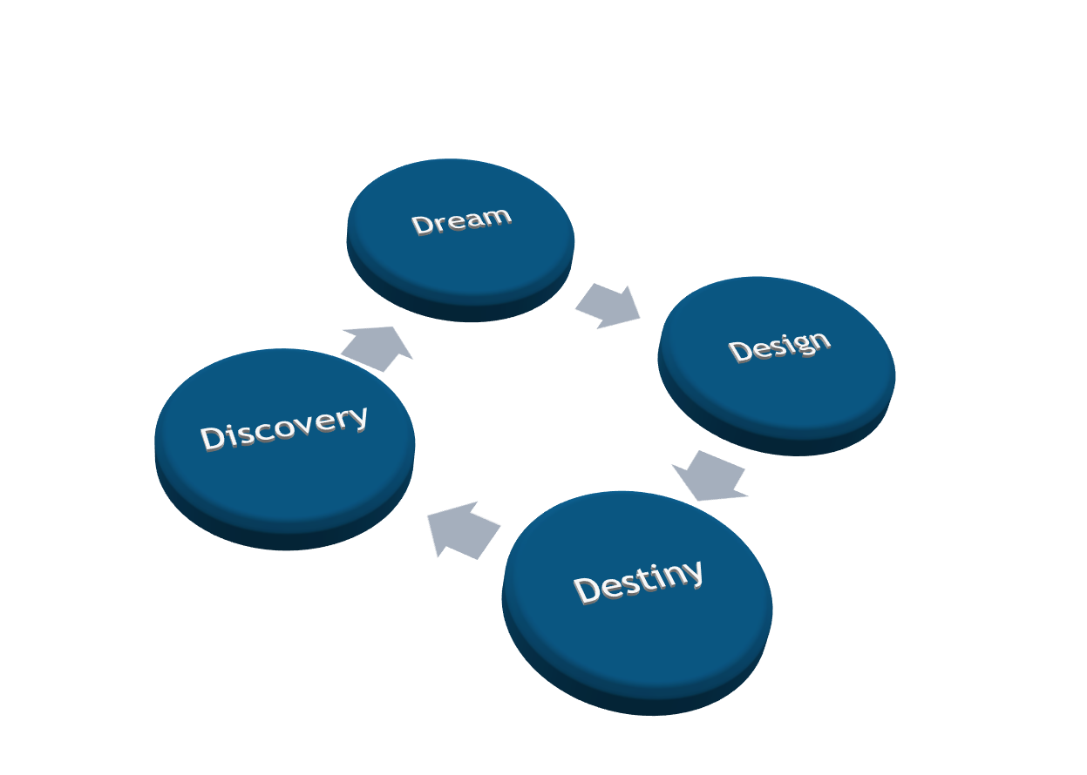
Student representation
An action research project
4Ds

Slide 12
Some quotes
“It think that it is great that we get student representation from the very start….it is good to know that we are being listened to”.
“I really enjoy that we get to meet with the heads of the medical school”
“… not enough people know about it.”
“… (they) don’t know what actually happens during the meetings”
“I sent an email request (to my fellow students, asking which issues should be raised) and only got 3 replies”
“… some (students who are not student representatives) isolate themselves and then feel neglected”

Slide 13
Supporting university teachers
A series of semi structured interviews
Thematically coded
Leading to a decision about the way forward

Slide 14
Negative themes
The lack of recognition/career progression for teaching
Lack of support for teaching
And less commonly mentioned
Lack of knowledge about “what to teach”
Lack of training as teachers

Slide 15
Positive themes
Students
Apprentices
Role model
Making things better

Slide 16
Negative and Positive
The difficulty of balancing teaching/research and clinical commitments
Although there are frustrations, there is a recognition (from the most senior interviewees), that this is one of the things that makes the job interesting.

Slide 17
Lack of recognition
...it used to be much better say 20 years ago, when honorary lecturer status was given out in recognition of good input, and was respected. People were brought together for example the examiner's dinner and examiners meetings as well. (Christopher)
...Well, things like your role not being actually explicit, acknowledged, rewarded, whatever. Sometimes makes certain aspects of your role difficult, because you'll always be competing...(Ann)

Slide 18
Lack of support for teaching
I'm flabbergasted by the support I've had from the clinicians. (Christopher)
...and we still work well together, we still back each other up we still support each other (Alan)
... Just makes me think how sad it is, that I don't think is the University's job to support me in that respect. (Bob)

