Slide 1


Stress addressing the root causes
David Taylor
dcmt@liv.ac.uk
http://www.liv.ac.uk/~dcmt

Slide 2

When you come to University

Slide 3
Part of the continuum
Many changes
  Structure
  Feedback
  Level of achievement
  Accommodation
  Independence
Learning the unwritten rules

Slide 4
Structure
For many students, coming to University is a move away from a controlled environment towards independence

Slide 5
Feedback
Students are probably used to regular and detailed feedback
From their teachers
And from their family

Slide 6
Achievement
Students may well have been the most able amongst their peers
There is a uniform anxiety about how well they will perform compared to their new peers

Slide 7
Accommodation
Most students will either be away from home for the first time
Or they will be balancing their new found independence with their old family circumstances

Slide 8
Independence
They will be realising that they are at the threshold of facing the world on their own
And now they have to start learning the unwritten rules

Slide 9


Slide 10

For some

Slide 11

For others

Slide 12
The real issue
Bordieu
becoming
Bernstein
boundaries
Land
community
Wenger

Slide 13


Slide 14
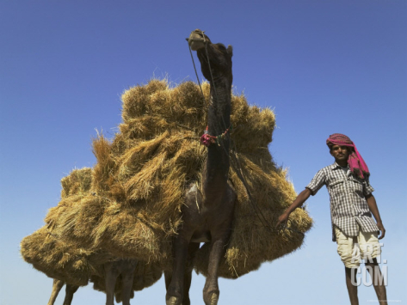
Stress…
865kg
Lazarus and Folkman 1984

Slide 15
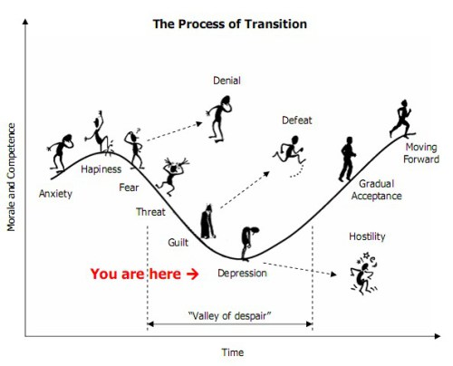
Actually it is about transition
Jorge Simones, after
Kubler-Ross 1969

Slide 16
enjoy

Slide 17
strain

Slide 18
Overcome

Slide 19
Cope

Slide 20
Why?
There is some really interesting data – and some strategies – from Dr. Enatescu, Timisoara which we will discuss in the workshop
But what is our model?

