Slide 2
Strategic approaches and possibilities
David Taylor

Slide 3
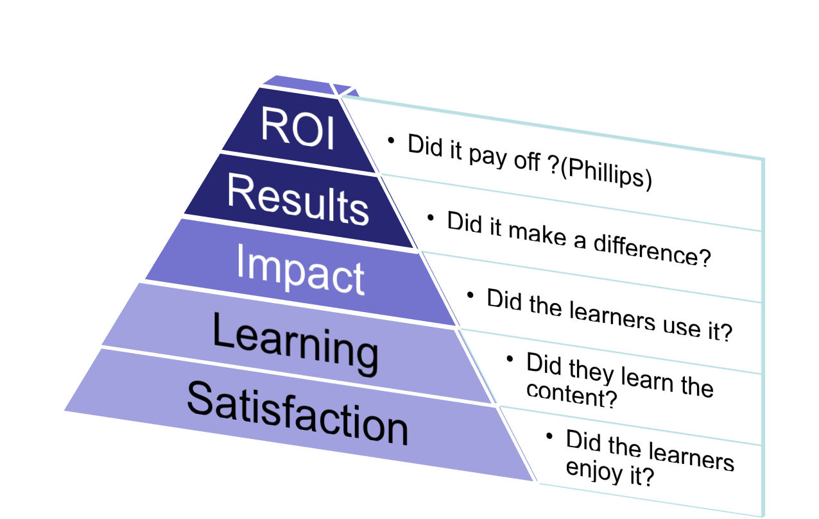
To start at the end
Kirkpatrick

Slide 4
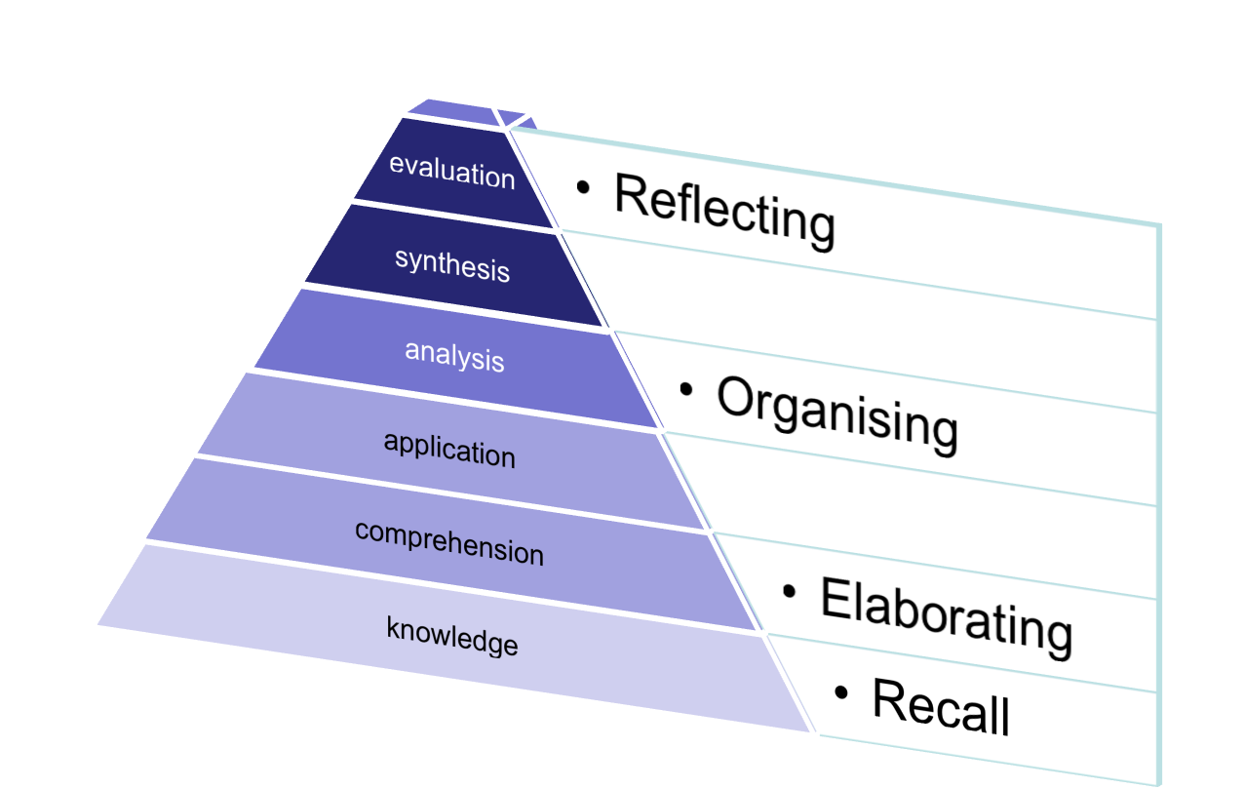
So what do you want to do/see
Bloom

Slide 5
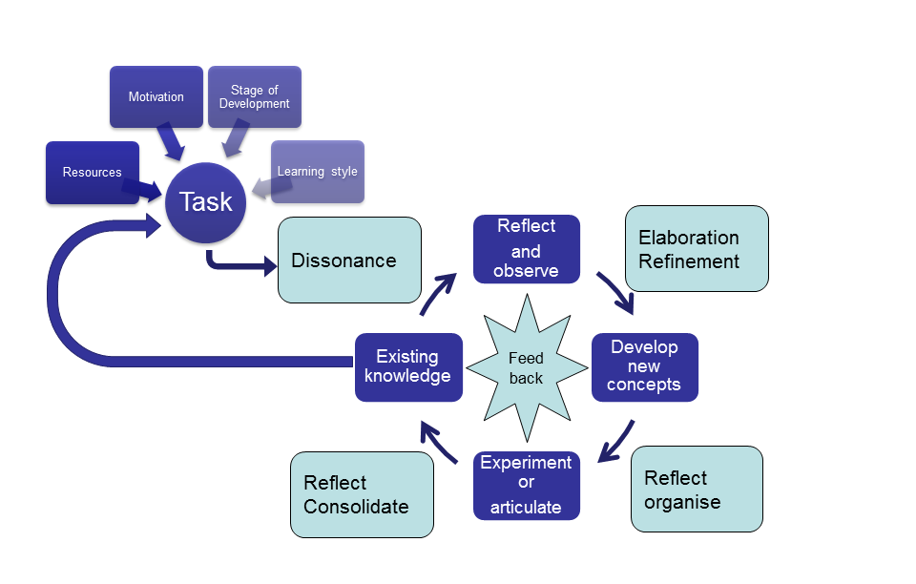
How people learn

Slide 6
There are four elements
Dissonance
Elaboration
Organising
Consolidating
Not necessarily in exactly that order – but they are all necessary

Slide 7
Dissonance

Slide 8
Dissonance – most important
Existing knowledge
Activate
Articulate
The task
Resources
Motivation, development, style
Not the only phase!

Slide 9
Elaboration and refinement

Slide 10
Elaboration and refinement
After observing and reflecting upon the dissonance
We develop a series of possible explanations
The “richness” and the “context” of the elaborations is important

Slide 11
Reflect and organise

Slide 12
Reflect and organise
We then have to narrow down the possibilities – choosing the best alternatives
Organise them into a story that makes sense
And test our ideas

Slide 13
Reflect and consolidate

Slide 14
Reflect and consolidate
We have articulated what we think or received the results of our experiment
And have received feedback
So we are in a position to affirm or reject our new ideas

Slide 15
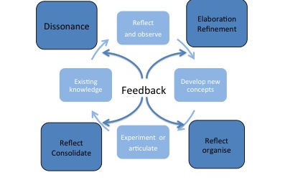
Feedback is important

Slide 16
Approaches
Possibilities are only limited by our imagination
But we need to provide scaffolding

Slide 17
Options
Set pieces
Lectures/ Practical work
Small group work/ward rounds
Opportunistic
Research
Clinical placements
But we need to know where we are on the continuum….

Slide 18
It is not simple
Self-directed learning
Directed
self- learning
Instruction
Lectures
CBL
PBL
TBL

