Slide 1
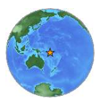
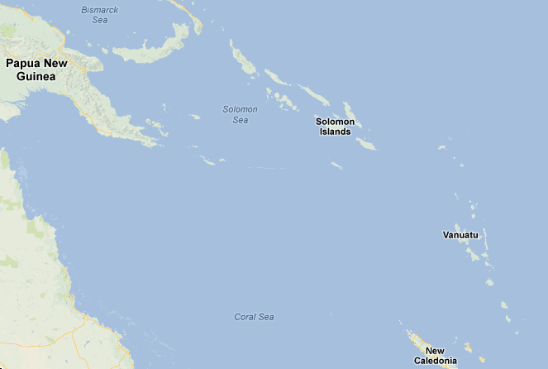
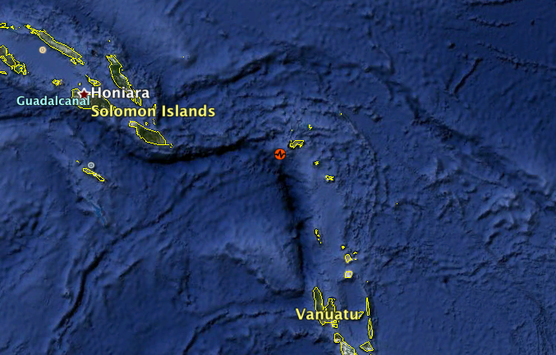
Magnitude 8.0 SOLOMON ISLANDS
Wednesday, 6 February, 2013 at 01:12:23 UTC
A 8.0 magnitude earthquake occurred offshore in the Solomon Islands. The earthquake occurred at a depth of 28.7 km (17.8 miles) and a tsunami warning was issued for the region. This is the second largest earthquake to strike the Solomon Island region in nearly 40 years.
Australia

Slide 2
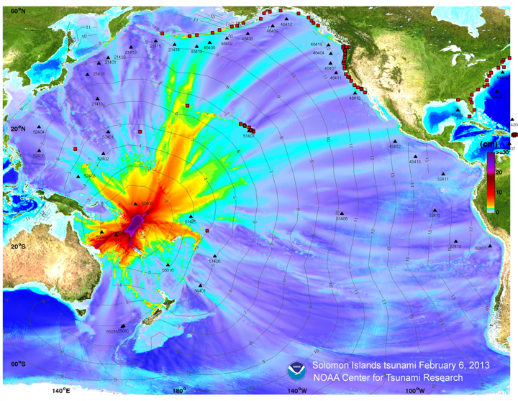
Magnitude 8.0 SOLOMON ISLANDS
Wednesday, 6 February, 2013 at 01:12:23 UTC
Tsunami model amplitude information is shown colour-coded to the scale. Filled colours show maximum computed tsunami amplitude in cm during 24 hours of wave propagation. Black contours show computed tsunami arrival time.
Image courtesy of the NOAA Centre for Tsunami Research
Link to NOAA animation for the February 6, 2013 Solomon Island tsunami propagation

Slide 3
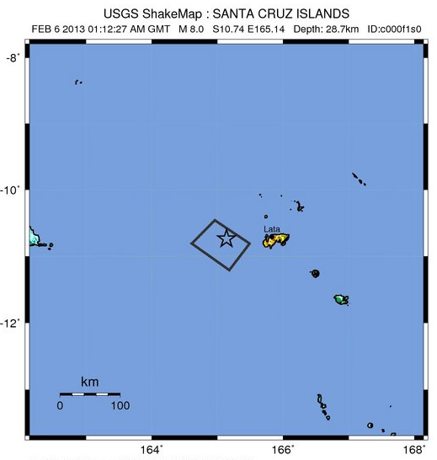
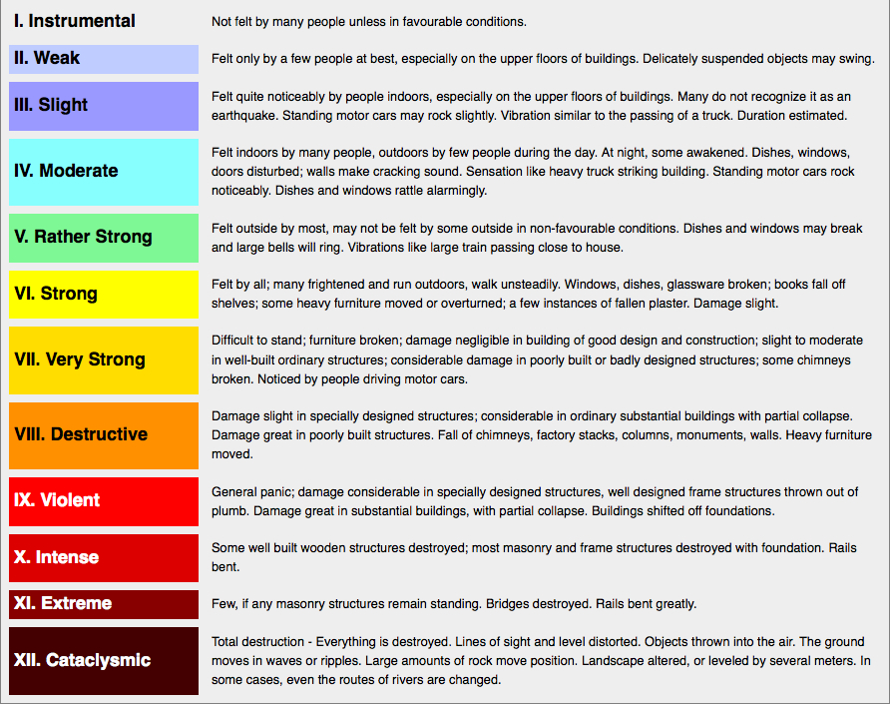
Magnitude 8.0 SOLOMON ISLANDS
Wednesday, 6 February, 2013 at 01:12:23 UTC
Strong to very strong shaking was recorded in Lata, the island closest to this earthquake with hundreds of residents.
Shaking intensity
Modified Mercalli Intensity Scale (courtesy of University of Alberta)

Slide 4
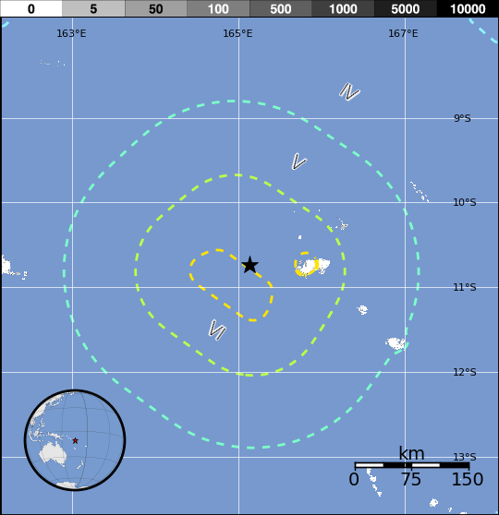
Magnitude 8.0 SOLOMON ISLANDS
Wednesday, 6 February, 2013 at 01:12:23 UTC
USGS PAGER
Population Exposed to Earthquake Shaking
Overall, the population in this region resides in structures that are vulnerable to earthquake shaking, though some resistant structures exist. The predominant vulnerable building types are mud wall and informal (metal, timber, GI etc.) construction. Table below shows estimated population exposure to earthquake shaking.
Image courtesy of the US Geological Survey

Slide 5
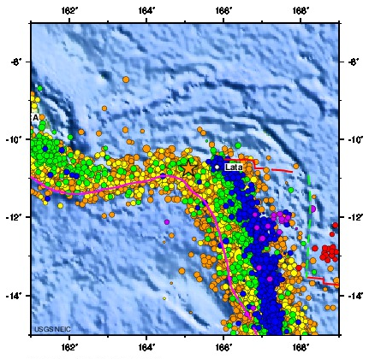
Magnitude 8.0 SOLOMON ISLANDS
Wednesday, 6 February, 2013 at 01:12:23 UTC
Earthquake and historic seismicity
The earthquake epicentre (yellow star) is plotted on the map with regional seismicity since 1990.
A series of M7.4 to M8.1 shallow thrust earthquakes have occurred along this portion of the plate boundary in recent years.
Image courtesy of the US Geological Survey

Slide 6
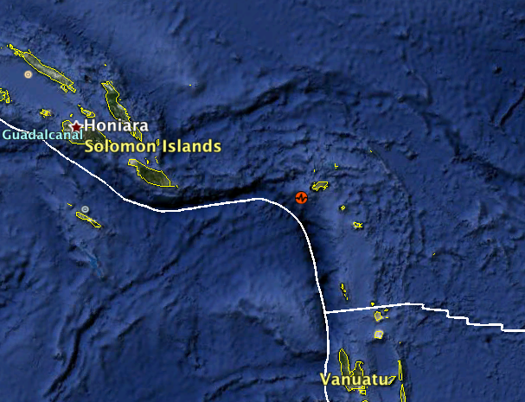
Magnitude 8.0 SOLOMON ISLANDS
Wednesday, 6 February, 2013 at 01:12:23 UTC
Pacific Plate
Northern New Hebrides Trench
Australia Plate

Slide 7
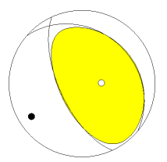
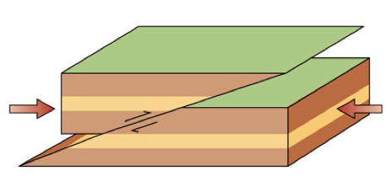
Magnitude 8.0 SOLOMON ISLANDS
Wednesday, 6 February, 2013 at 01:12:23 UTC
Tectonic summary
The earthquake occurred due to shallow thrust faulting on or near the plate boundary interface between the Australia and Pacific plates. In the region of this earthquake, the Australia plate converges with and subducts beneath the Pacific plate, moving towards the east-northeast at a rate of 90 mm/yr.
The figure on the left shows the style of faulting (focal mechanism), and the right one shows schematically how plates associated with the thrust faulting move.
USGS Centroid Moment Tensor Solution

Slide 8
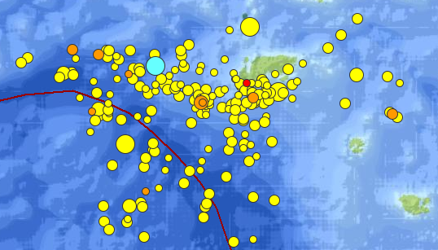
Magnitude 8.0 SOLOMON ISLANDS
Wednesday, 6 February, 2013 at 01:12:23 UTC
Aftershocks
As of UTC 11/02/2013 13:51:23, five days after the main shock, there have been 381 events of magnitude 2.5 or larger. The largest aftershock was a magnitude 7.1 that occurred 11 minutes after the main shock. Two aftershocks both with M7.0 occurred 42 minutes and 52 hours after the main shock respectively.
M8.0
Main shock
M 7.0
aftershock
Aftershocks (orange and yellow) from United States Geological Survey in this region following the main shock (blue).
M 7.0
aftershock
M 7.1
aftershock
50 km

Slide 9
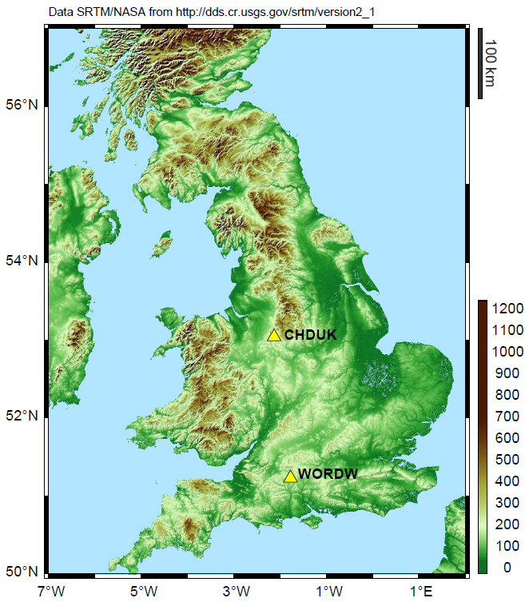
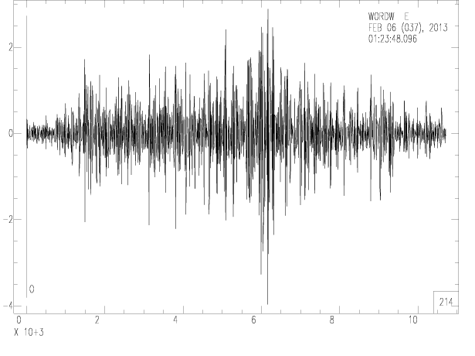
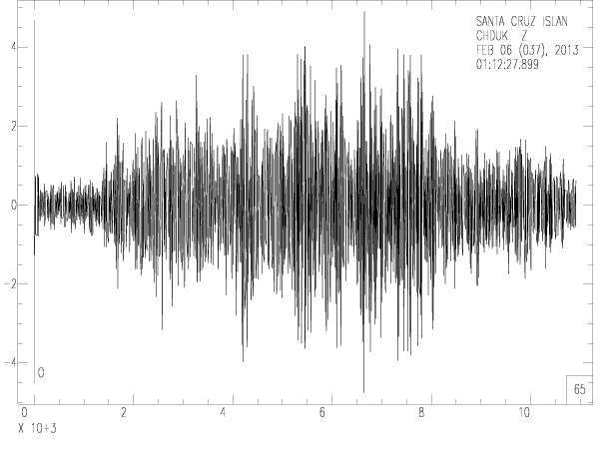
Magnitude 8.0 SOLOMON ISLANDS
Wednesday, 6 February, 2013 at 01:12:23 UTC
Seismogram recordings by school seismometers
Bishop Wordsworths School
Cheddleton Nr.Leek

Slide 10
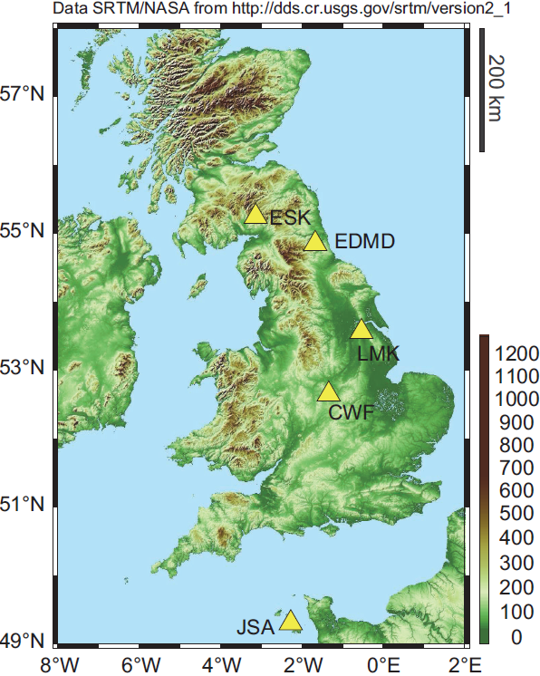
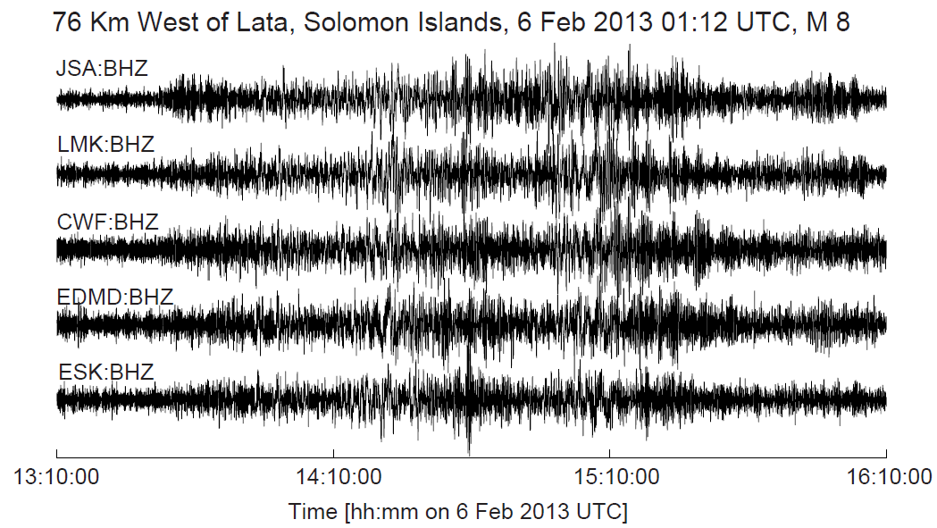
Magnitude 8.0 SOLOMON ISLANDS
Wednesday, 6 February, 2013 at 01:12:23 UTC
Seismogram recordings by various seismometers across the UK

Slide 11
Magnitude 8.0 SOLOMON ISLANDS
Wednesday, 6 February, 2013 at 01:12:23 UTC
Find out more….
BGS (British Geological Survey) – seismology and earthquakes – frequently asked questions http://www.earthquakes.bgs.ac.uk/education/faqs/faq_index.html
IRIS (Incorporated Research Institutions for Seismology) – learning about earthquakes http://www.iris.edu/hq/programs/education_and_outreach/students
UK School Seismology Project – classroom activities, videos and support documents http://www.bgs.ac.uk/schoolseismology/home.html
USGS (United States Geological Survey) – FAQs, glossary, posters, animations http://earthquake.usgs.gov/learn/
USGS summary of the Solomon earthquake http://origin-earthquake.usgs.gov/earthquakes/eventpage/usc000f1s0#summary
Tsunami information http://nctr.pmel.noaa.gov/solomon20130206/

