Slide 1
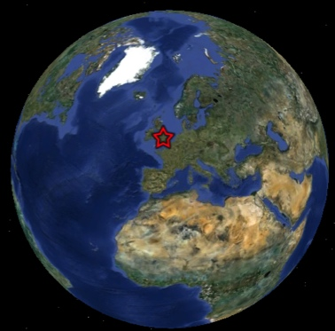
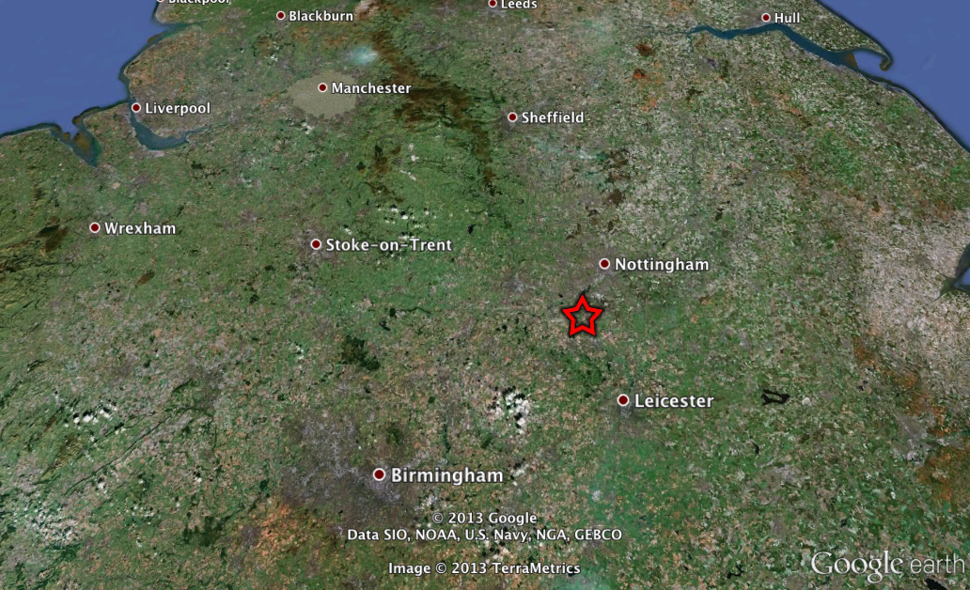
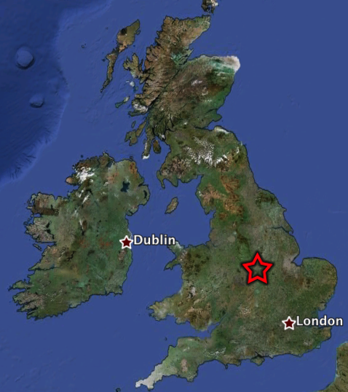
Magnitude 2.9 LOUGHBOROUGH, LEICS, UK
Friday, 18 January, 2013 at 05:20:44 UTC
A magnitude 2.9 earthquake occurred in the East Midlands region of the United Kingdom on 18 January 2013. The earthquake occurred at a depth of 13 km (8 miles). Approximately 26 earthquakes of this magnitude occur in the UK every year.
The earthquake was felt in the towns of Loughborough, Derby, Nottingham and Leicester. Shaking was felt as far away as Buxton and Warwick.

Slide 2
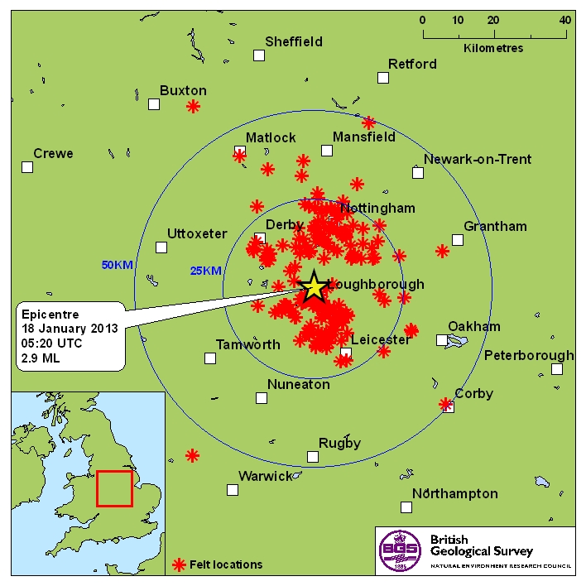
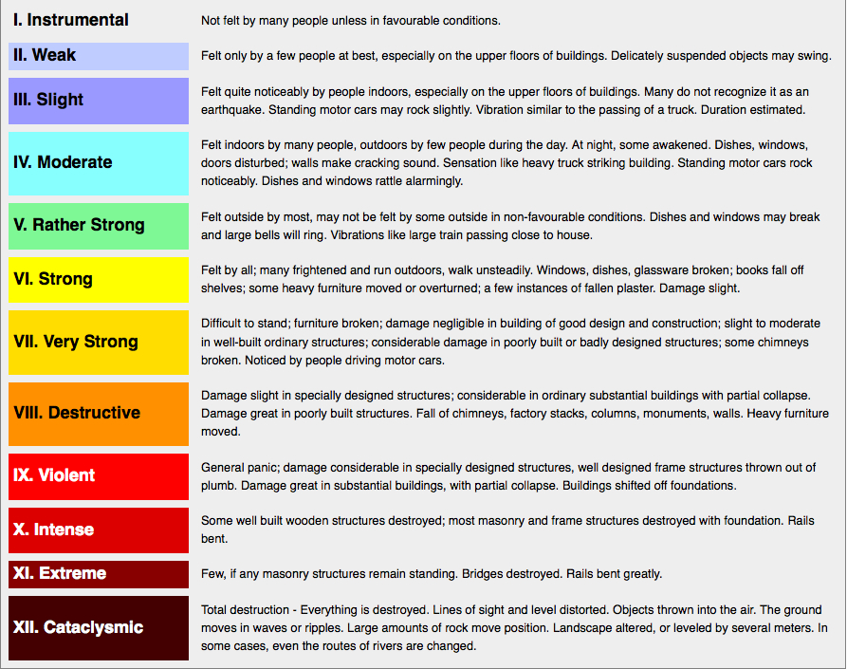
Magnitude 2.9 LOUGHBOROUGH, LEICS, UK
Friday, 18 January, 2013 at 05:20:44 UTC
Where was it felt?
Maximum recorded intensity was IV in Loughborough
Location of earthquake felt reports (image courtesy of BGS)
Modified Mercalli Intensity Scale (courtesy of University of Alberta)

Slide 3
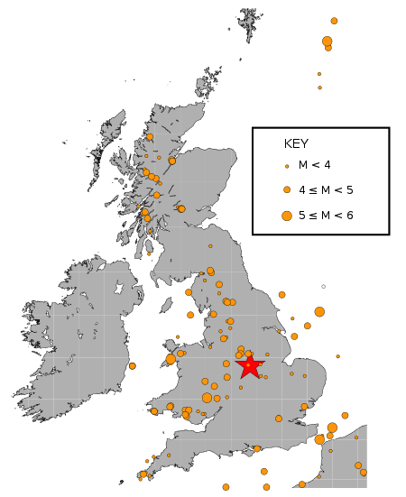
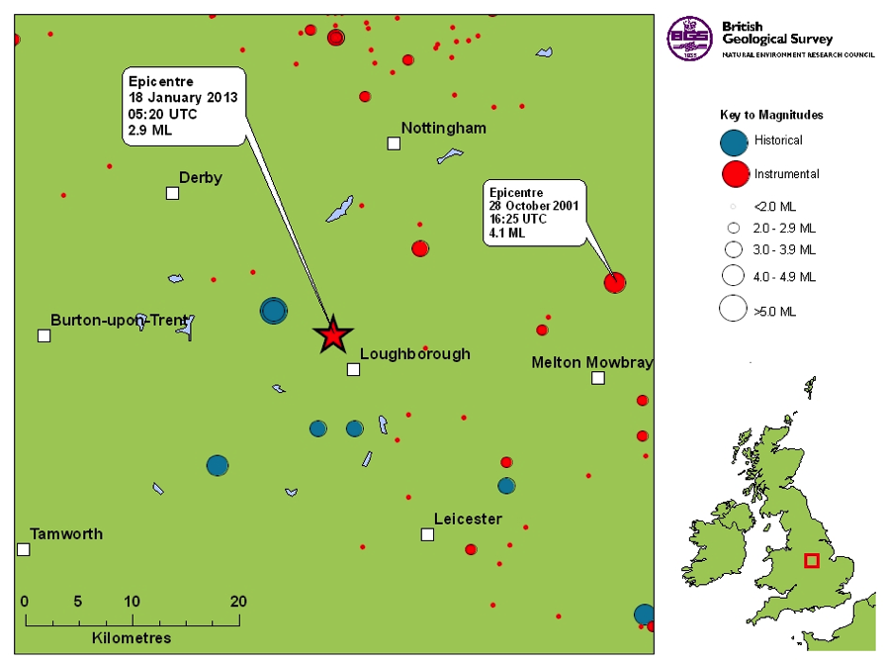
Magnitude 2.9 LOUGHBOROUGH, LEICS, UK
Friday, 18 January, 2013 at 05:20:44 UTC
Earthquake and historic seismicity
The earthquake epicentre (red star) is plotted on the map with regional seismicity since 1960.
Historic seismicity of the British Isles
Small earthquakes have been known to occur in this region of the UK before.
Historic seismicity
in the region of the mainshock (image courtesy of BGS)

Slide 4
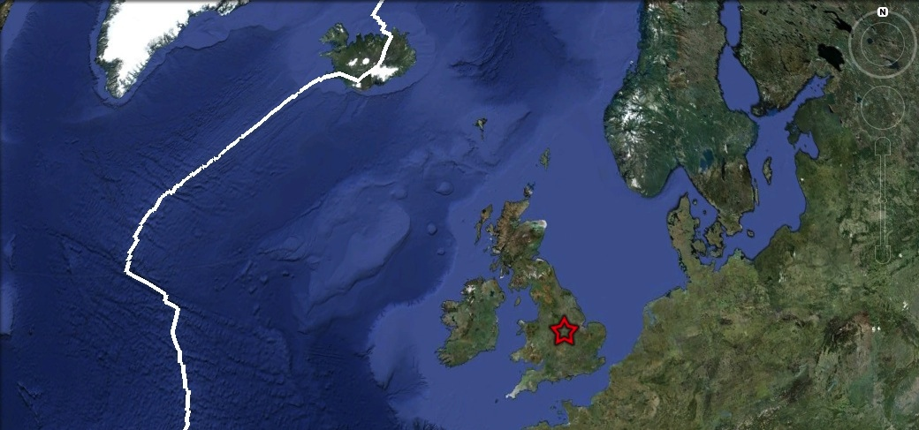
Magnitude 2.9 LOUGHBOROUGH, LEICS, UK
Friday, 18 January, 2013 at 05:20:44 UTC
Tectonic interpretation
Although the UK does not lie on an active tectonic plate boundary (one of its nearest plate boundary being the Mid-Atlantic Ridge), stress within the plate is released along pre-existing faults within the crust. In areas of low seismicity, such as the British Isles, it is difficult to identity the causative fault. Furthermore, with such low-magnitude events, it is not possible to determine the earthquake’s focal mechanism.
Mid-Atlantic
Ridge

Slide 5
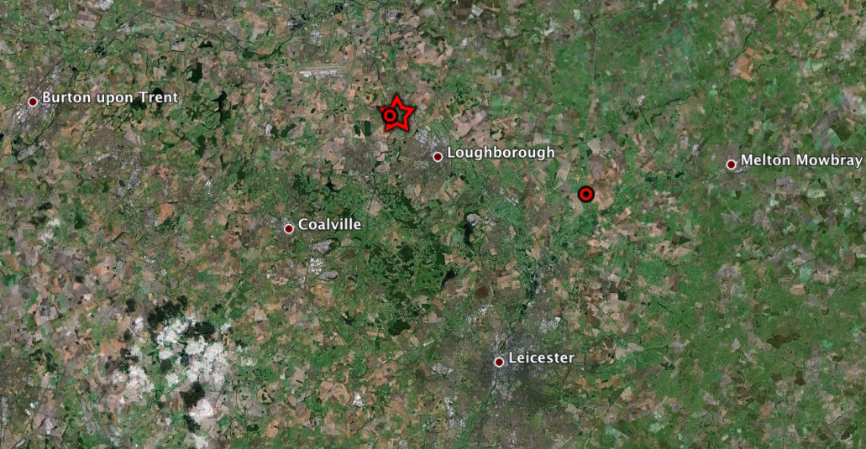
Magnitude 2.9 LOUGHBOROUGH, LEICS, UK
Friday, 18 January, 2013 at 05:20:44 UTC
Aftershocks
Since the earthquake, two aftershocks have been recorded by the British Geological survey. The largest of these occured on 04/02/13 with a magnitude of 2.4, and was located to the south-east of the mainshock.
Aftershocks (red circles) recorded by the British Geological Survey in this region following the mainshock (red star).

Slide 6
Magnitude 2.9 LOUGHBOROUGH, LEICS, UK
Friday, 18 January, 2013 at 05:20:44 UTC
Loughborough High School (LHSUK)
Seismogram recordings from UK schools
School Seismometer at the
University of Liverpool (DEOS)
Paulet High School, Burton on Trent (PAUL)

Slide 7
Magnitude 2.9 LOUGHBOROUGH, LEICS, UK
Friday, 18 January, 2013 at 05:20:44 UTC
Seismogram recordings from BGS network and locating the earthquake
By finding the arrival time difference between the P and S waves, we can calculate the distance of the earthquake from the seismometer station. If we do this for several stations, we can determine the approximate epicentre of the earthquake by finding where these circles intersect.

Slide 8
Magnitude 2.9 LOUGHBOROUGH, LEICS, UK
Friday, 18 January, 2013 at 05:20:44 UTC
Find out more…
BGS (British Geological Survey) – seismology and earthquakes – frequently asked questions http://www.earthquakes.bgs.ac.uk/education/faqs/faq_index.html
IRIS (Incorporated Research Institutions for Seismology) – learning about earthquakes http://www.iris.edu/hq/programs/education_and_outreach/students
UK School Seismology Project – classroom activities, videos and support documents http://www.bgs.ac.uk/schoolseismology/home.html
USGS (United States Geological Survey) – FAQs, glossary, posters, animations http://earthquake.usgs.gov/learn/
EMSC (European Mediterranean Seismological Centre) http://www.emsc-csem.org/

