Slide 1
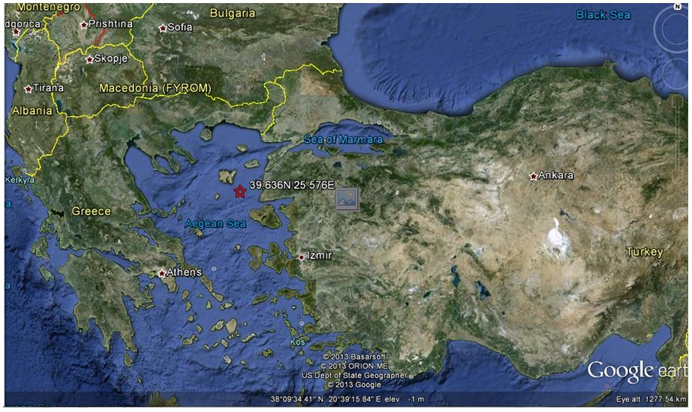
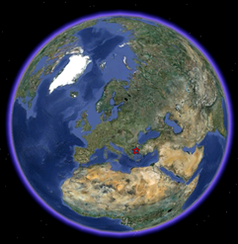
Magnitude 5.7 Earthquake, Aegean Sea
Tuesday, 8th January 2013, at 14:15:08 UTC
A magnitude 5.7 earthquake occurred in the Aegean sea, between Greece and Turkey, at 14:16 on the 8th January 2013. The earthquake occurred 32 km below the sea bed.
The earthquake caused no casualties or major damage, but was widely felt at the nearby islands of NE Greece and NW Turkey, and was also felt in Athens, 250 km away from the epicentre.

Slide 2
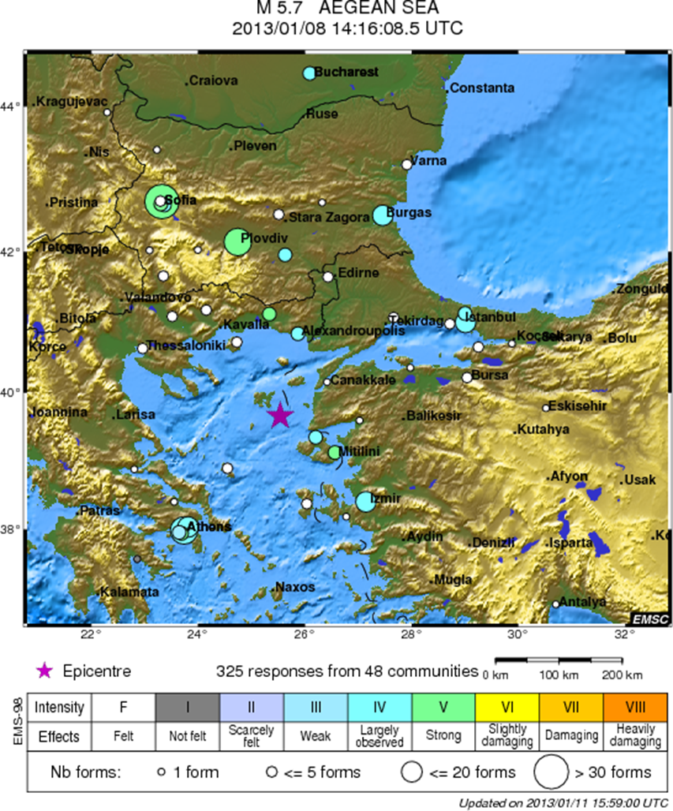
Magnitude 5.7 Earthquake, Aegean Sea
Where was it felt?
The maximum recorded intensity was ‘V’ or ‘strong’ in Bulgaria, to the North of the earthquake.

Slide 3
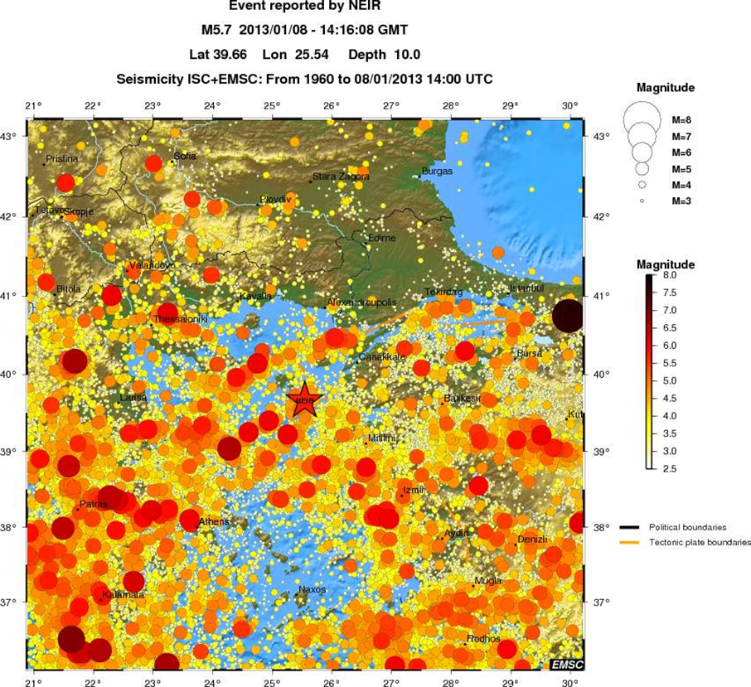
Magnitude 5.7 Earthquake, Aegean Sea
Earthquake and historic seismicity
The earthquake epicenter (red star) is plotted on the map with regional seismicity since 1960.
The Mediterranean is tectonically complex, with many plate boundaries. Many earthquakes of this magnitude have occurred in this area since 1960.

Slide 4
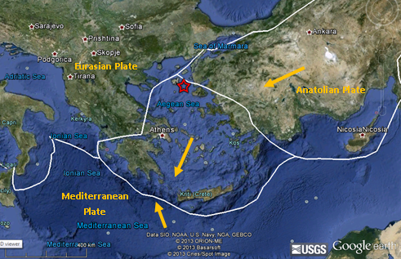
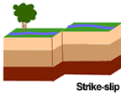
Magnitude 5.7 Earthquake, Aegean Sea
Tectonic interpretation
The Aegean sea is highly tectonically complex, and sits between several plate boundaries. The Anatolian plate (Northern Turkey) is moving Eastward, colliding with the Eurasian plate and the Mediterranean plate.
This earthquake is strike slip and most likely occurred on a fault that is related to the conservative margin between the Anatolian and Eurasian plate. Because it is strike slip there is little vertical displacement, and so the earthquake did not cause any major tsunami.
Focal mechanism of a strike-slip Earthquake from the Global CMT Catalogue.
Tectonic setting plotted using plate boundary data from the USGS.
Diagram showing a strike slip fault,
Copyright USGS.

Slide 5
Magnitude 5.7 Earthquake, Aegean Sea
Aftershocks
As of the 12th of February there have been 286 aftershocks, the largest of which is a magnitude 5. The seismicity occurring since the 8th January is concentrated close to the main shock.
For fully up to date aftershock information you can visit the following webpage:
http://www.emsc-csem.org/Earthquake/214/M5-7-Aegean-Sea-Jan-8th-2013#int
Image courtesy of Google Maps and EMSC.

Slide 6
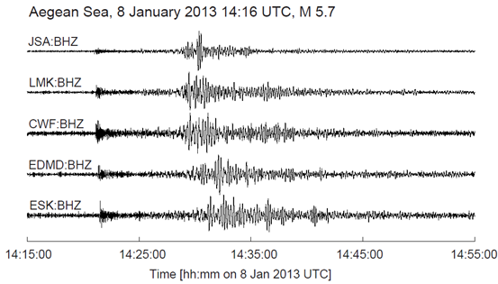
Magnitude 5.7 Earthquake, Aegean Sea
Seismogram recordings
The Aegean Earthquake has been recorded at various seismometers across the UK.
The P-wave arrivals are at ~14:18 UTC and the S-wave are at 14:27-14:28 UTC.

Slide 7
Finding out more…
UK School Seismology Project – classroom activities, videos and support documents http://www.bgs.ac.uk/schoolseismology/home.html
EMSC (European Mediterranean Seismological Centre) http://www.emsc-csem.org/
IRIS (Incorporated Research Institutions for Seismology) – learning about earthquakes http://www.iris.edu/hq/programs/education_and_outreach/students
USGS (United States Geological Survey) – FAQs, glossary, posters, animations http://earthquake.usgs.gov/learn/

