Slide 1
GradeMark for Electronic Marking and Feedback
Denis Parkinson & Dr Stephen McKinnell
School of Health Sciences

Slide 2
Overview
Why use e-marking and feedback
The School of Health Sciences 2013-14 pilot
Demonstration
Questions and Answers

Slide 3
What do we already know?
University of Glamorgan (2010) - Turn it in or Turn it off? A Pilot Project for Turnitin and Grademark Experience.
University of Exeter (2012) – Online Coursework Management Evaluation.
University of Glamorgan (2012) - Assessment Diaries & Grademark.
University of Huddersfield (2013) - Evaluating the Benefits of Electronic Assessment Management.

Slide 4
Glamorgan 2010
104 students from 4 Faculties
Positives
Convenient
No need for hard copies
Raises awareness of plagiarism
Easy to use
Confirmation of submission
Encourages early submission
More detailed feedback
Negatives
Difficult to interpret Originality Reports
Poor preview layout.
Double work if also asked to submit hard copy.

Slide 5
Exeter 2010
An indirect evaluation of student experiences (view of academic and admin staff)
Discrepancies in the (staff) perceptions of benefits
45% felt feedback experience hadn’t changed
26% felt feedback experience had go worse

Slide 6
Glamorgan 2012
296 students – surveys and focus groups.
Advantages
Easy to use
Legibility
Student engagement with feedback
Disadvantages
Online access
Reading on screen

Slide 7
Huddersfield 2013
Survey (n=804) and focus groups
Benefits
Easier to submit (no travel)
Avoids printing – printing panic
Confident submission was received
Legibility
More detailed / clearer feedback

Slide 8
School of Health SCiences

Slide 9
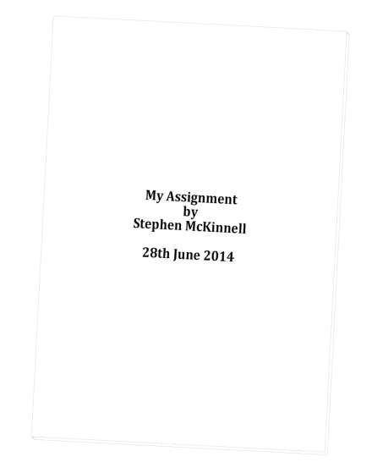
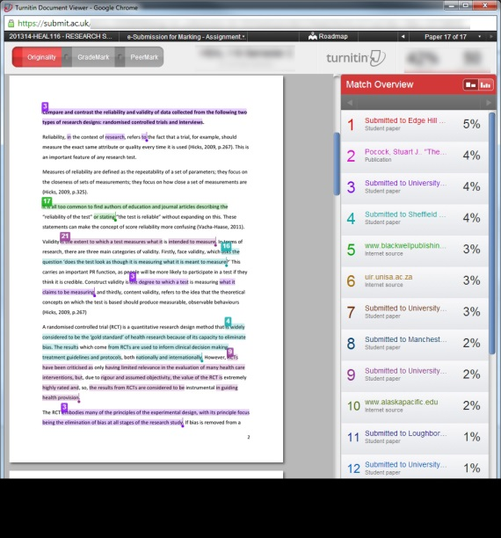
Current Approach
Paper submissions
Marked
Annotated / Feedback sheets
Electronic submissions
TurnitinUK
Originality reports

Slide 10
Why?
School Academic Quality and Standards Committee
University
Aware that the UoL is looking into policy/guidance
Students
Benefits?
Staff
Increased discussion

Slide 11
Evaluation
23 modules in 2013-14
6 undergraduate programmes
Diagnostic Radiography, Nursing, Occupational Therapy, Orthoptics, Physiotherapy, Radiotherapy.
1 postgraduate programme
PGDip in Radiotherapy

Slide 12
Evaluation
935 submissions (Sem. 1 - 439, Sem. 2 - 496)
40 members of staff

Slide 13
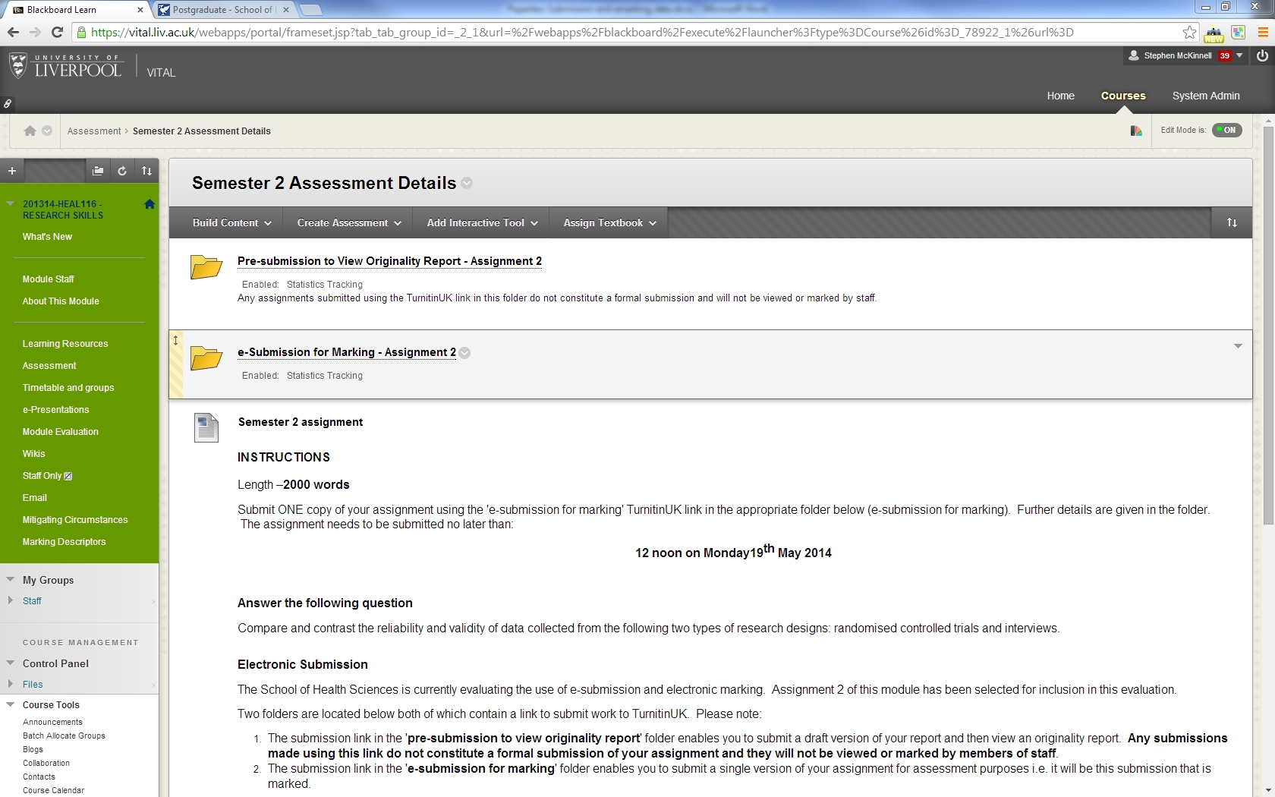
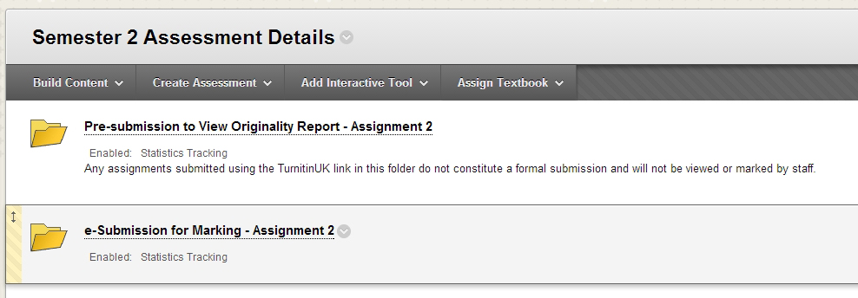
Submission Details

Slide 14
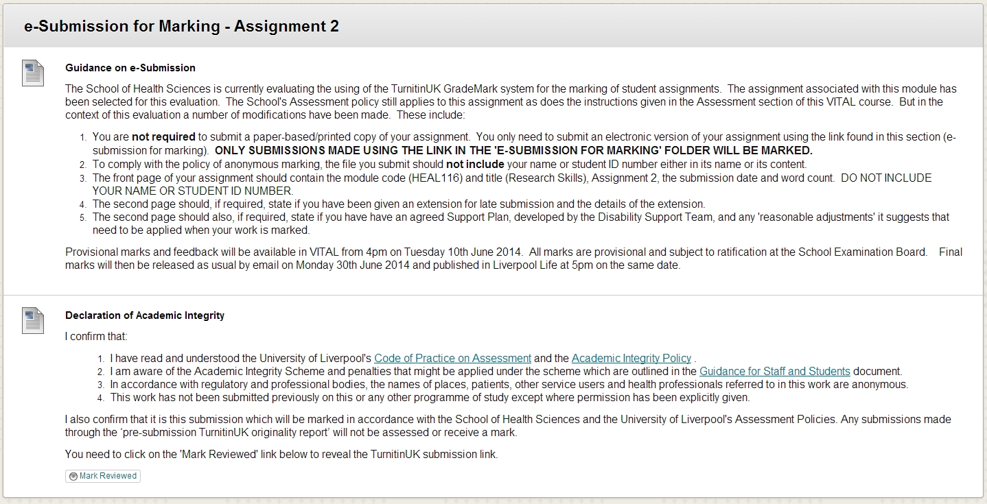
Submission Details

Slide 15
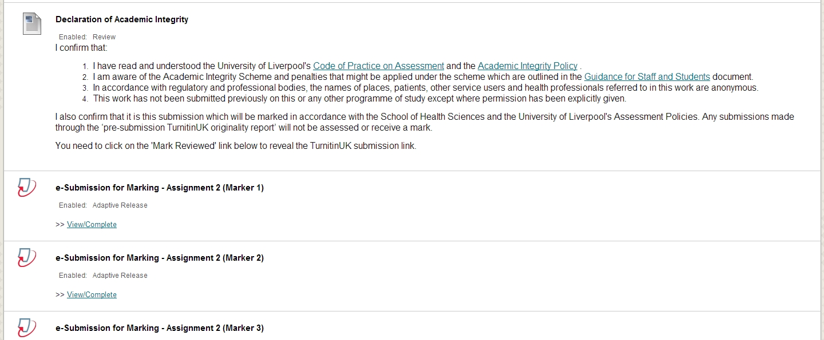
Submission Details

Slide 16
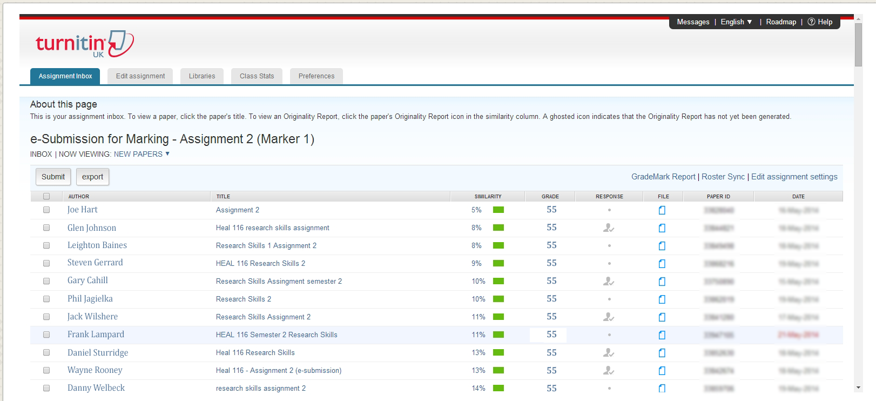
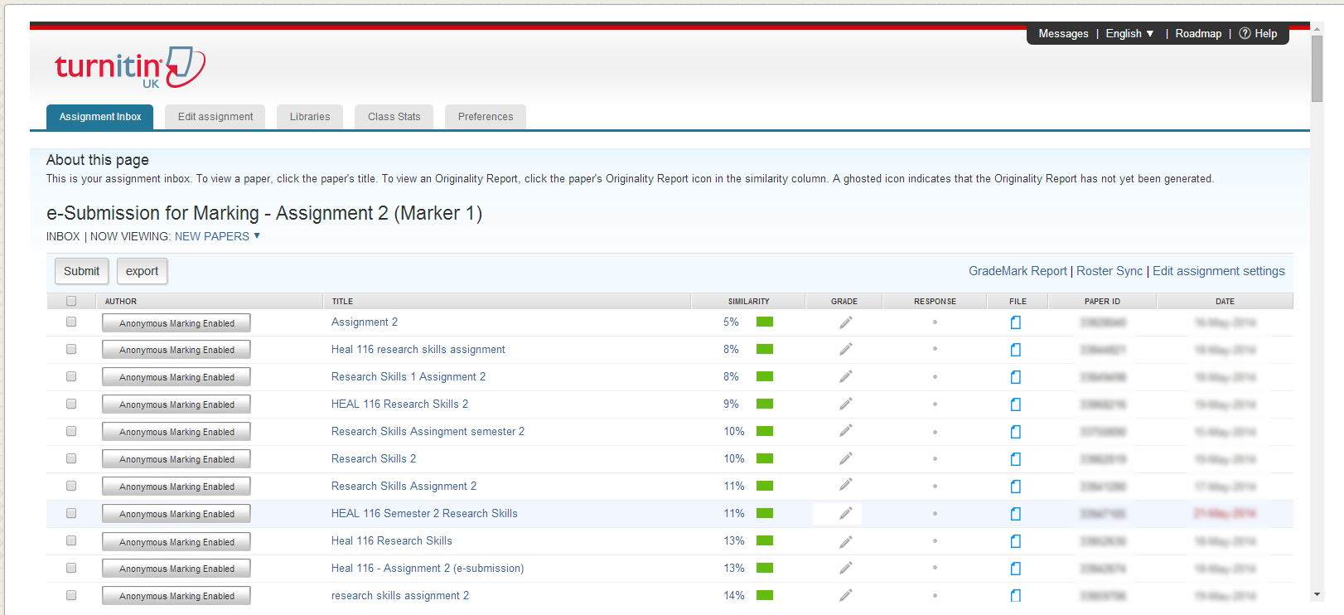
Inbox

Slide 17
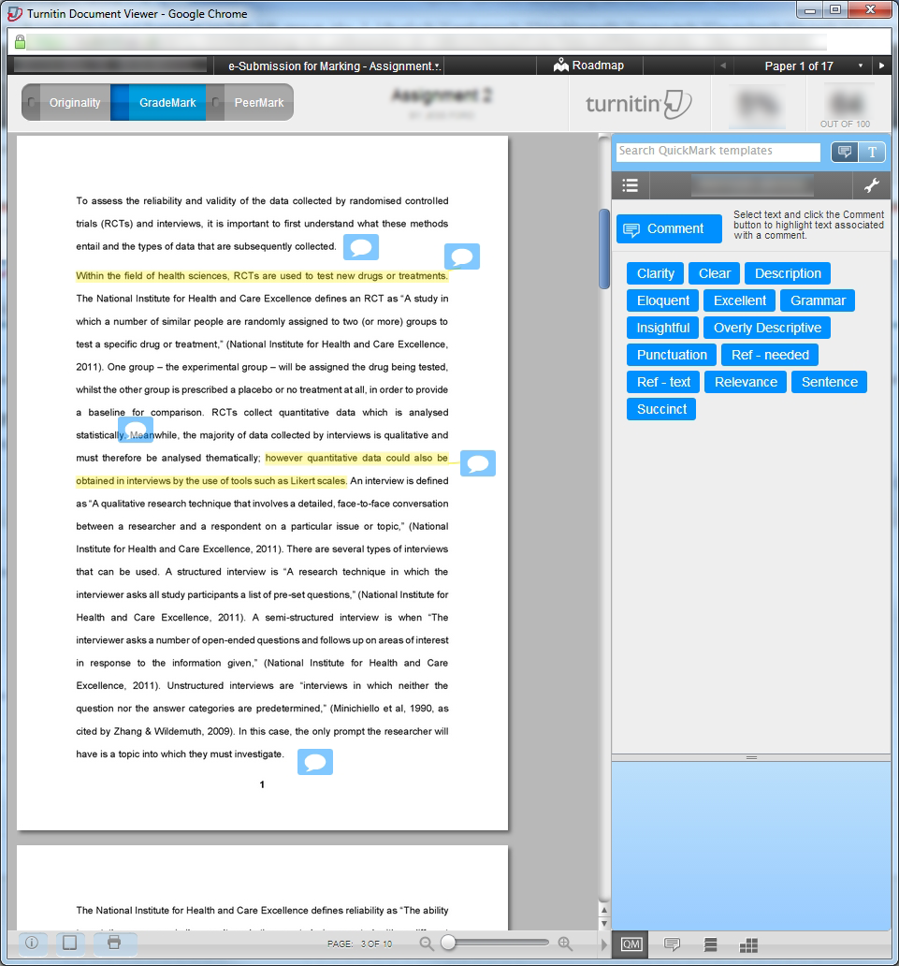
Marking
Quick Marks
In-text annotations

Slide 18
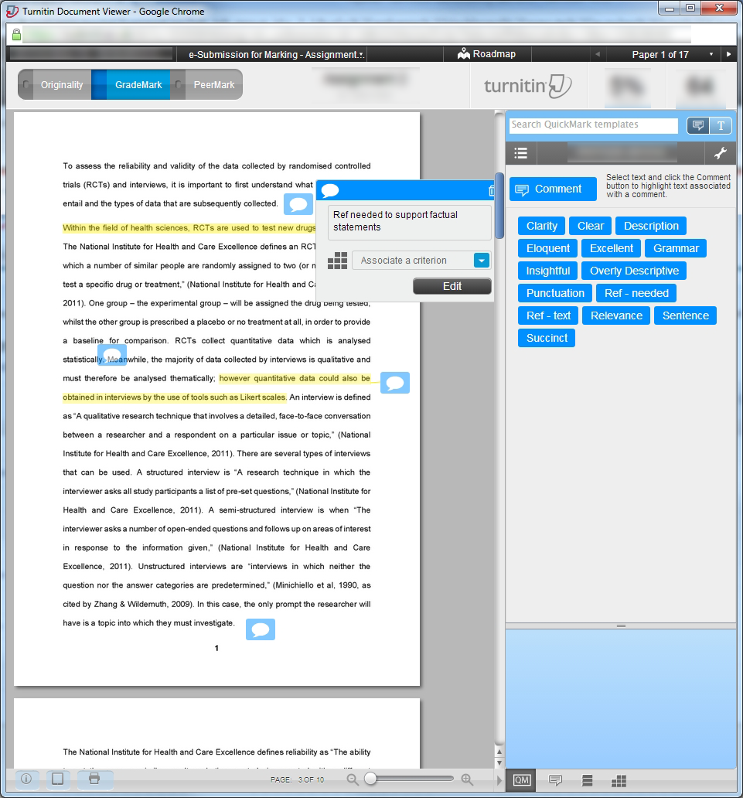
Marking
Quick Marks
In-text annotations

Slide 19
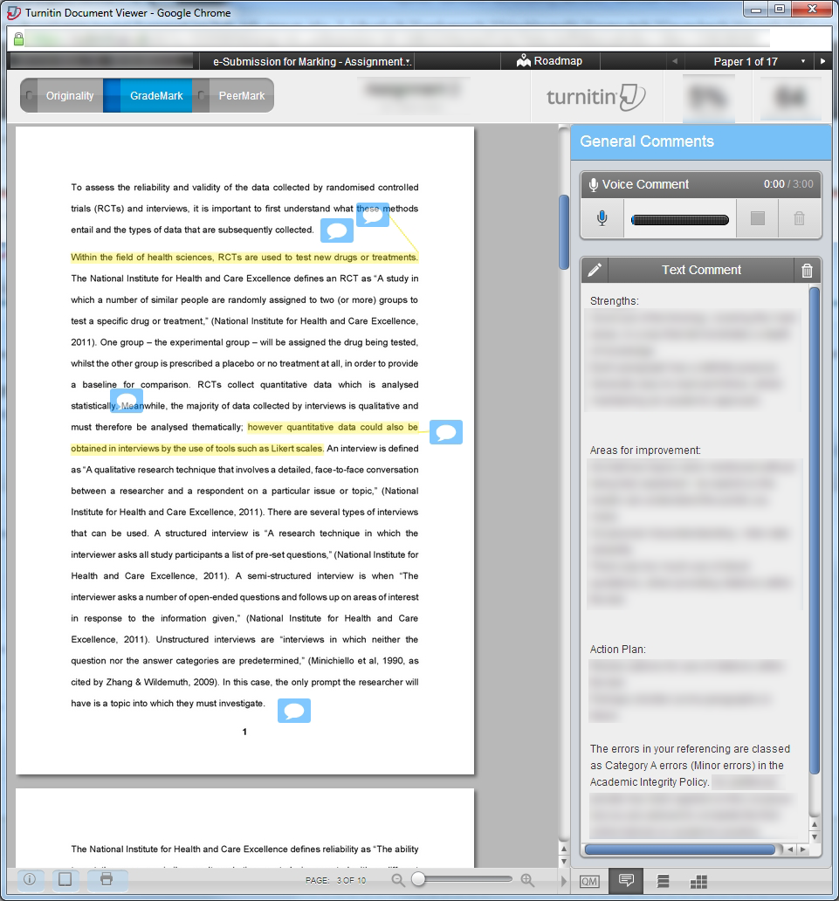
Marking
General
Comments

Slide 20
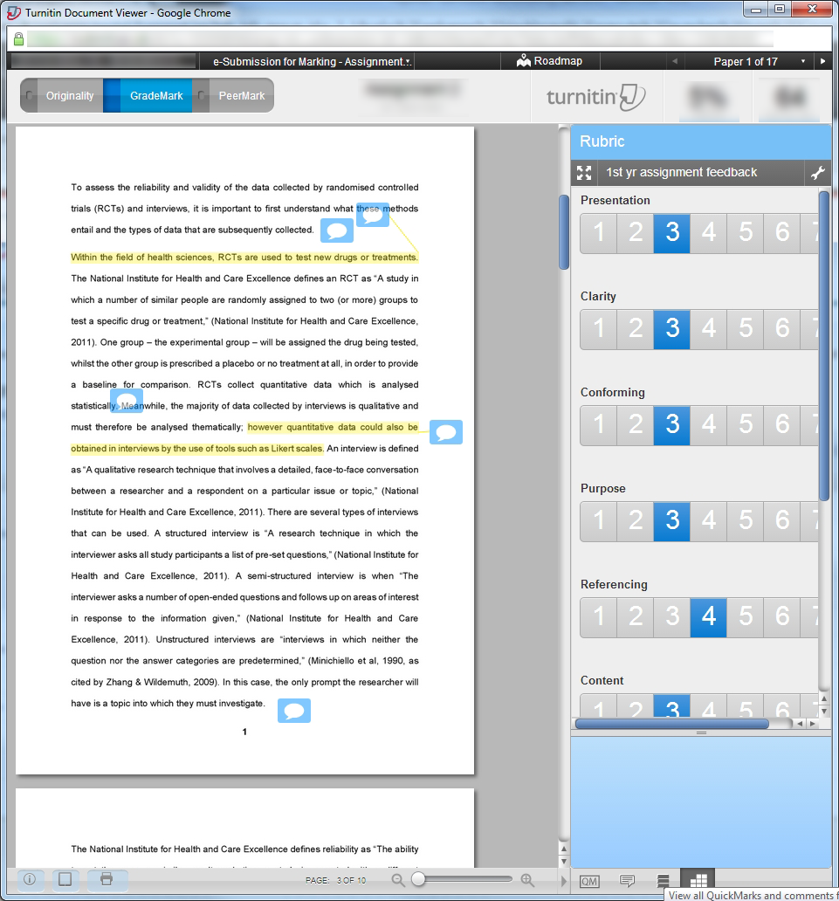
Marking
Rubric

Slide 21
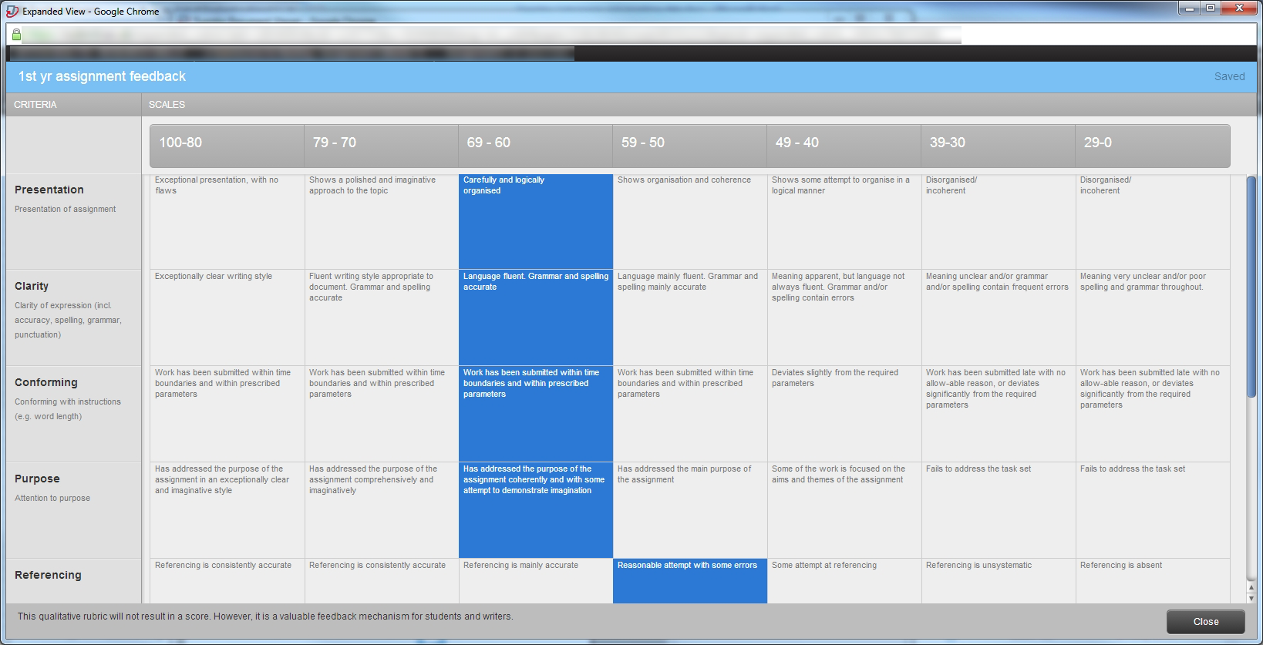
Marking

Slide 22
Example
Details
4 different markers
Random allocation of students to markers
Tools/Approach
VITAL groups
4 TurnitinUK submission links
VITAL adaptive release rules

Slide 23
Outcomes

Slide 24
Feedback – Semester 1
18 June 2014
Year 1 modules
29/44 36/41 20/40 20/37 38/38
Year 2 modules
22/33 20/33 29/32 50/57 19/33 20/22
25% students have not accessed feedback

Slide 25
Staff - Views
This was a positive experience which I enjoyed and from the comments from the students they also seemed positive.
Took some time to set up the specific comments needed for this assignment but once they were written it was easy to use for remaining assignments.
I enjoyed the experience. I was slow starting initially, because I was adding to the standard comments section. After the first few assignments, this section made the process much faster overall because I was tending to make similar comments on the assignments. So well worth investing the time and effort in developing the comments section initially.

Slide 26
Issues
One ‘lost’ submission
Be careful on the ‘TurnitinUK Assignments By Groups’ screen
School Policies
Need modifying
Financial suspension of students
MWS accounts and VITAL

Slide 27
Student Handbooks

Slide 28
E-Submission Guidance

Slide 29
E-Submission Guidance
Draft checking links
Students allowed to view Originality reports
E-submission for marking links
The only submission that will be marked
Digital receipts confirm submission
No digital receipt – assume no submission

Slide 30
E-Submission Guidance
Single submission
Contact Assessment Officer or Programme Secretary if a mistake has been made
Digital receipts needed to withdraw an assignment.
Requests to re-submit not normally considered within 2 working days of due date.

Slide 31
E-Submission Guidance
Financial Suspension
Restrictions placed on MWS user account
Students need to contact the Director of Studies to make alternative arrangements.
Late or non-submission due to FS will be penalised if DoS has not been contacted

Slide 32
E-Submission Guidance
Hard Copy & e-Submissions
Both must be made before submission deadline.
If either comes in after the submission deadline, the date of the latest submission will be used to calculate penalty.
If one is missing – incomplete submission and a zero mark will be awarded.
Guidance will be given about what can be excluded from the e-submission (appendices or reference list).
If the two submissions are different a penalty will be applied.

Slide 33
Conclusions
Technical environment – okay
Fairly intuitive to use
Some national issues (slowness)
Policies
Modification
Guidance for students & staff
Students
Valued access to Originality reports
Feedback improvements
Staff
Support and training
Changes to working practice

Slide 34
Finally
School Guides
GradeMark http://goo.gl/42wFP6
TurnitinUK http://goo.gl/vuaAQt
Multiple TurnitinUK Inboxes http://goo.gl/emDmZ9
Contacts
Steve McKinnell smck@liv.ac.uk
Denis Parkinson denis@liv.ac.uk

Slide 35
References
Exeter (2012). Online Coursework Management Evaluation http://www.jisc.ac.uk/whatwedo/programmes/elearning/assessmentandfeedback/ocme.aspx
Glamorgan (2010). Turn it in or Turn it off? A pilot project for Turnitin and Grademark experience. http://www.plagiarismadvice.org/research-papers/item/turn-it-in-or-turn-it-off-a-pilot-project-for-turnitin-and-grademark-experience

Slide 36
References
Glamorgan (2012). The evaluation of Assessment Diaries and GradeMark at the University of Glamorgan. http://www.jisc.ac.uk/whatwedo/programmes/elearning/assessmentandfeedback/glamorgan.aspx
Huddersfield (2013). EBEAM: Evaluating the Benefits of Electronic Assessment Management http://www.jisc.ac.uk/whatwedo/programmes/elearning/assessmentandfeedback/ebeam.aspx

