Slide 1
DEFENCE MECHANISMS OF THE BODY
The Function of White Blood Cells

Slide 2
Defence Mechanisms
Non-Specific Resistance
Specific Resistance

Slide 3
Non-Specific Resistance
Skin and Mucous Membranes
Natural Killer Cells
Phagocytosis
Inflammation
Fever

Slide 4
Skin and Mucous Membranes
Mucus
Tightly packed cells
Waterproof
Hairs/cilia
MUCOUS
MEMBRANES
SKIN
Tears
Saliva
Sebum
Sweat
Gastric Juice

Slide 5
Natural Killer Cells
Leucocytes
(WBC’s)
Lymphocytes
20-25%
Monocytes
3-8%
Neutrophils
60-70%
Eosinophils
2-4%
Basophils
1%
T Cells
B Cells
Natural Killer Cells

Slide 6
Natural Killer Cells
Type of lymphocyte
Next line of defence after skin and mucous membranes.
Attack abnormal body cells

Slide 7
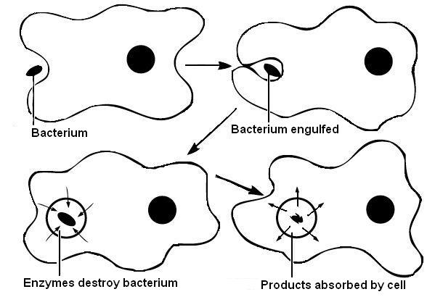
Phagocytosis
Leucocytes
(WBC’s)
Lymphocytes
Monocytes
Neutrophils
Eosinophils
Basophils

Slide 8
Inflammation
Leucocytes
(WBC’s)
Lymphocytes
Monocytes
Neutrophils
Eosinophils
Basophils
Inflammation – the initial
reaction of body tissue to
infection or injury
Results in area becoming painful, swollen, hot and red

Slide 9
Fever
Raised body temperature
Also known as PYREXIA
Pyrogens (chemical messengers) reset the body’s thermostat
Fever speeds up chemical reactions and phagocytosis

Slide 10
White Cell Count
Leucocytes
(WBC’s)
Lymphocyte
Monocyte
(Phagocytosis)
Neutrophil
(Phagocytosis)
Eosinophil
(Allergic Reactions)
Basophil
(Inflammation)
T Cell
?
B Cell
?
Natural Killer Cell
(Tumours or Virus infected cells)

Slide 11
Summary of Non-Specific Defence
Bacteria/Virus
SKIN AND MUCOUS MEMBRANES
NATURAL KILLER CELLS AND PHAGOCYTOSIS
(Plus Inflammation and Fever)
LYMPHATIC FLUID AND/OR BLOOD

Slide 12
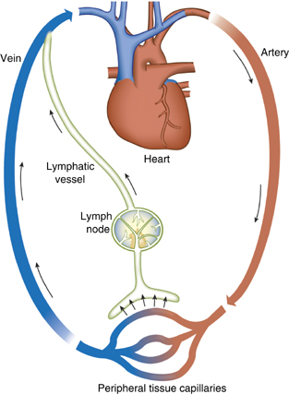
Lymphatic System
Spleen

Slide 13
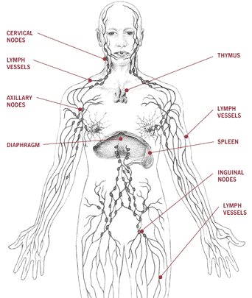
Lymphatic Tissue

Slide 14
End of part one

