Slide 1
Part two
Ataxic gait
Treatment options

Slide 2
Ataxia gait
Inability to make movements which require groups of muscles to act together in varying degrees of co-contraction.
Easiest to observe during single-stance phase as requires co-contraction of leg muscles in order to support body weight, whilst co-ordinated change in the relative activity of the muscles to move body weight forward
Notes:
From a flexed hip position at heel strike to an extended hip position at toe off.
Greatest difficult seen, either uses stance leg as rigid strut or staggers as co-ordination is lost
Walking aids can help by reducing the need for weight support through stance
Walking aids also increase flexion at the hips which reduces the co-ordination required to change from flex to ext

Slide 3
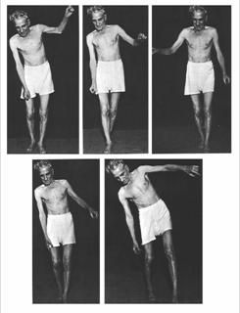

Slide 4
Cerebellar gait
Walking slowed, short, irregular and unequal length steps
Affected side leg – over high swing phase with excessive flex at hip and knee, lowered abruptly with uncontrolled force
Veers erratically, difficulty with stops and turns esp. if performed quickly
Inter joint coordination at hip, knee and ankle abnormal
Joint – joint decomposition
Notes:
Reduced movement in one joint, in order to convert multi joint movement into a series of single joint movement

Slide 5
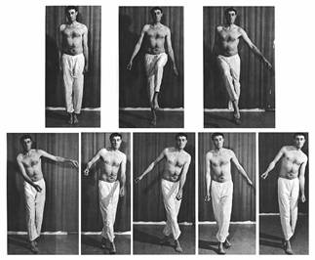

Slide 6
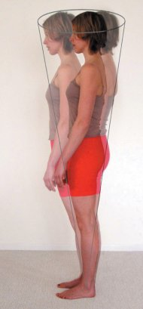
Postural instability
Increased standing postural sway (measured by centre of pressure movement recordings on a force plate) depend upon location of lesion
Notes:
Anterior lobe – high velocity and low ampliture in AP direction, tremor and increased intersegmental mvts head , trunk legs
Vestibulocerebellar (flocculonodula) low frequency and high amplitude without direction preference
Lateral cerebellar only slight postural instability

Slide 7
Analysis
Easy to spot - hard to analyse
Tend to make hypermetric movements – limbs move further than desired target
Tend to use too much force
Tremor common
Movements slower than normal

Slide 8
Co-ordination tests
Finger-nose test
Heel-shin test
Rombergs test
Dysdiadochokinesia
Dysmetria
Trunk ataxia tests
Tandem walking
Notes:
Control of voluntary movements, ability to co-ordinate movements
Focus on ability to perform simple than more complex tasks
Function such as eye-hand co-ordination, right left co-ordination
Lack of co-ordination / lack of rhythm is caused by cerebellar lesions
Trunk ataxia test
Crook lying one knee drop outs – hips
Pelvic tilt and bridging – pelvis and trunk
may try to increase stability by fixing with UL / knees and head

Slide 9
Treatment principles - cerebellar
Identify causal factors and treat effectively
Creating stability around proximal joints and in trunk
Functionally allow appropriate compensation strategies
Prevent over dominance of one posture / or movement
Considers supportive seating, weighted frames, damping devices ‘neater eater’
May require longer duration or intensity of practice
Notes:
Damage can affect the extent and rate a which individual adapt locomotion – need longer to train

Slide 10
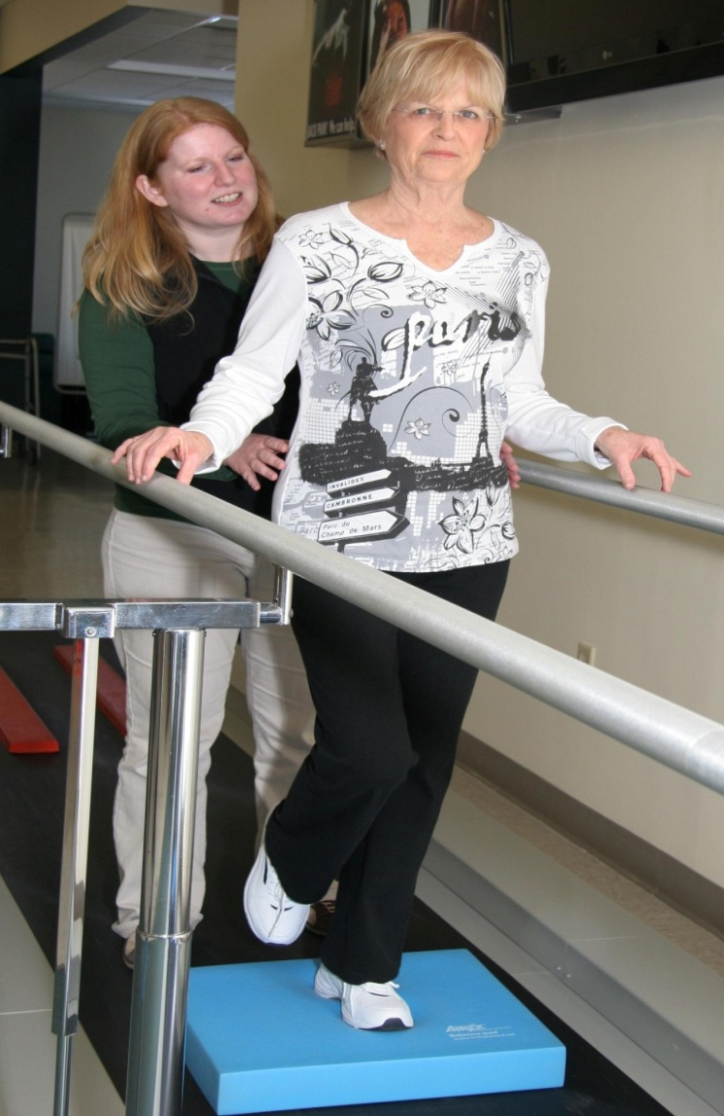
Management of the Ataxias: towards best Clinical Practice: Physiotherapy supplement
Dynamic task practice that challenges stability and explores stability limits and aims to reduce upper-limb weight bearing seems an important intervention for people with cerebellar dysfunction to improve gait and balance

Slide 11
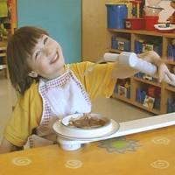
Management of the Ataxias: towards best Clinical Practice: Physiotherapy supplement
Strength and flexibility training may be indicated in conjunction with the above
A compensatory approach
(which includes orthotics and devices,
movement retraining, reducing the degrees
of freedom and optimising the
environment) seems valuable for teaching
people practical, everyday strategies and
ways of managing the condition and may
be particularly important for those with
severe upper limb tremor

Slide 12
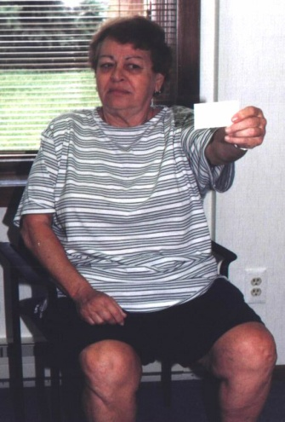
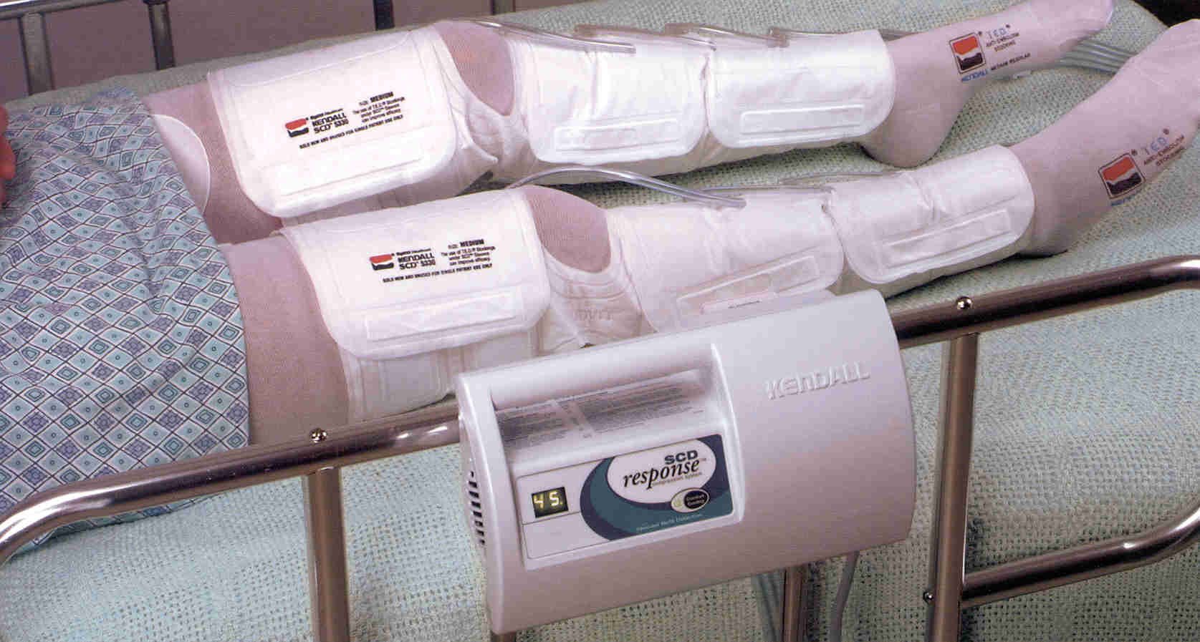
Treatment
Vestibular
-Habituation exercise
Sensory
- Compensation strategies
- Function and advice essential
- Stimulation

Slide 13
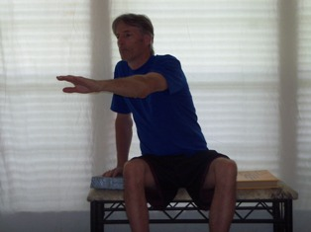
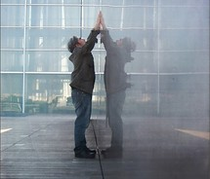
Aims for cerebellar ataxia
Counteract the postural and mvt adjustments
Encourage postural stability and dynamic weight – shifting increase smooth co-ordination of movement

Slide 14
Common abnormal postural features
Exaggerated lumbar lordosis
Anterior pelvic tilt
Flexion at the hips
Hyperextension of the knees
Weight towards the heel parts of the feet
Clawed toes (gripping)

Slide 15
Treatment techniques
Weight shifting in different positions
Lowering and raising the centre of gravity
PNF
Use of slow reversals, rhythmic movements and stabilisations
Gymnastic ball
Thalamic stimulation for tremor
Notes:
Encourage anticipatory postural adjustments

Slide 16
Recent research
Body weight support treadmill training 5/12 Rx non ambulatory to mobility with an aid (Cernak et al 2008)
Treadmill training 4/52 improved TUG and gait measures (Vaz et al 2008)
External body weights – anterior due to loss of balance posterior, improved sway and function (Gibson-Horn 2008)
Pressure splints 20 mins prior to each session 3 x’s a wk for 4/52 improved with combined approach (Armutlu et al 2001)
Notes:
16 yr female cerebellar brainstem infarct 16/12 previous training 5days a week, increased time speed decreased assistance and support
used visual cues and then head up to prevent the flexion head up increased propriception
2. 2 TBI pts ataxic ABA design 3 20 mins session per week, used tape to increase step length on treadmill, increased velocity, allowed to hold rail and then remove one hand
3. MS pt 1.5lb of weight case study report, detailed in Rx but lacks objective outcome measurement
4. MS sensory ataxia, combined PNF treatments, weight bearing, coordination exercises

Slide 17
Summary
Role of cerebellum - control of axial muscles and posture, coordination and planning of limb movements, control of eye movements, cognitive function, error detection and correction, learning / adaptation
Ataxia – issues with coordination
Rx aims to create stability and improve function

Slide 18
References
Armutlu K, karabudak R, Nurlu G, 2001. Physiotherapy approaches in the treatment of ataxic Multiple sclerosis: a Pilot study. Neurorehabilitation and neural repair 15, 203-211
Cassidy E, Kilbride C, Holland A, 2009. Management of the Ataxias: towards best Clinical Practice, Physiotherapy Supplement. Ataxia UK, www.ataxia.org.uk
Cernak K, Stevens v, Price R, Shumway-Cook A, 2008. Locomotor training using body-weight support on a treadmill in conjunction with ongoing physical therapy in a child with severe cerebellar ataxia. Physical Therapy 88, 1, 88-97
Edwards S, 2002. Neurological Physiotherapy Churchill Livingston, London
Gibson-Horn C, 2008. balance-based torso-weighting in a patient with ataxia and multiple sclerosis: a case report. JNPT 32, 139-146
Morton S, Bastian A, 2007. Mechanisms of cerebellar gait ataxia, The Cerebellum 6,1,79-86
Stokes M, 2005. Physical management in Neurological rehabilitation Elsevier Mosby, London
Vaz D, Schettino R, Castro T, Teixeira V, Furtado S, FigueiredoE, 2008. treadmill training for ataxic patients: a single-subject experimental design. Clinical Rehabilitation 22, 234-241

