Slide 1
Ataxia
Greek word – ‘without order’
Amanda Deaves
PHTY 222
Neuromuscular studies II

Slide 2
Learning outcomes
To define ataxia and types of ataxia
To revise role of the cerebellum
To review the components of ataxic gait
To understand common ataxia tests
To understand the common treatment principles for ataxia
To review recent research regarding the treatment of ataxia

Slide 3
Ataxia
Disturbances in co-ordination
Movements clumsy
Gait unsteady with a wide base and reeling quality ‘drunken gait’
Irregular jerky movements of trunk in sitting
Intention tremor
Notes:
Define and describe

Slide 4
Types of ataxia
Sensory
  High stepping gait pattern
  Reliance on visual or auditory
  Unaware of leg or foot position
Vestibular
  Disturbed equilibrium in standing & walking
  Loss of equilibrium reactions
  Wide based staggering gait pattern
Cerebellar
  Disturbances in rate, regularity and force of mvt
  Loss of mvt co-ordination
  Overshooting – dysmetria
  Decomposition of mvt – dyssynergia
  Loss of speed and rhythm of alternating mvt- dysdiadochokinesia
  Inco-ordination of agonist – antagonist muscles – intention tremor
Notes:
3 types
Sensory – lesions affecting peripheral sensory nerves conveying proprioceptive and cutaneous information, conditions affecting dorsal columns or the primary sensory cortex. Amplitude of postural sway increased when standing with feet together & eyes closed
Upper limb poor reaching excessive force to grip
Vestibular – peripheral or central disorders affecting the vestibular nuclei and / or afferent / efferent connections
Affecting vestibular apparatus – involved in initiation and modulation of postural adjustments and stabilising the head against gravity can be over reliance on remaining information
May limited head movement to prevent symptoms but this lead to inadequate use of somatosensory information – need to stimulate gaze control to improve balance
Cerebellar – lesions of the mid line structures, vermis, flocculonodular lobe produce bilat symptoms affect axial parts of the body, truncial ataxia, titubation, and gait issues
Kinetic tremor – oscillation during mvt, postural tremor, holding limb in position, titubation – trunk and head, postural trunk tremor, lower limbs and legs

Slide 5
Common causes
MS
Traumatic head injury
Friedreich’s ataxia
Spinocerebellar ataxia
Posterior fossa tumours
Neuropathy
Alcohol
Notes:
Freidrch – 2 per 100,000 persons, genetic abnormality recessively inherited
Ms- ? All types depends on plaques
Spinocellellar ataxia – degenerative disorders manifested by progressive ataxia
Neuropathy disease of nerves – sensory ataxia

Slide 6
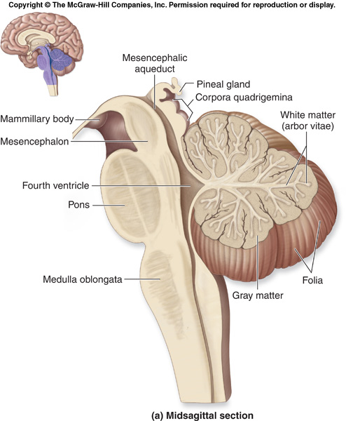
Location of cerebellum
Notes:
Discuss CBM ataxia
Describe location
Attached via 3 peduncles, superior, middle, inferior
Afferent and efferent connections

Slide 7
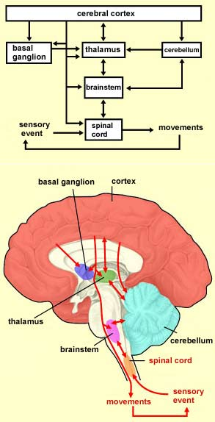
Notes:
Overview of the feed forward and feedback control within the CNS
Cerebellum listening and correcting movements
Red nuclues in the midbrain key in the communications with the cerebellum

Slide 8
Cerebellar regions / role
Voluntary limb mvts
Eye mvts
Balance
Locomotion
Higher brain function
Notes:
Developing / modern view that the different regions of the cerebellar play an integral role in the control of different behaviours
This view is based on the anatomy of the cerebellar afferent and efferent connections as well as neural recordings and lesion studies
Cerebellar integrity is critical for trail and error adaptation of motor behaviours to new context - learning

Slide 9
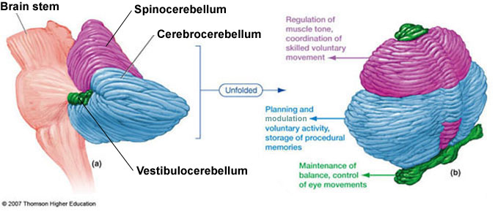

Slide 10
Functional and anatomical systems
spinoCBM
Control of axial muscles and posture
Vermis and intermediate region
pontoCBM
Coordination and planning of limb movements
Lateral cerebellar hemispheres
vestibuloCBM
Posture and control of eye movements
Flocculus
Notes:
Consists of 2 hemispheres – separated by the vermis
Anterior lobe – receives proprioceptive input, controls anti-gravity muscles of the body regulating posture
Posterior lobe – coordination of muscle movement – role in fine motor control
Flocculonodular lobe – most inferior part of the vermis – involved in the maintenance of equilibrium
Four deep nuclei (dentate, emboliform, globose, fastigal nuclei) have axons projecting to the brainstem and beyond

Slide 11
Role
Compares intended movements with actual movements
Whilst receiving information from vestibular and visual system
Error signal via descending motor pathways
Inferior olive stimulates climbing fibre to Purkinje cell to store motor memory (learning / adapting)
Notes:
Originating from the motor cortex
From information from muscle afferents and spinal cord interneurons

Slide 12
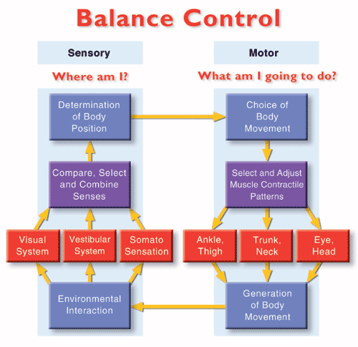

Slide 13
Brainstem
Cerebellum
Afferent information
Mossy fibres
Purkinje cells
Inferior olive
Climbing fibres
Output via red nucleus, thalamus to cortex
Deep cerebella nuclei
Notes:
Afferent information
Dorsal spinocerebellar tract – sensory state of limbs
Ventral spinocelebellar tract – motor commands from spinal interneurons
Vestibular inputs
Reticular inputs
Pontine nuclei
Inferior olive in the medulla receives information from a varity of sources, error detection and correction.
Indirect and direct stimulation of purkinje cells to control the inhibitory output.
Indirect pathway involves the stellate cell, basket cells, golgi cell, granule cell and parallel fibres
Deep cerebella nucei – fastigial, dentate, interpositus, vestibular nuclei

Slide 14
Normal locomotion
Reciprocal flexor and ext muscle activity
Modulations of timing, rate, force
Coordinates jt segments between and within jts
Maintain equilibrium
Upright posture during walking
Utilizes both anticipatory and feedback mechanisms
Adapting to novel contexts
Providing adaptability to pattern
Novel context or visual guidance – lateral zone
Medial & intermediate zones critical role
Medial cerebellar zone
Based on trail and error practice
Notes:
Locomotion generated in brainstem and spinal cord
Produces highly sterotyped walking pattern

Slide 15
End of Part One

