Slide 1
Physiotherapy BSc (Hons)

Slide 2
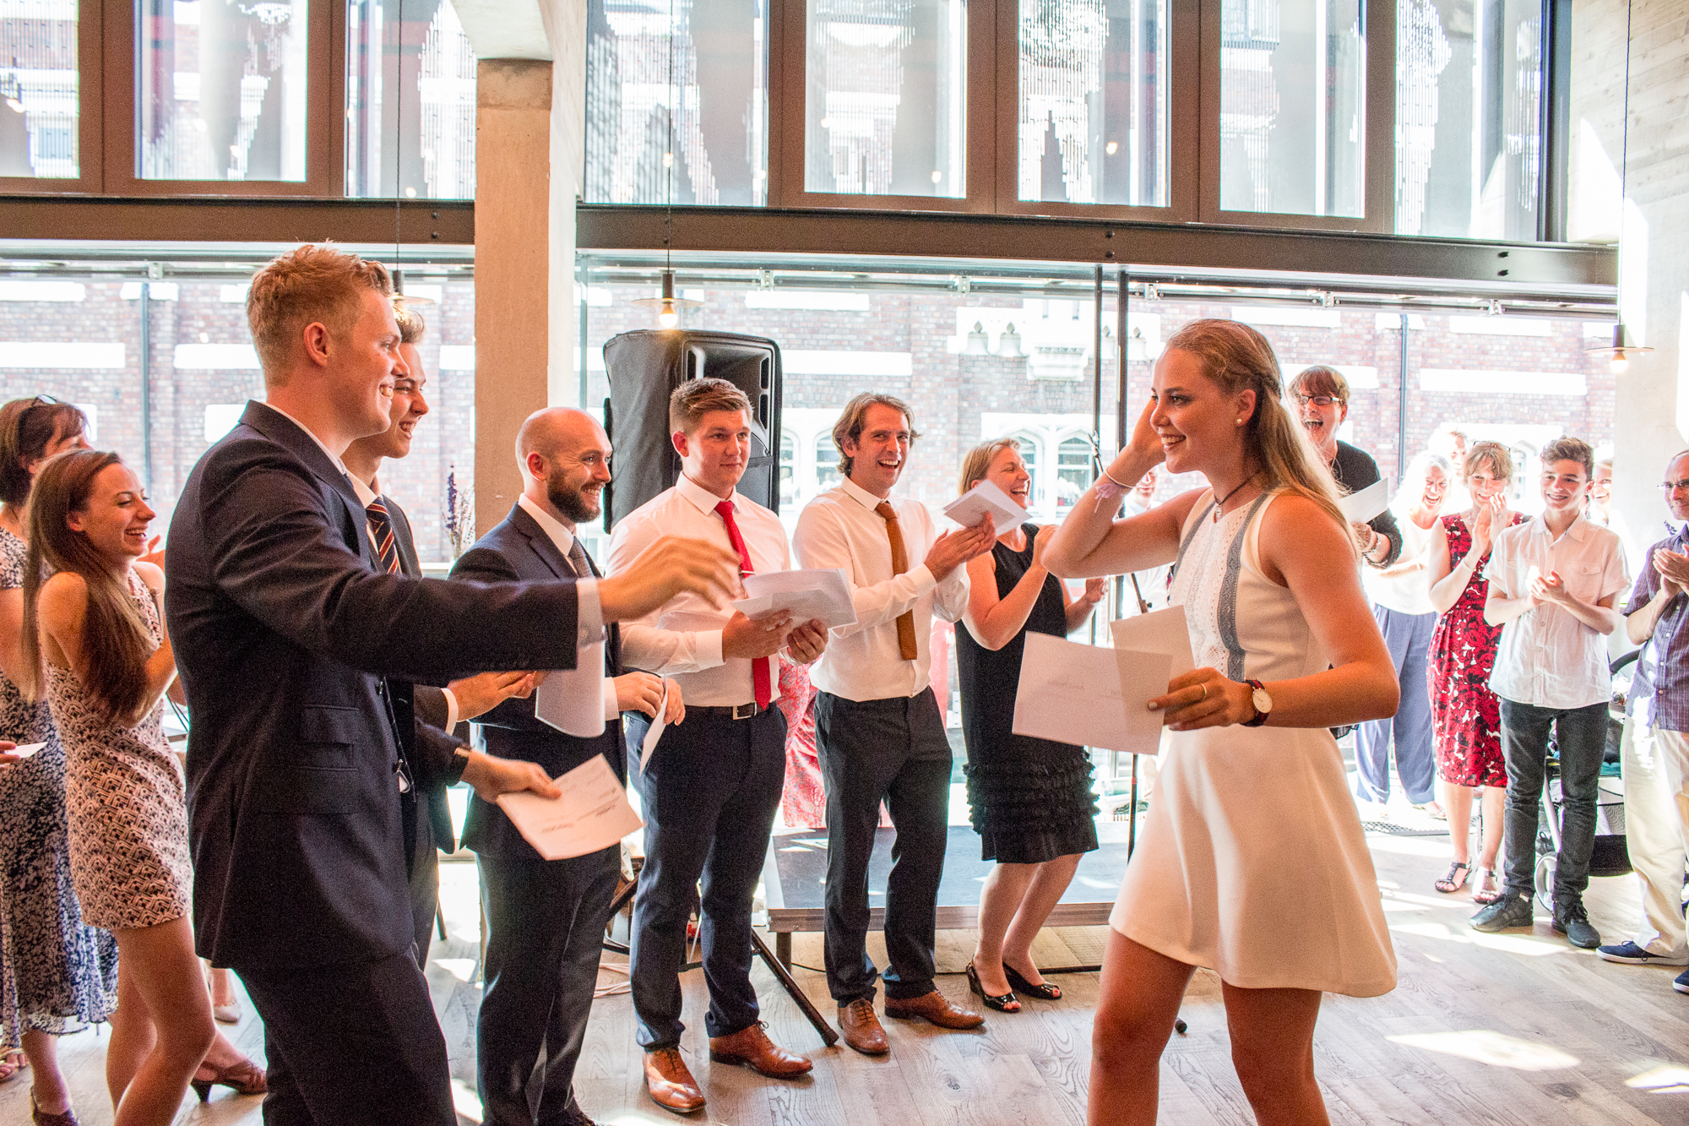
The 2016 graduating students receiving their prizes

Slide 3
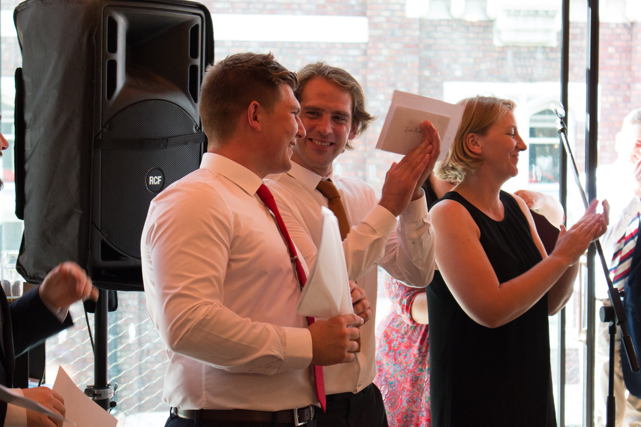
The 2016 graduating students receiving their prizes

Slide 4
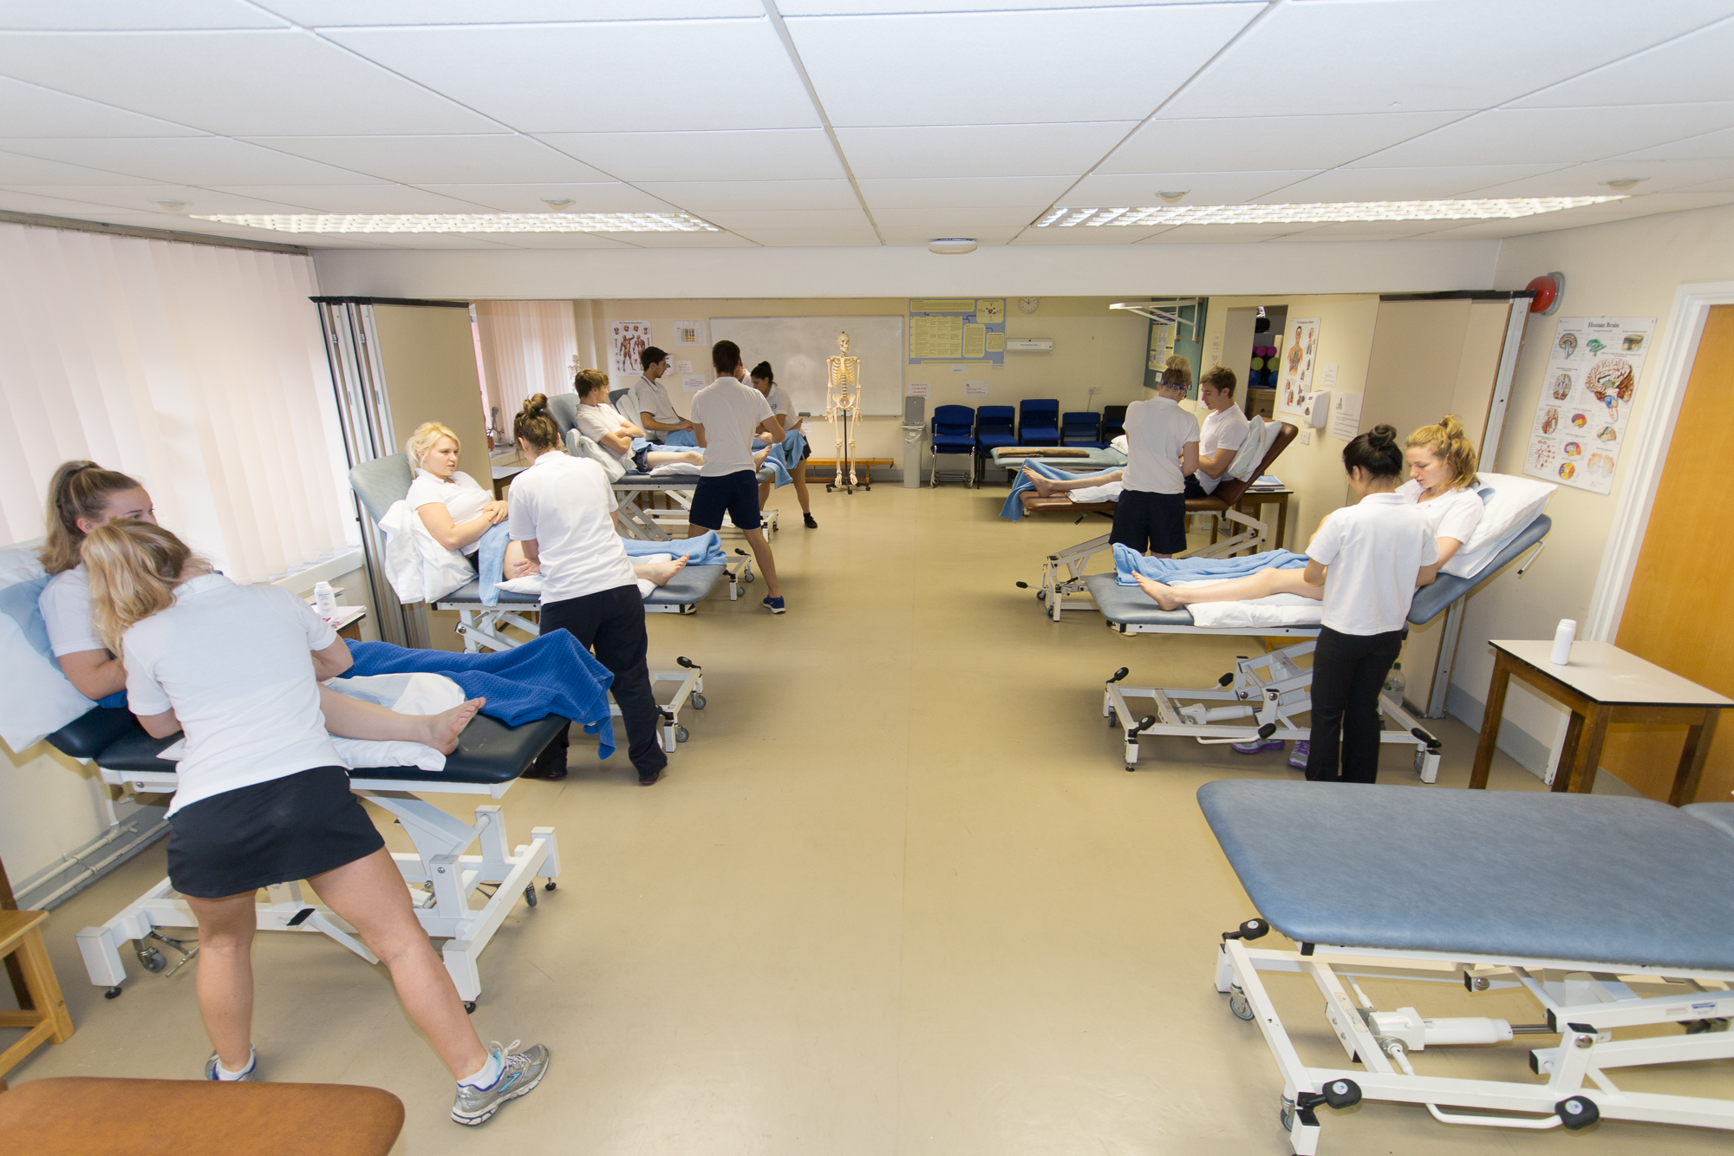

Slide 6
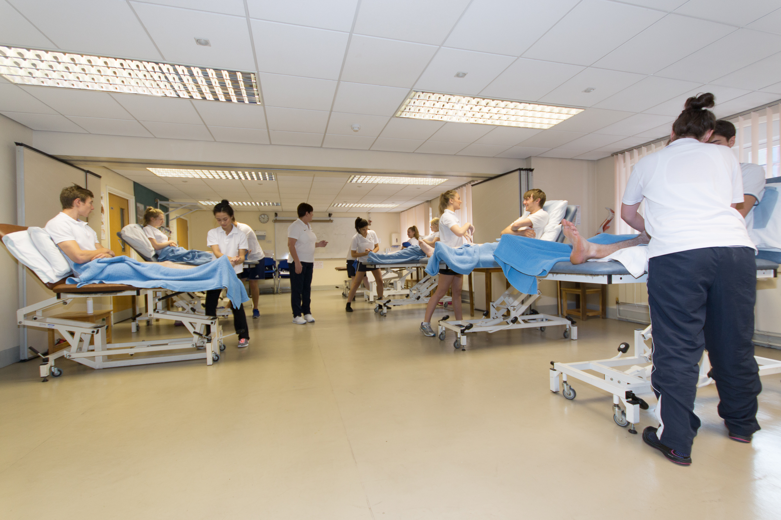

Slide 7
The Complete University Guide 2018
Physiotherapy at Liverpool
ranked 4th of out 35
(1st in the North West)

Slide 8
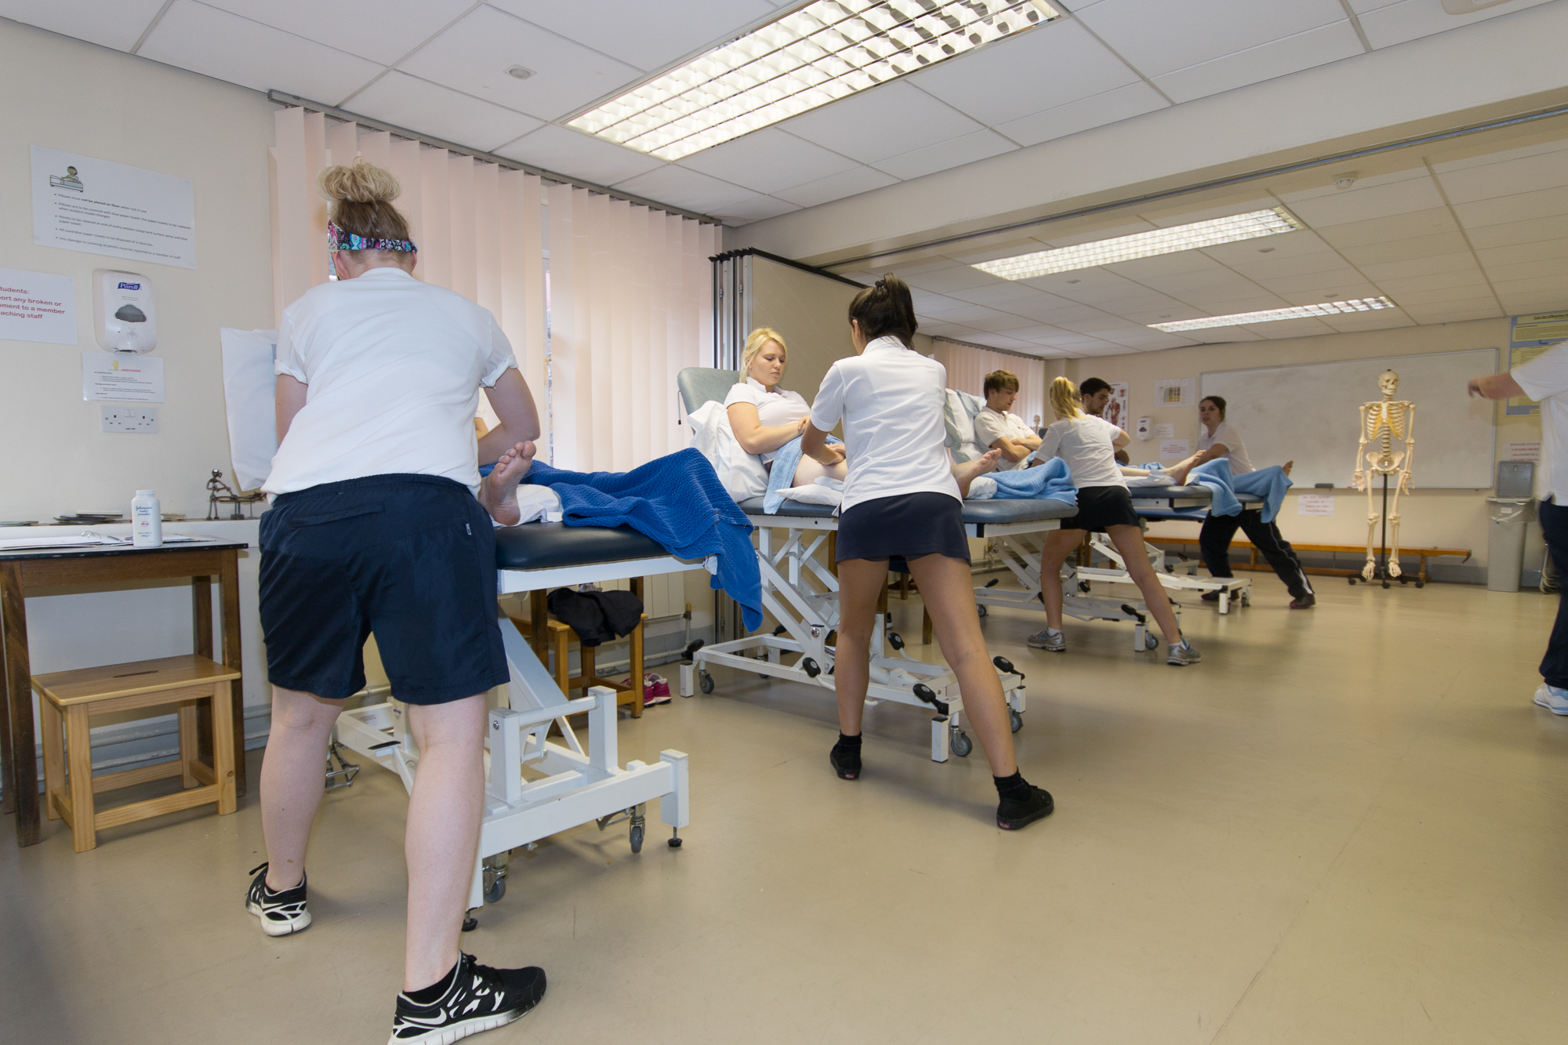

Slide 9
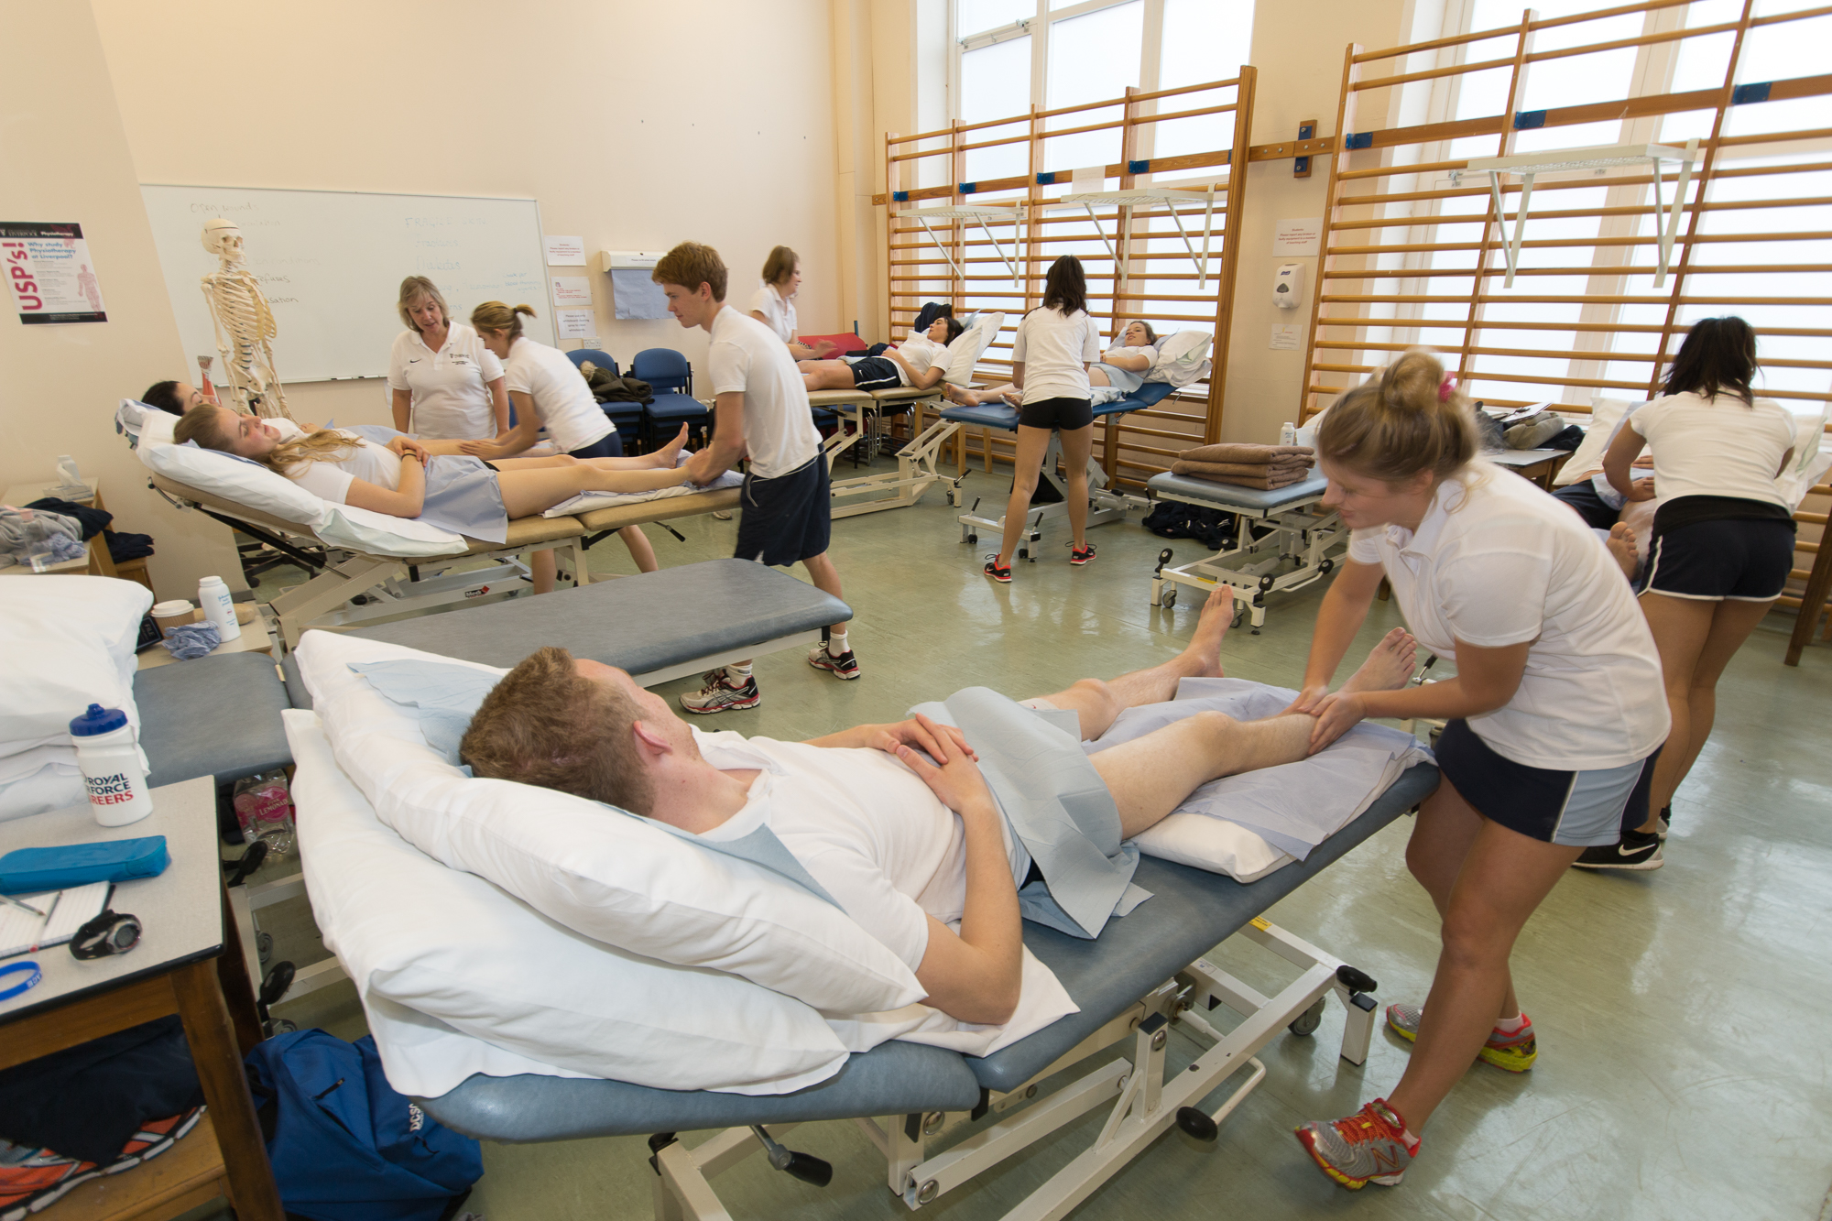

Slide 11
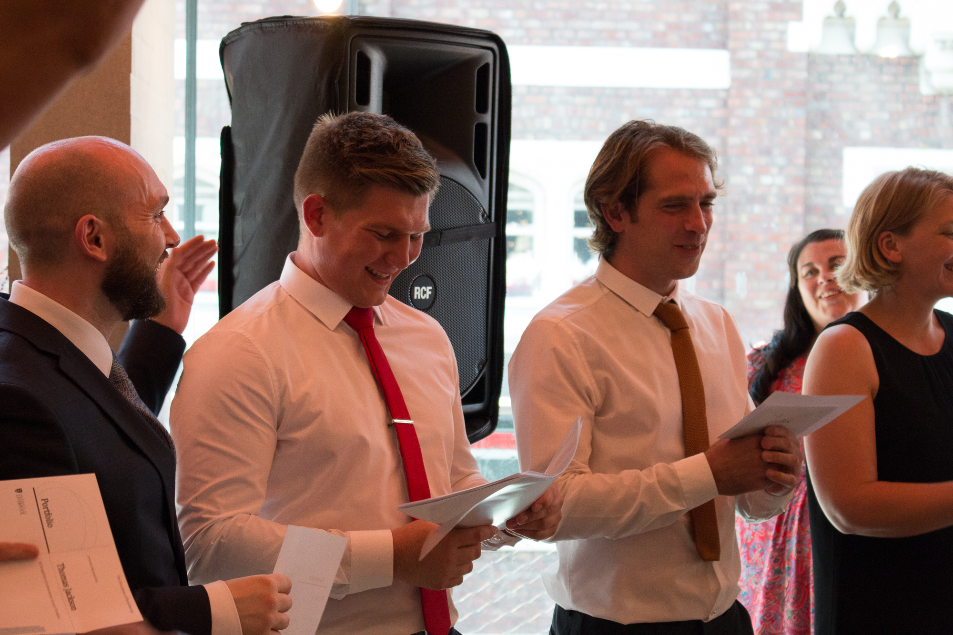
The 2016 graduating students receiving their prizes

Slide 12
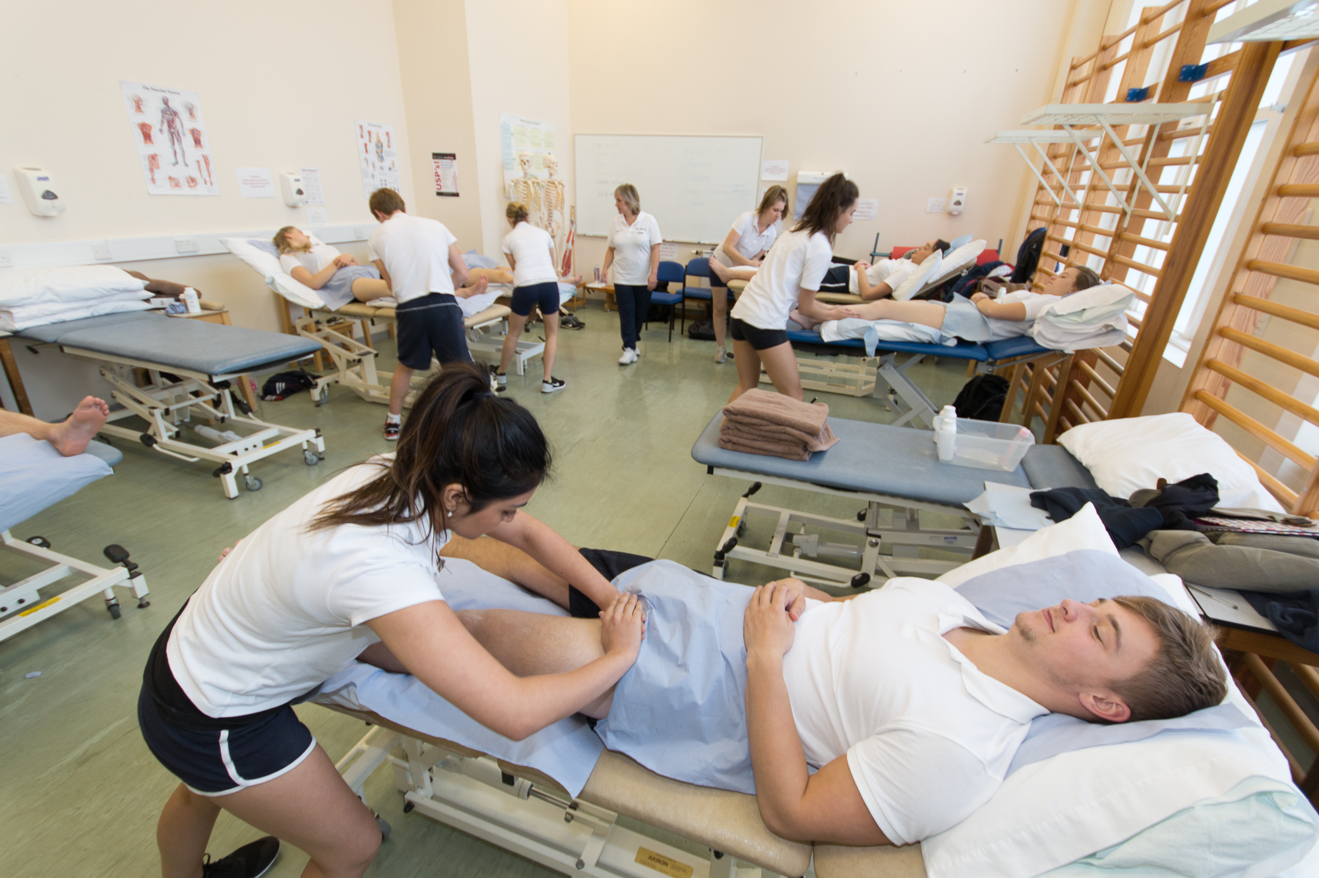

Slide 13
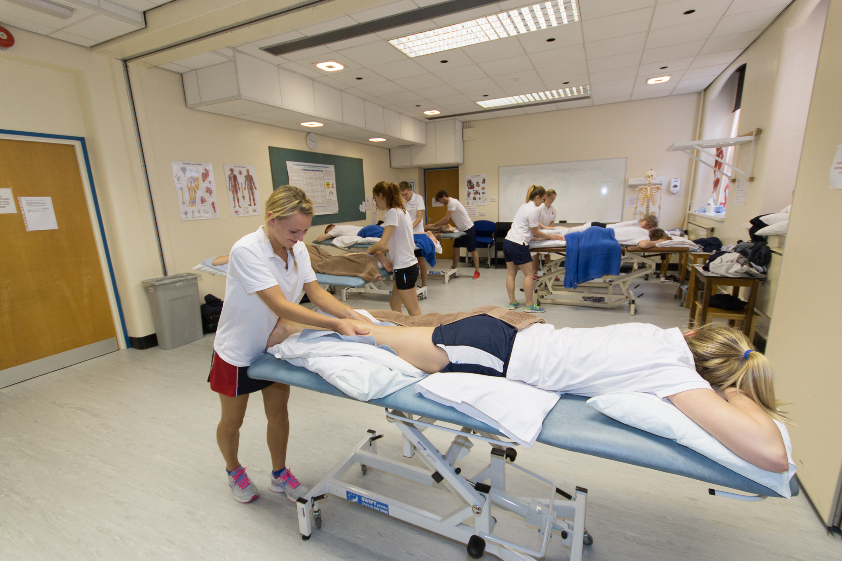

Slide 14
“Every single member of staff
has made a huge contribution
to my life”

Slide 15
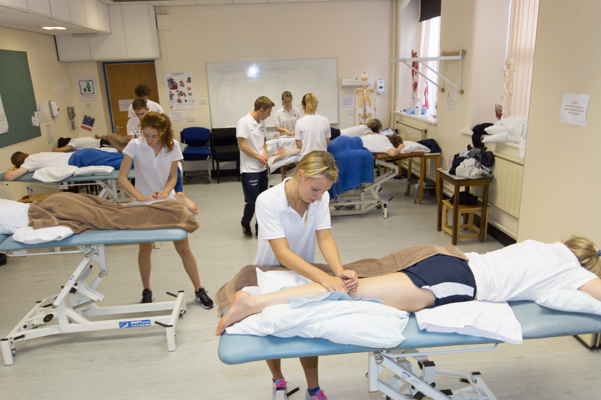

Slide 16
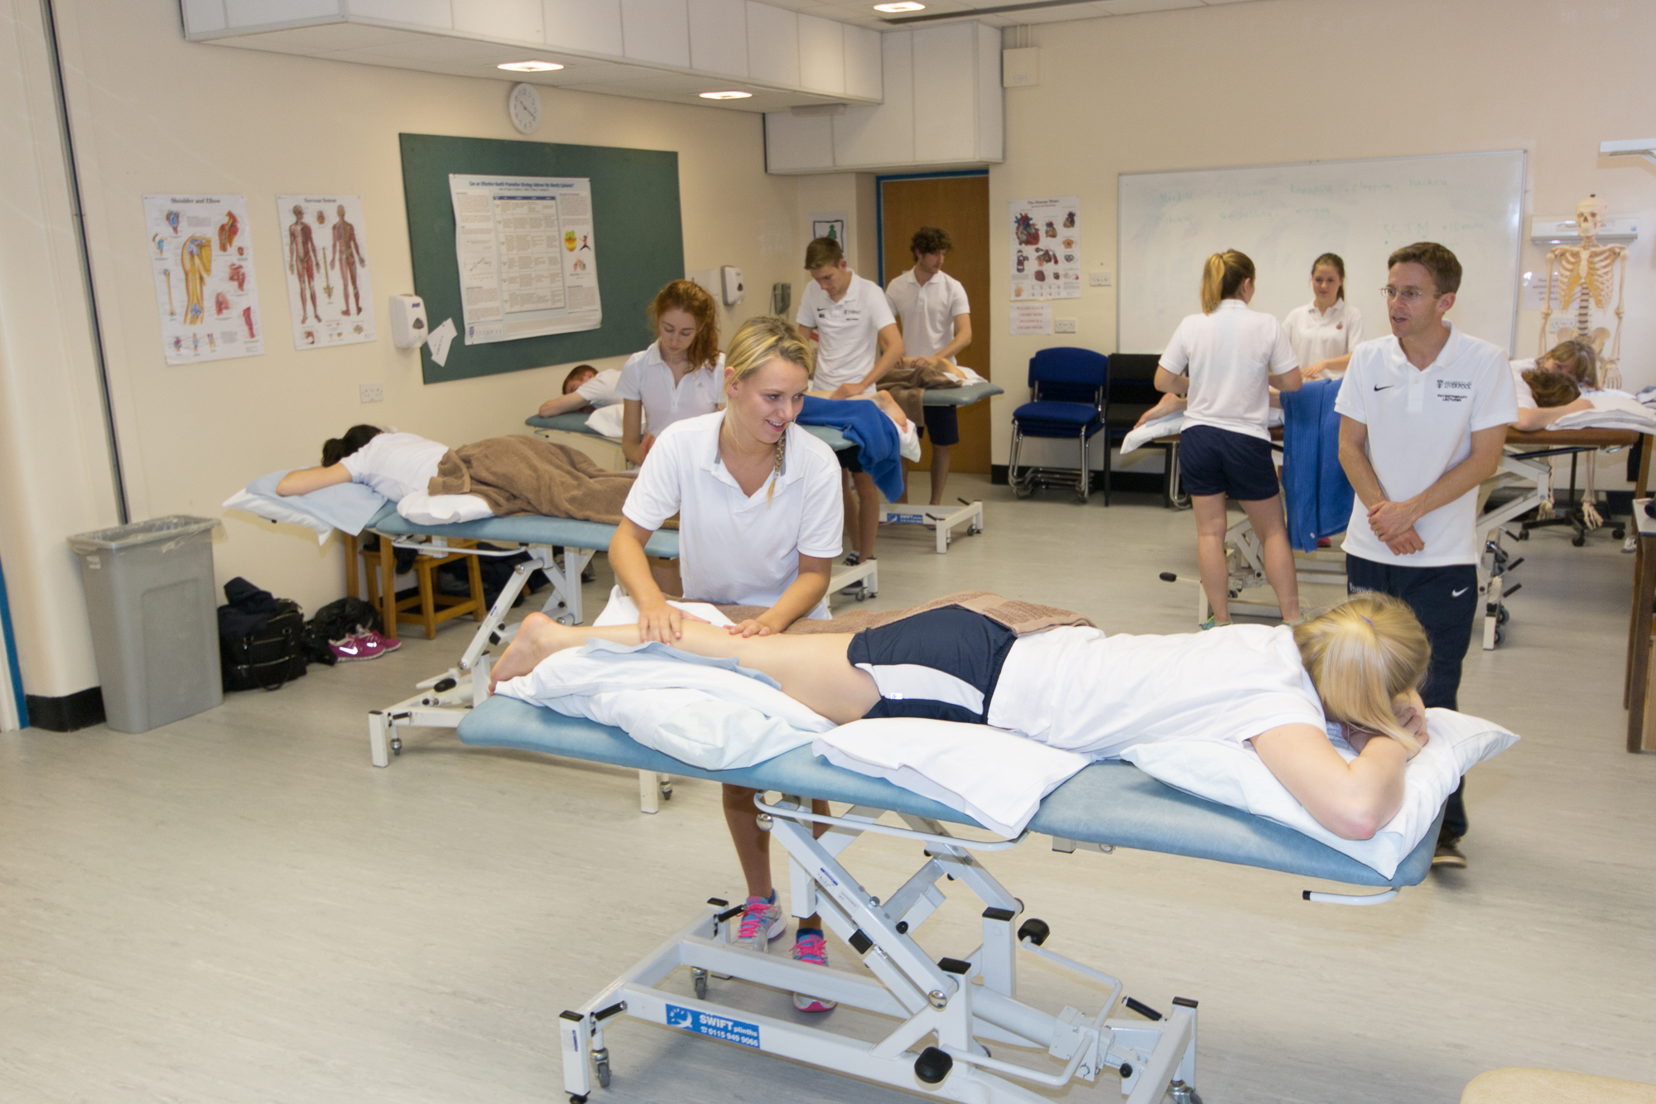

Slide 19
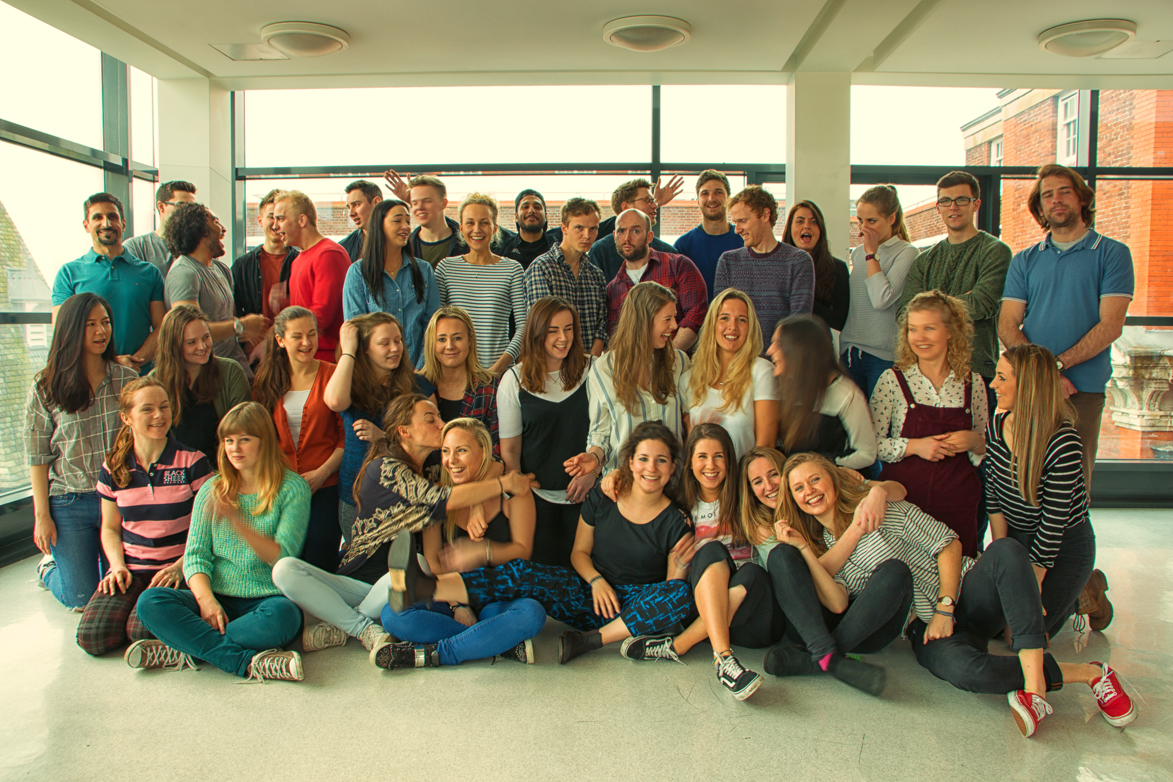
The 2016 graduating students

Slide 20
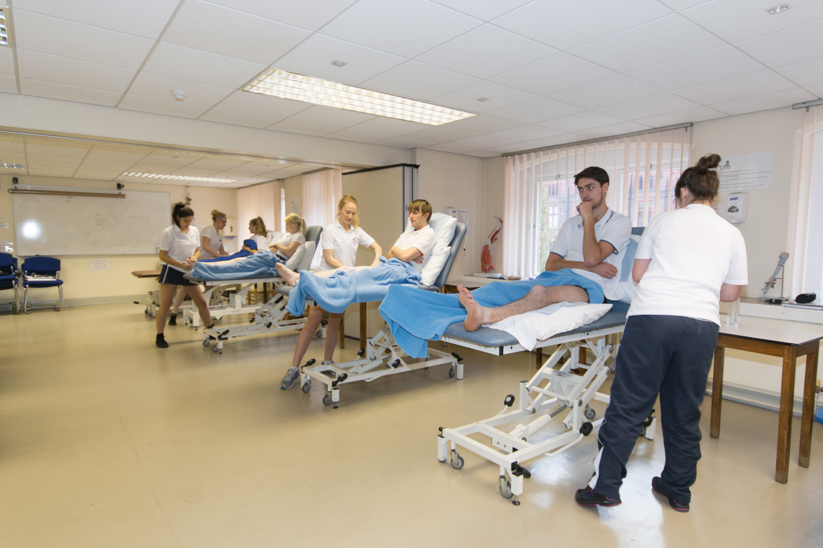

Slide 21
“The Physiotherapy Department
at the University of Liverpool
feels like one big family”

Slide 22
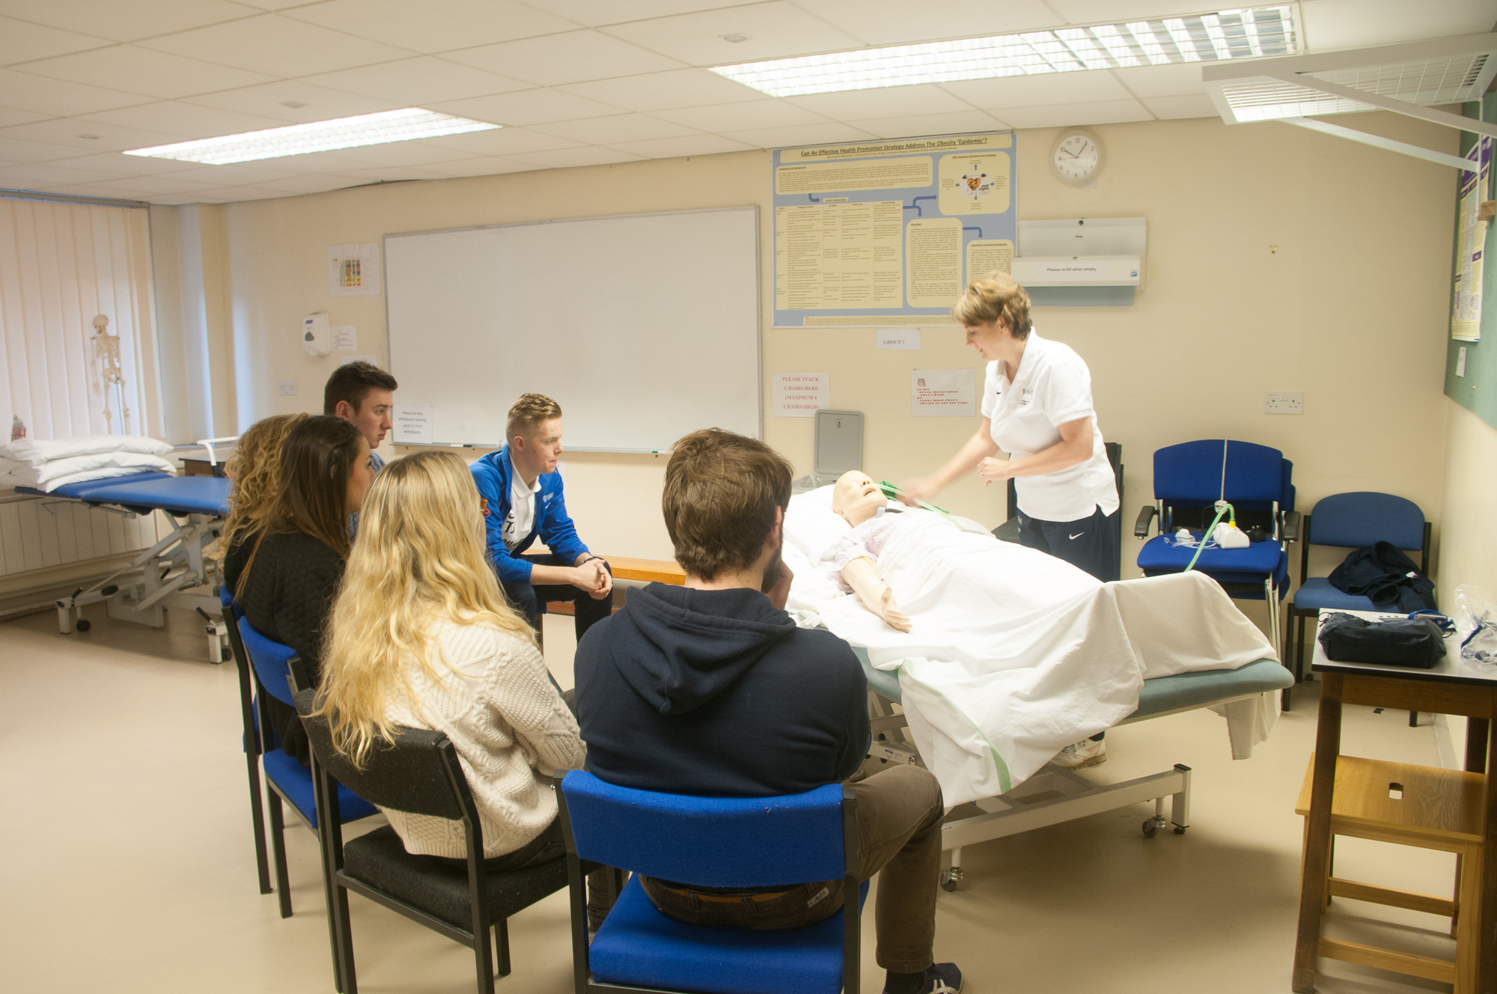

Slide 24
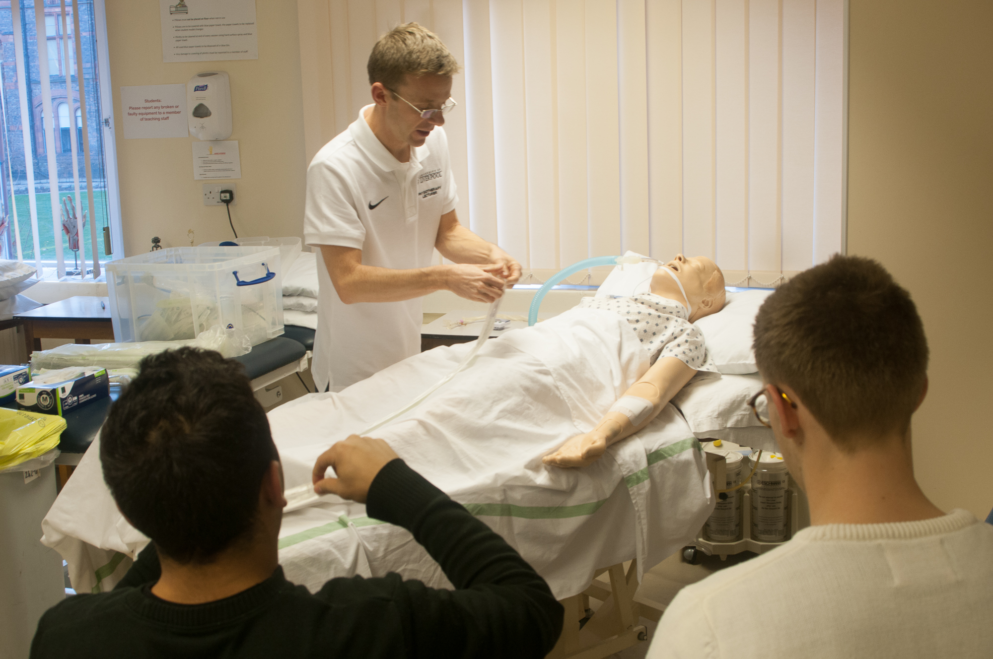

Slide 25
1st in the North West for Physiotherapy
(The Complete University Guide 2018)

Slide 26
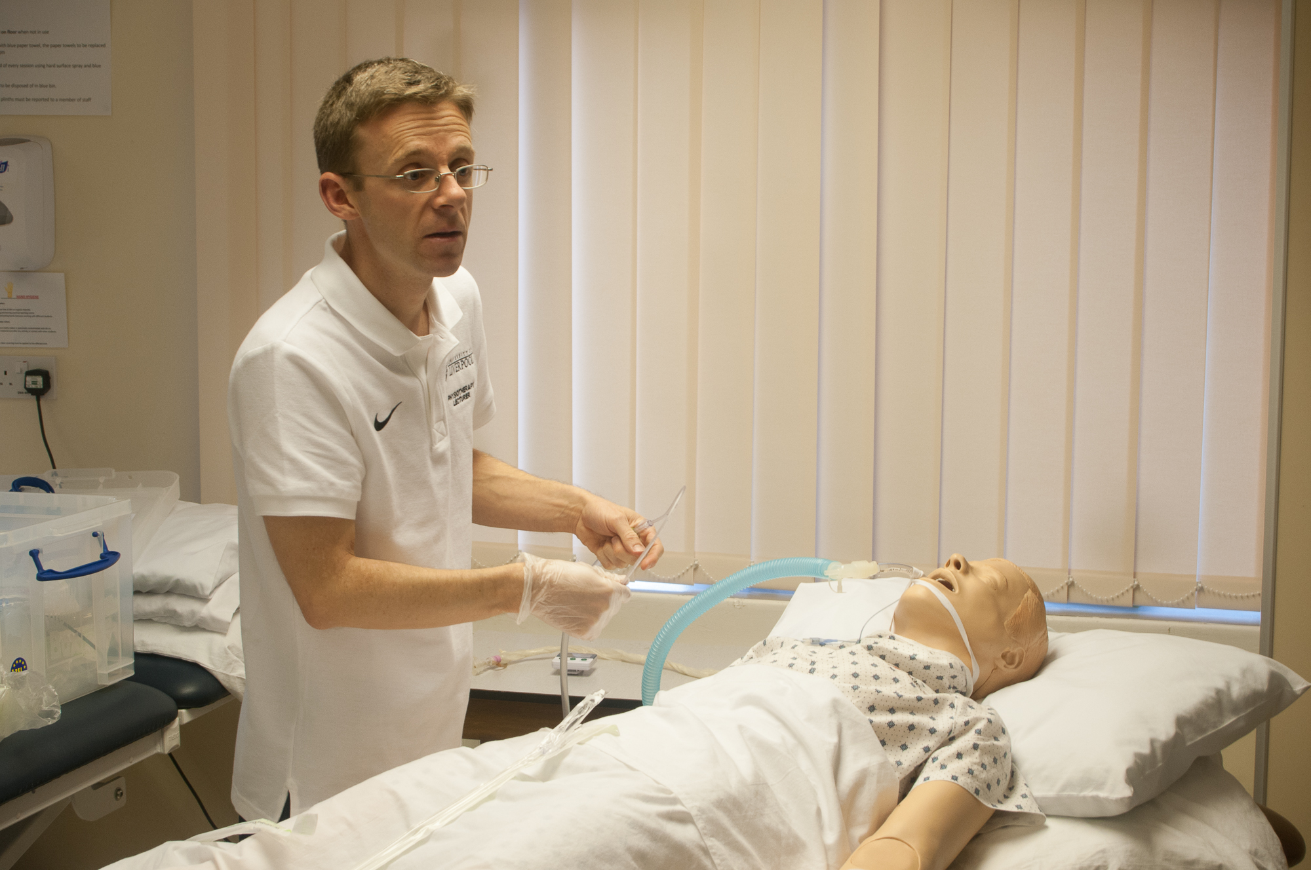

Slide 27
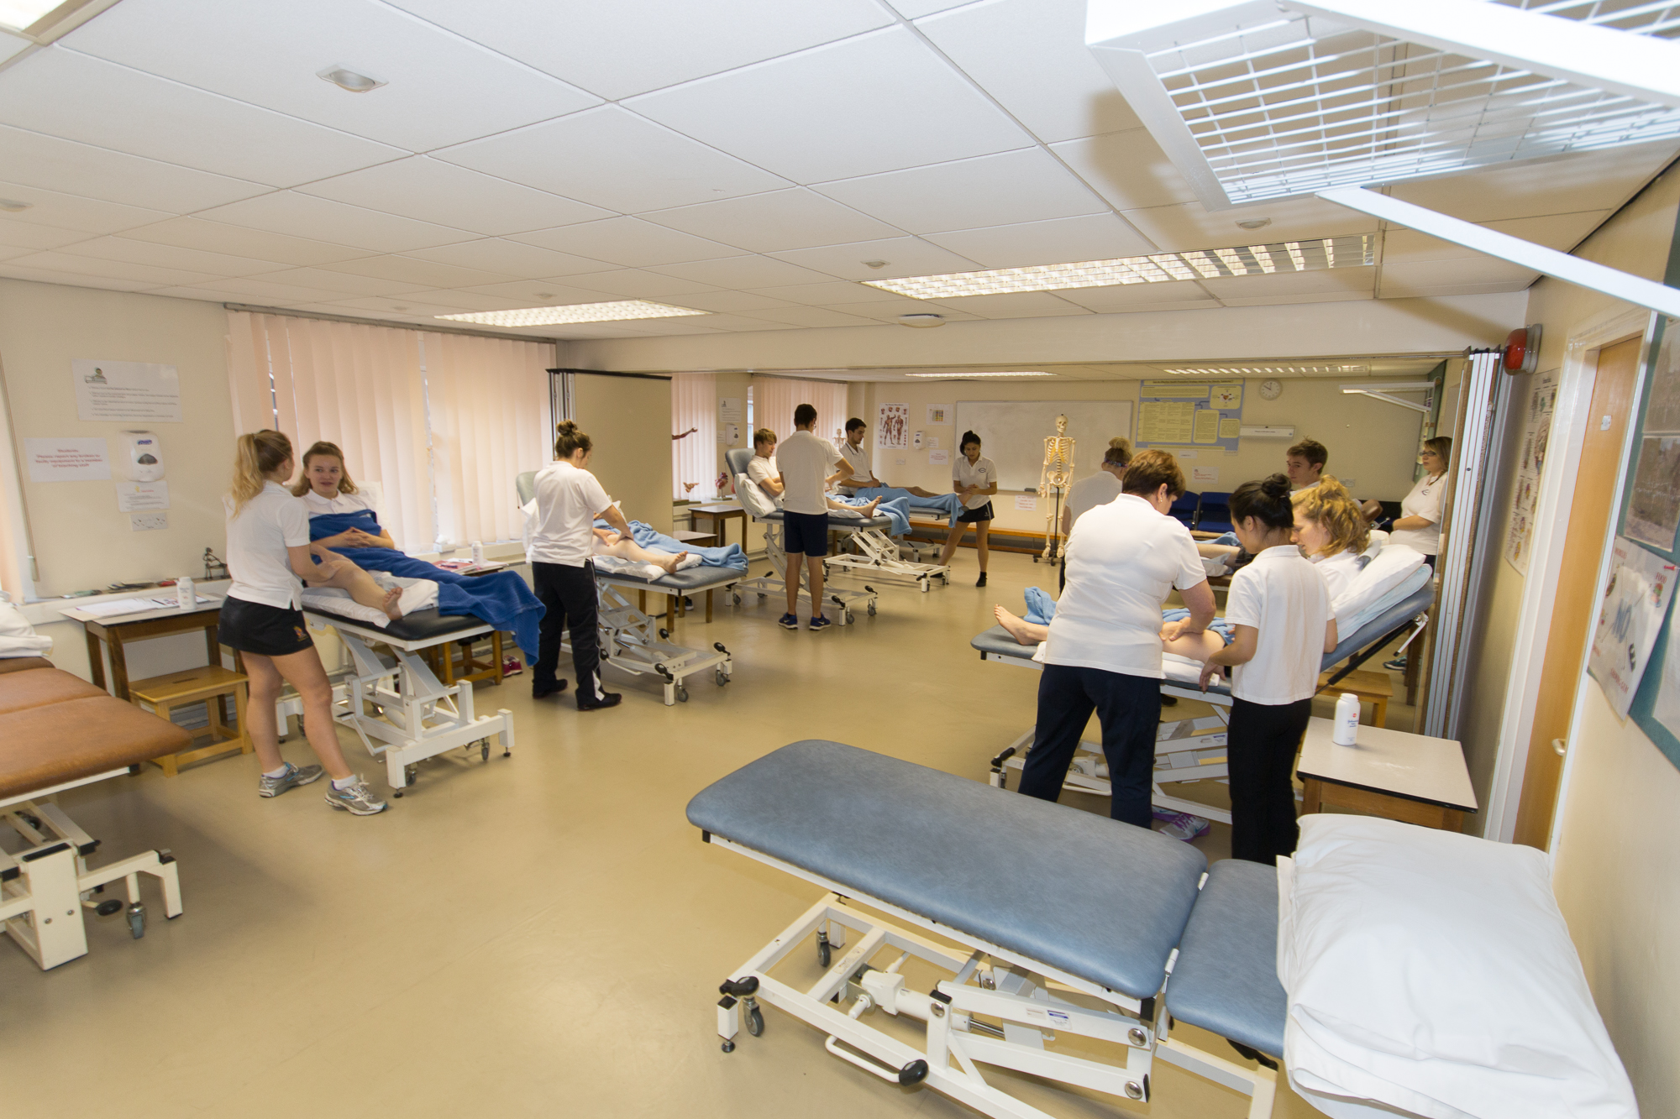

Slide 28
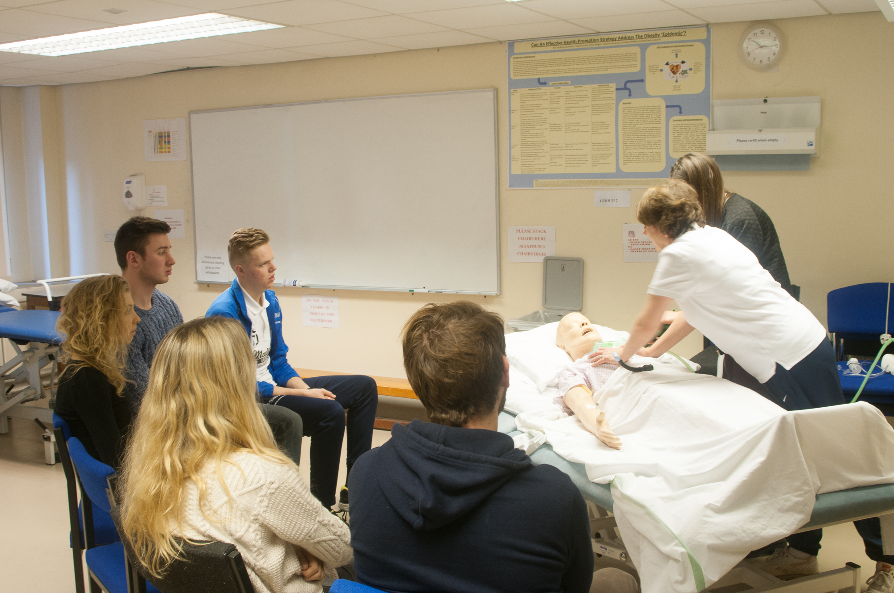

Slide 29
“Each and every member of staff has a huge heart and are passionate about what they do”

Slide 30
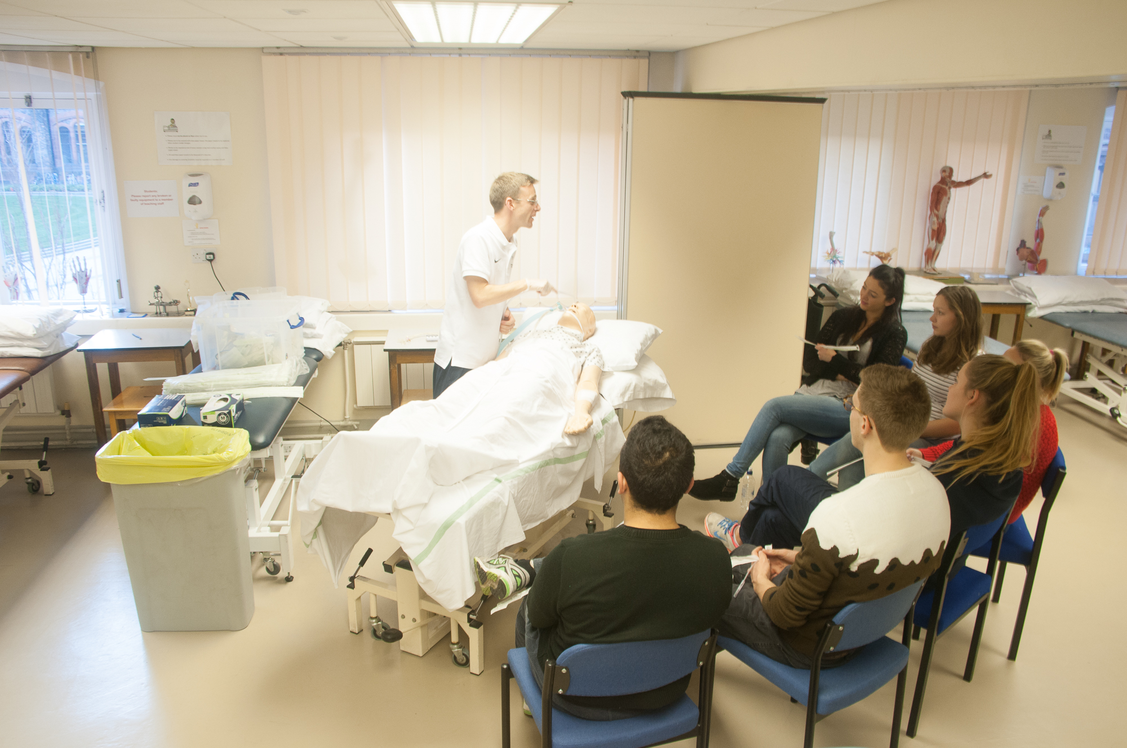

Slide 34
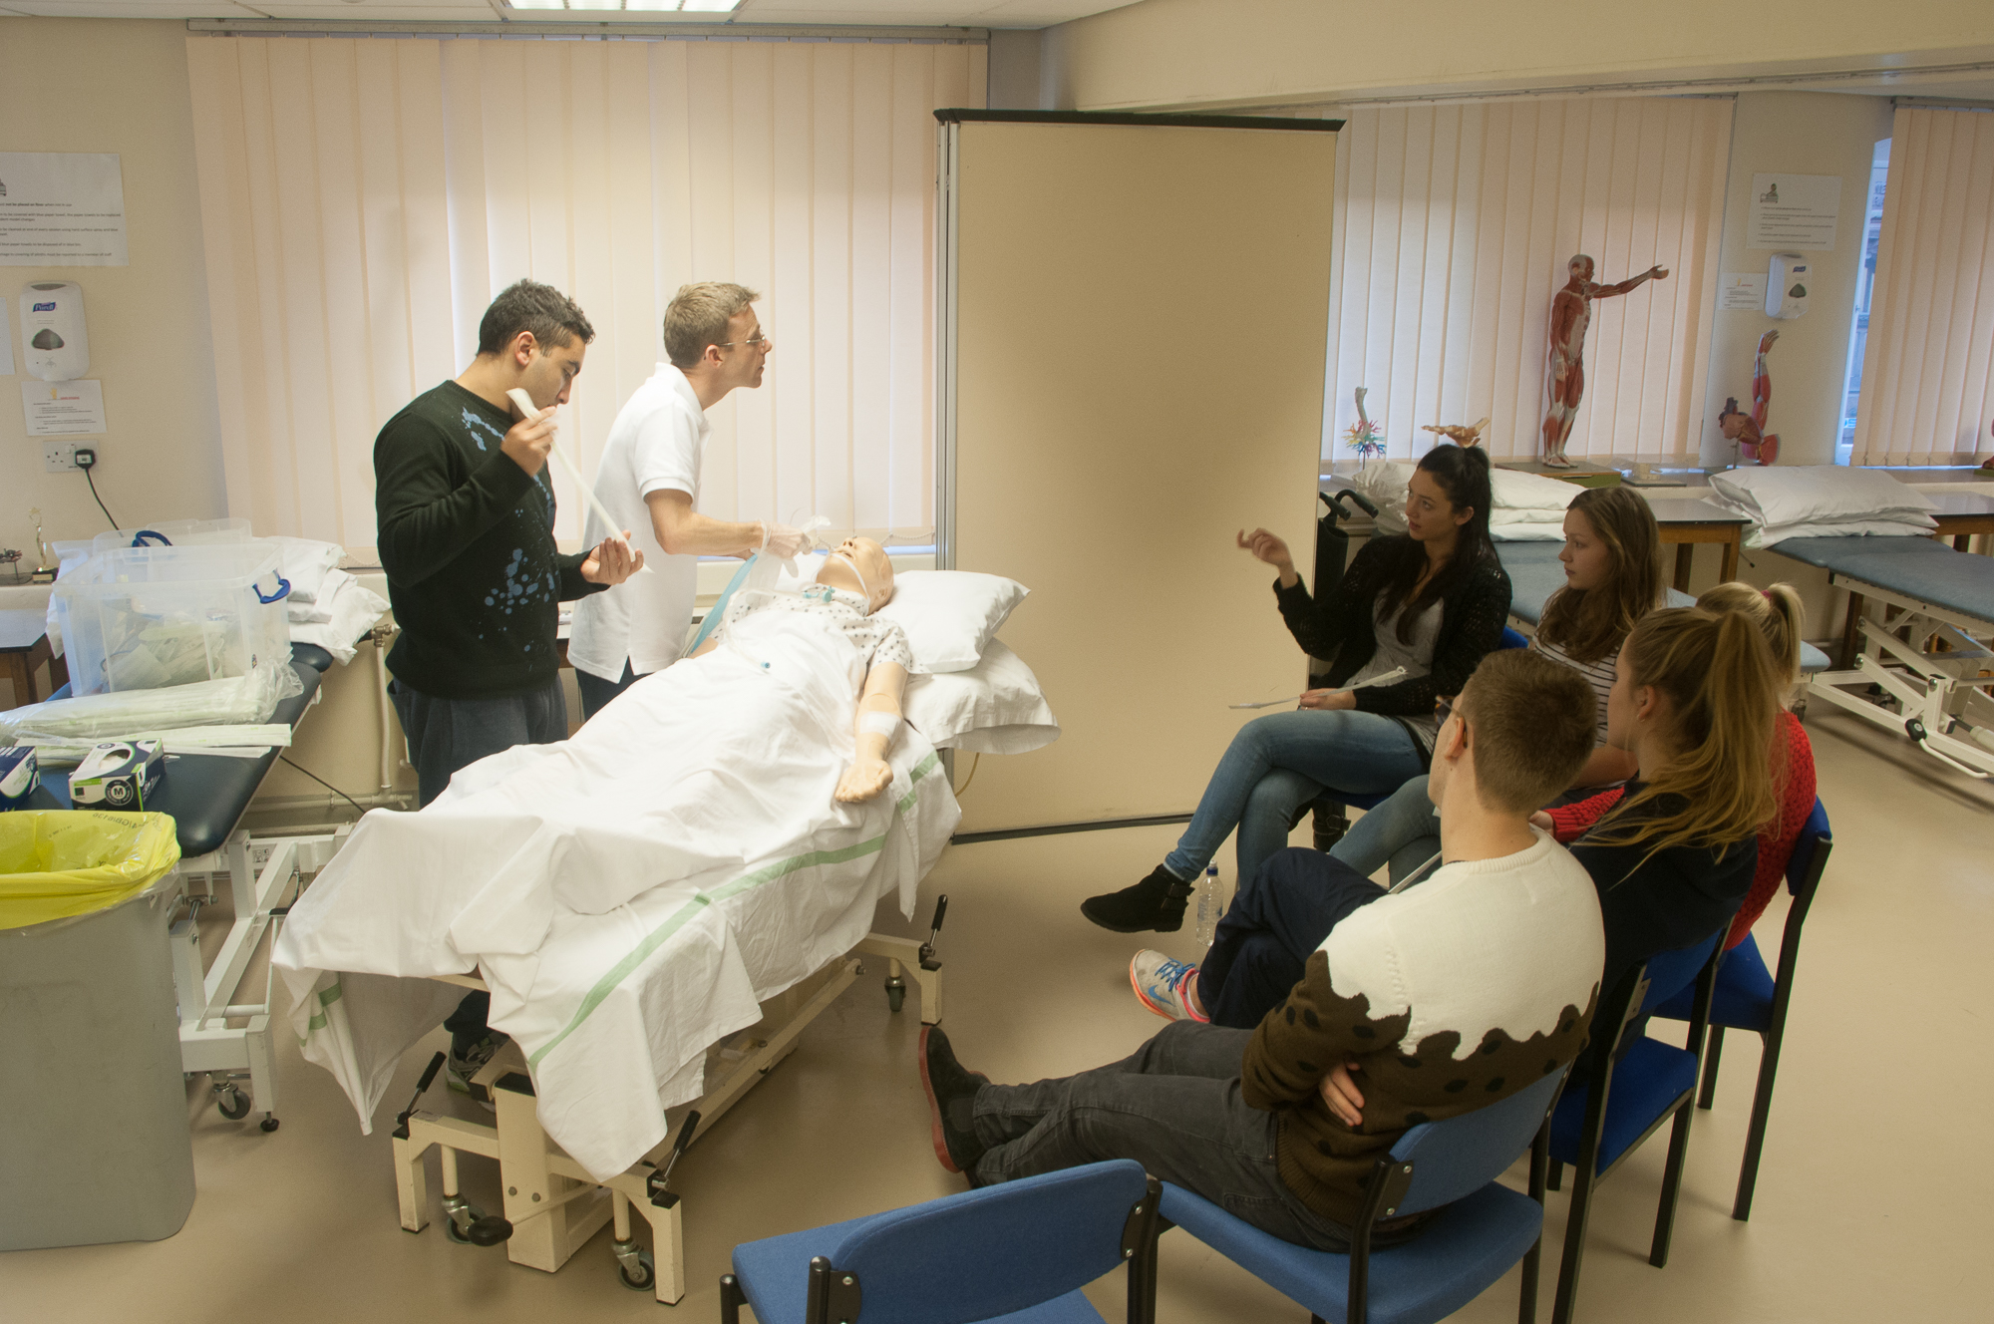

Slide 35
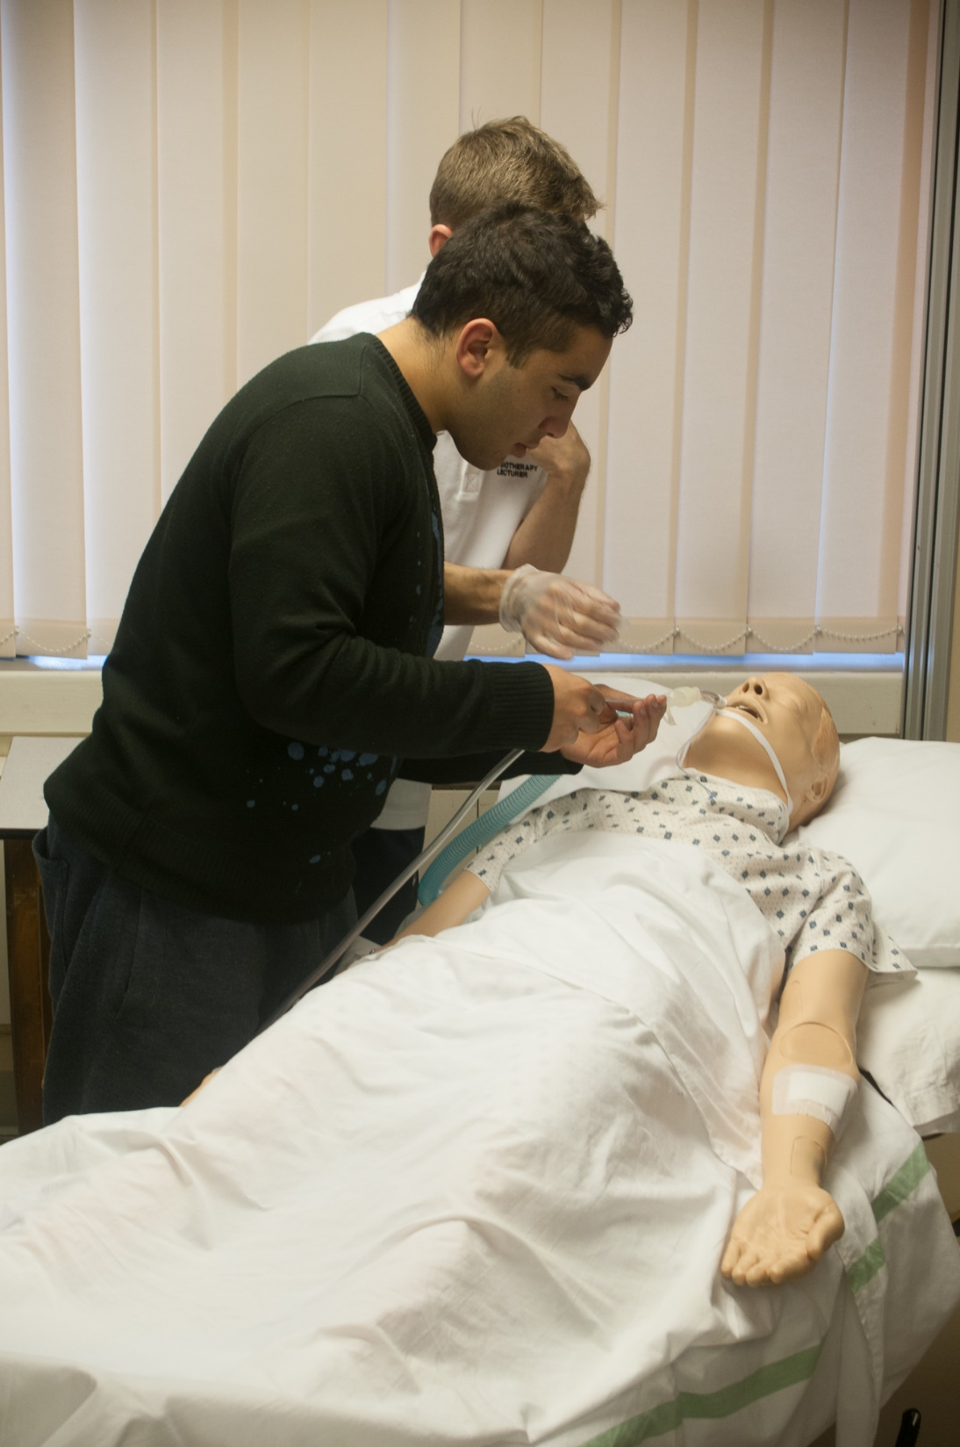

Slide 36
“I have received a challenging and life-changing education provided by an incredibly knowledgeable, supportive and caring team of educators”

Slide 40
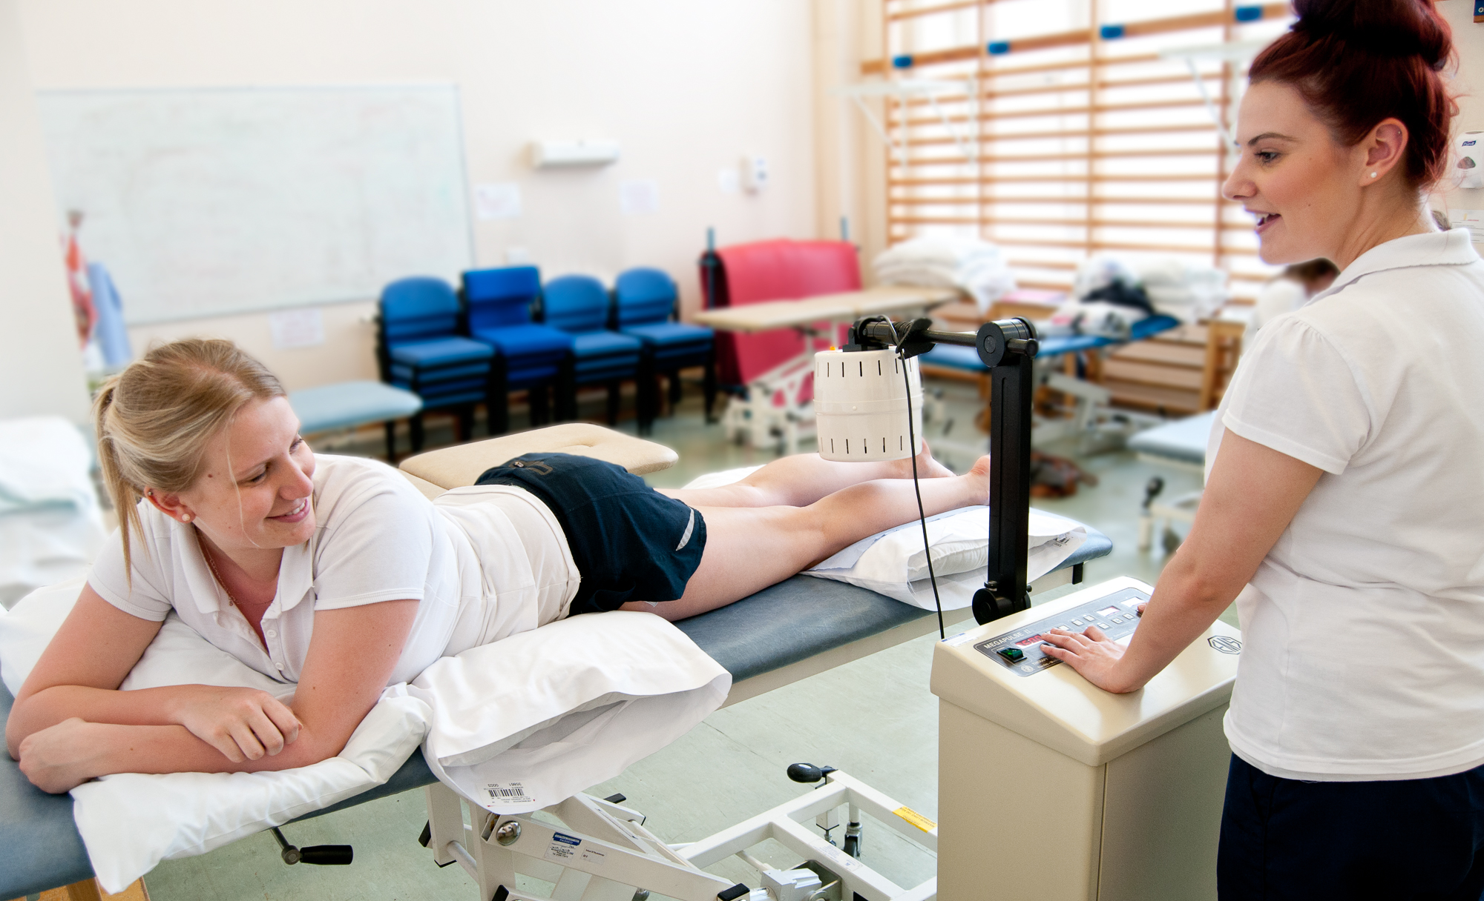

Slide 41
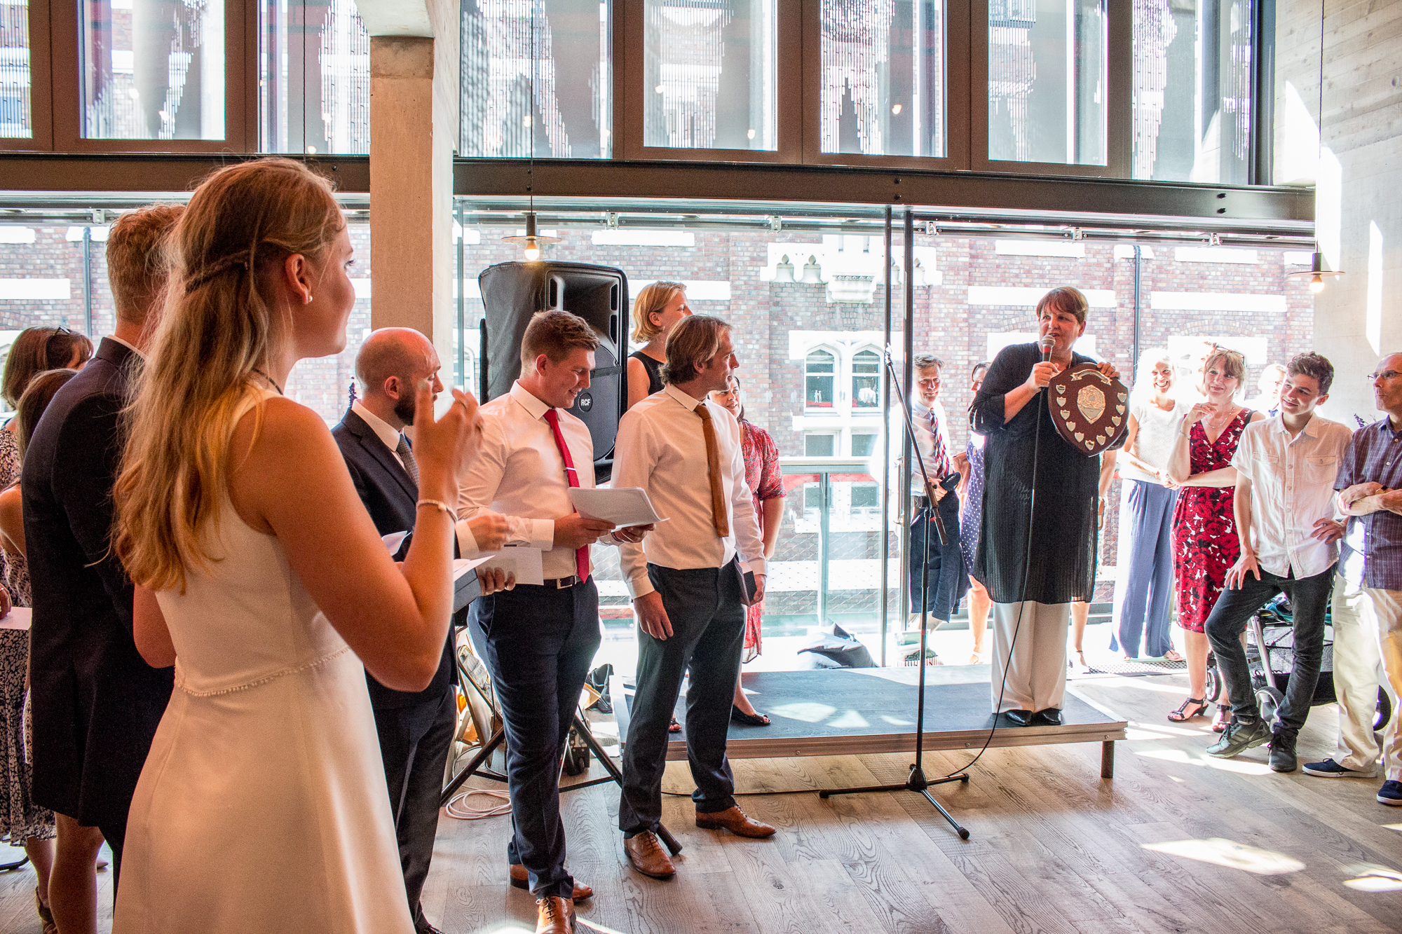
The 2016 graduating students receiving their prizes

Slide 42
“The staff are a credit to the university. Always willing to help and always there to support”

Slide 44
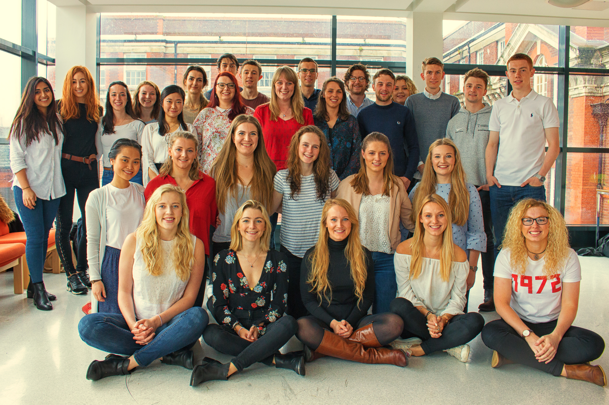
The 2017 graduating students

