Slide 1


SAMR: Transformation learning with technology
Anita Holt

Slide 2
Question...
Do you use technology for technologies sake, or are you SAMRING?????????????

Slide 3
SAMR in 120 seconds

Slide 4
Question:
  If you used an online quiz, with self assessment, instead of your usual paper-based one, where in the SAMR model would you be?
  What could you do to move this activity to the next stage?

Slide 5
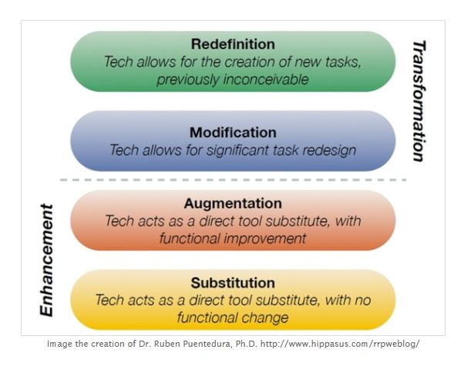

Slide 6
How well do you do?
Further information on the SAMR model and other models:
http://www.youtube.com/watch?v=gYYcvADUovY
http://www.educatorstechnology.com/2013/06/samr-model-explained-for-teachers.html

Slide 7
Contact Anita Holt
  ah@rsc-northwest.ac.uk
Notes:
If you would like any help and advice on anything you’ve heard in this session, please contact me via the email above.

